Slide 1
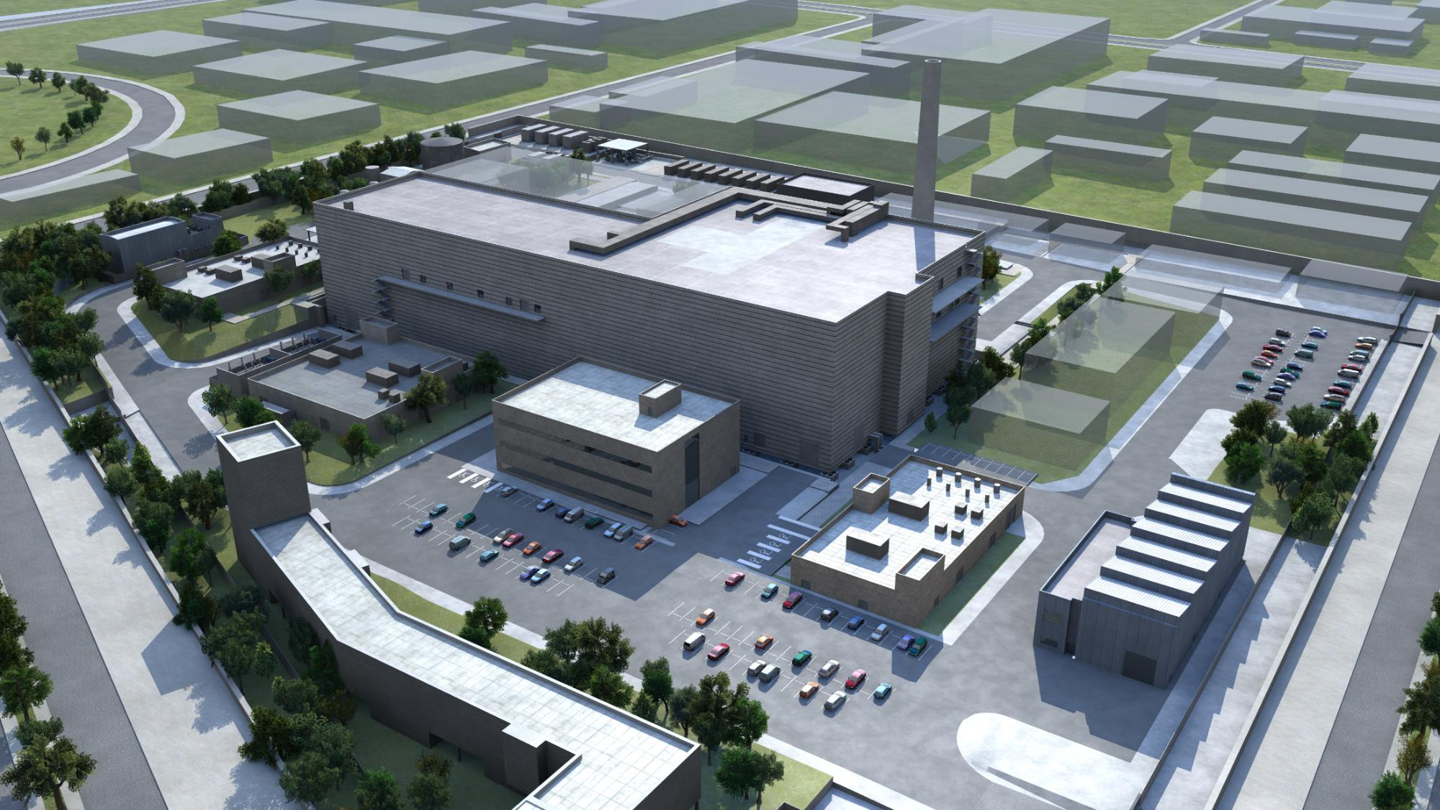
IFMIF-DONES Users Community Wojciech Królas 1/10/2024
This work has been carried out within the framework of the DONES-ConP1 Consortium, funded by the European Union via the Euratom Research and Training Programme – Euratom Work Programme 2023-2025 for nuclear research and training under Grant Agreement No 101145952 — DONES-ConP1. Views and opinions expressed are however those of the author(s) only and do not necessarily reflect those of the European Union or the European Commission. Neither the European Union nor the European Commission can be held responsible for them.

Slide 2
IFMIF-DONES Users Community
The establishment of the IFMIF-DONES Users Community …
… started as a bottom-up initiative of the potential future users of DONES discussing experimental opportunities and interacting with the designers of the facility
The community sees its main role to establish a link of communication between the DONES engineering activities and the future users
The main lines of work of the DONES community are:
- to discuss and prepare the DONES Irradiations Programme,
- to agree on the Post-Irradiation Examination Programme,
- to identify and develop most attractive lines of research activities outside of the materials irradiation programme to be performed at DONES,
- to prepare conceptual designs of experimental stations and study their feasibility and compatibility with the baseline design of DONES,
- to prepare a comprehensive DONES Experimental Programme combining fusion and non-fusion experiments.
In addition, the community will foster the presence of the DONES Users at relevant conferences, such as ICFRM, ISFNT, SOFT, FEC, IPAC, nuclear physics and nuclear medicine conferences in Europe and worldwide. Representatives of other science communities will be informed of DONES capabilities and invited to participate in the technical and scientific development of the complementary science program and related instrumentation.

Slide 3
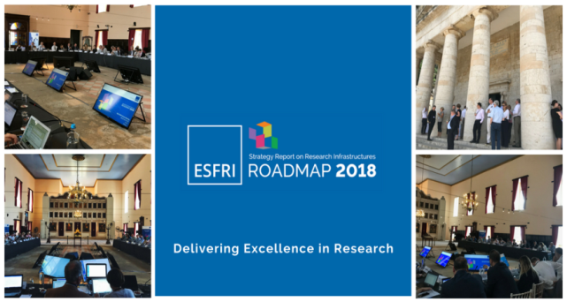
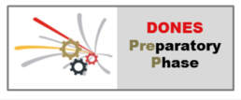
IFMIF-DONES – a multidisciplinary neutron facility
In 2018 DONES recognized by the ESFRI European Strategy Forum on Research Infrastructures, included in the roadmap
The key mission of the facility is the irradiation and qualification of materials for DEMO and fusion reactors but it has unique characteristics that must be available for other scientific purposes

Slide 4
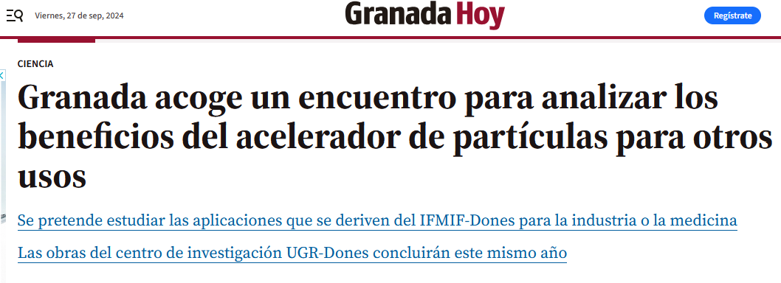
DONES Users meetings
2022:
Last year:
100 participants (70 in-person)
45 presentations
109 participants, 25 presentations
This meeting:
1-2 October 2024 Zagreb, Croatia 80+ participants
38 presentations

Slide 5
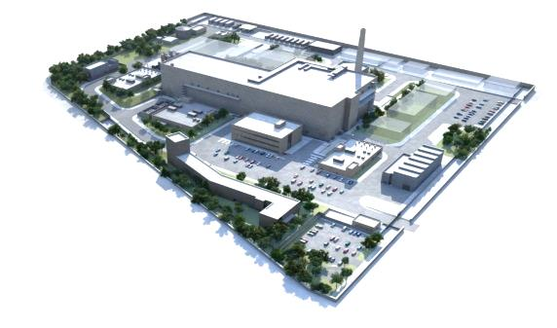
DONES Users Committee
Frederik Arbeiter (KIT) – fusion materials and other irradiation modules Daniel Cano-Ott (CIEMAT) – nuclear physics Andreja Gajović (RBI) – management of users community Atsushi Kasugai (QST) – fusion materials Antonio M. Lallena (University of Granada) – biological and industrial applications Alain Letourneau (CEA Saclay) – neutron physics Marek Lewitowicz (GANIL) – nuclear physics and large scale facilities Adam Maj (IFJ PAN) – nuclear physics Fernando Martínez Ávila (La Alhambra) – cultural heritage Gerald Pintsuk (FZ Jülich) – fusion materials Javier Praena (University of Granada) – radioisotopes and medical applications David Rapisarda (CIEMAT) – tritium breeding technologies Michael Rieth (KIT) – fusion materials
Wojciech Królas (IFJ PAN) – secretary of the DONES UC
Contact:
users@ifmif-dones.es

Slide 6
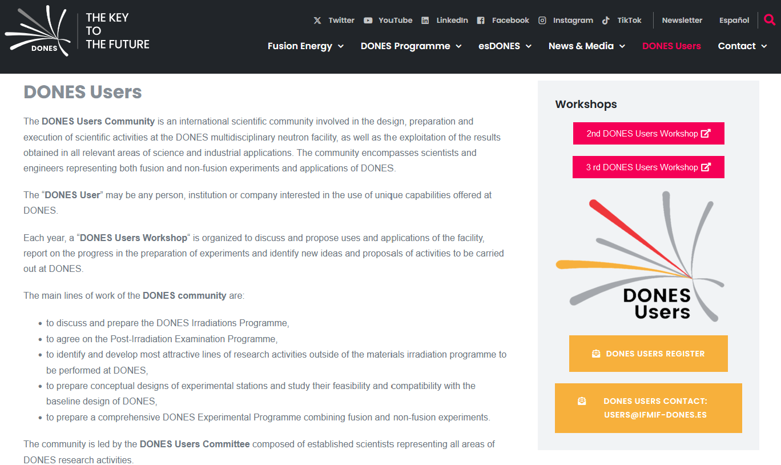
DONES Users web site
https://ifmif-dones.es/dones-users-2
Registration form for new users!
Contact:
users@ifmif-dones.es

