Slide 1
Overview on material qualification needs for future fusion facilities
Third DONES Users Workshop, 1-2. October 2024
G. Pintsuk
G. Aiello, S. Dudarev, J. Henry, M. Rieth, D. Terentyev, R. Vila, M. Wirtz

Slide 2
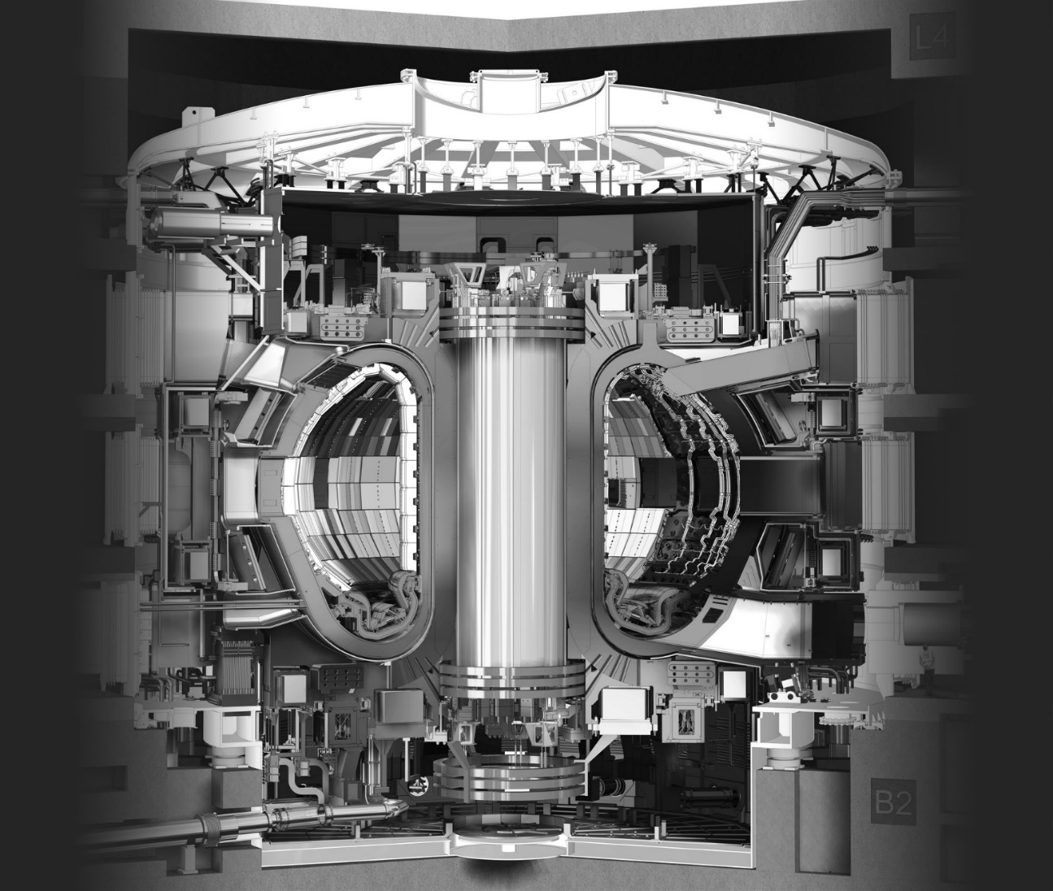
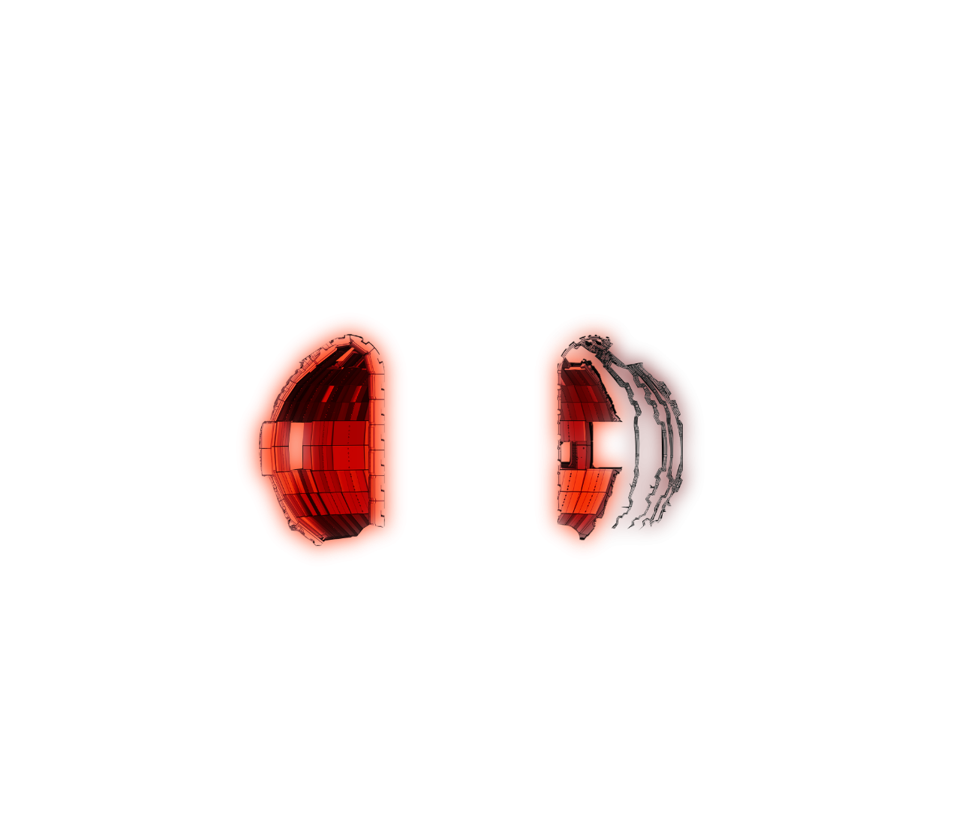

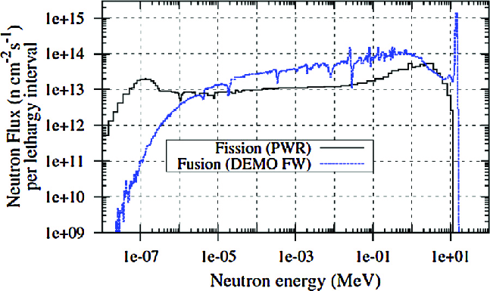
Introduction
Boundary conditions
Fusion neutron spectrum with high neutron flux of fast (14 MeV neutrons) compared to fission material test reactors (MTRs)
Neutron dose gradient from First Wall to vacuum vessel including attenuation of neutron energy (transition from fusion → fission spectrum)
Divertor loaded only by small angular fraction and partial shielding of fusion neutrons by vertical targets

Slide 3
Introduction
Structural Materials
EUROFER97 (EU-DEMO baseline) and RAFM-steels in general (e.g. F82H, ARAA, CLAM, ...) for Breeding Blanket (incl. First Wall) and Divertor Cassette Body
Advanced materials, e.g. ODS-steels for the First Wall (highest neutron loads)
High heat flux materials
Tungsten (baseline) and tungsten based materials (plasma facing at First Wall, divertor)
CuCrZr (baseline) and Cu-based materials (heat sink materials for divertor, limiter)
Functional materials
Optical materials (windows), dielectric materials (diagnostics, insulators): Silica, alumina, spinels, ...

Slide 4
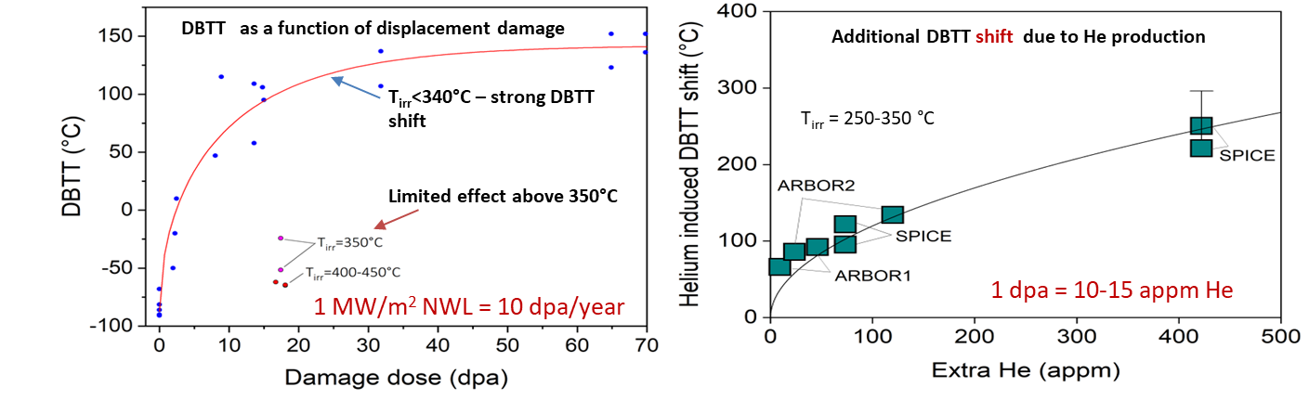
Structural material: First Wall & Breeding Blanket
RAFM & ODS steels
First Wall and structure of the Breeding Blanket
High fast (14 MeV) neutron fluence (20-50 dpa in DEMO, >50 dpa for FPP)
Fusion neutrons cause increased He transmutation (~10 appm/dpa) and He-embrittlement
System integration requires material “weldability” (incl. restoration of properties by post welding treatments)
Operational temperature range (< 350°C: embrittlement by displacement damage → choice of coolant; > 550°C: softening for baseline material(s) → advanced materials like ODS)
E. Gaganidze et al., JNM 2011
First Wall:
schematic view
Irradiation needs
Bulk material and joint properties: high dose, in particular He-effects
Tungsten/EUROFER-joints: “no serious problem” statement requires confirmation at high dose – medium / high priority → DONES but also VNS
Yu. Igitkhanov et al., JNM 2013

Slide 5
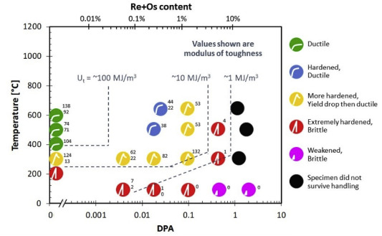
High heat flux material: plasma facing materials for FW and Divertor
Tungsten (based materials)
Coating / plating (2-3 mm) on the First Wall and for monoblock tiles in the divertor (5-8 mm above the cooling tube)
High fast (14 MeV) neutron fluence at the First Wall (dpa in steel divided by ~3) and reduced fast neutron fluence in the divertor due to geometry and location (~1 dpa/fpy at the strike point)
Moderated neutrons in the vicinity of the coolant will potentially lead to increased Re-transmutation (embrittlement and decrease of thermal conductivity, cf. fission irradiation studies)
Surface damage leading to increased erosion potentially an issue for plasma operation
Macro-crack formation and “barreling” due to high temperature material fatigue
Fission spectrum
Y. Katoh et al., JNM 2019
Irradiation needs
W Armor
Bulk material mechanical and thermo-physical properties: high dose effects (incl. H/He) with low Re-transmutation at medium to high temperature – medium priority
Coolant
Divertor monoblock: schematic view
CuCrZr + Cu

Slide 6
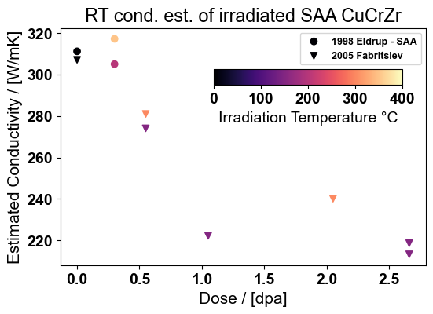
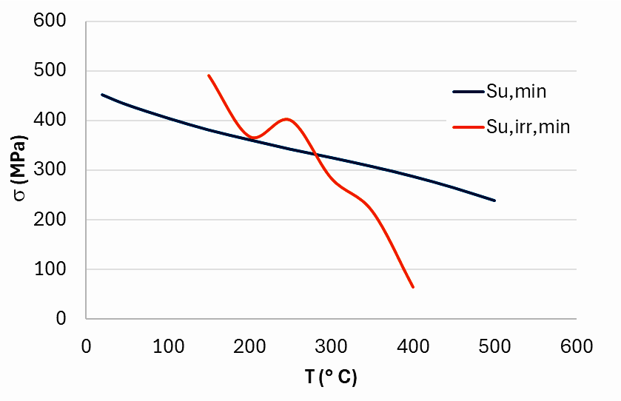
High flux materials: heat sink materials for Divertor
CuCrZr (Cu-based materials)
Preliminary study based on resistivity measurements for fission neutrons
Cooling tube in divertor components
Significant fast (14 MeV) neutron fluence (~3 times the dpa in tungsten): baffle region up to 7 dpa/fpy
He-transmutation rate similar to steel (~8 appm/dpa)
Change in thermo-physical properties
Limited temperature window due to irradiation (< 200°C, loss of uniform elongation, > 300-350°C softening.
Material corrosion (cooling water)
Design data from SDC-IC
W Armor
Coolant
Irradiation needs
Divertor monoblock: schematic view
CuCrZr + Cu
Influence of fast neutron induced H/He transmutation in CuCrZr on basic properties – medium / high priority
Hardening / swelling of the pure Cu interlayer by neutron damage and H/He transmutation – medium / high priority

Slide 7
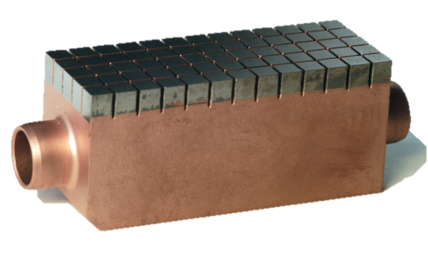
High heat flux materials: joints for divertor
PARIDE campaign
Tungsten / Cu / CuCrZr joints
Assessment normally done by irradiation of divertor mock-ups
Sufficient cyclic high heat flux (10 MW/m² steady state; up to 20 (25) MW/m² during ramp-up in DEMO) stability in the non-irradiated condition
Mock-up irradiation with relevant geometries requires comparably large space - in MTRs only in the low flux region
High heat flux performance evaluation after irradiation in correlation with bulk material properties and ideally interface properties (benchmarking for design by analysis)
Testing of interface properties requires complicated test specimen geometries when taking samples from mock-ups
0 dpa: 1000 cycles @ 18 MWm⁻²
0.6 dpa: 1000 cycles @ 10 MWm⁻²
(increasing of T_{surf})
0 dpa: 1000 cycles @ 20 MWm⁻²
0.6 dpa: 1000 cycles @ 18 MWm⁻²
(no degradation)
Irradiation needs
Determination of interface properties in IFMIF-DONES essential for design by analysis – medium / high priority
Irradiation of mock-ups for benchmarking and validation of modelling – enabling heat exhaust technologies for FPP

Slide 8
Functional materials
Optical and dielectric materials
Windows, insulators, materials for diagnostics
Normally rather far from the plasma, e.g. windows (line of sight or via mirrors?) – low to medium dose
PIE data on 14 MeV for functional materials limited to low dose (e.g. Evans, 1979: up to 2E-4 dpa)
High dose only in Material Test Reactors - for most applications this is a suitable neutron spectrum
Irradiation needs
Determination of the effect of He and H transmutation on material properties in combination with high dose
Testing of mock-up sensors in conditions very close to operational ones: Difficult to perform in fission reactors → this is a highly interesting but medium priority risk mitigation topic → anticipate DONES module design
Answer the question if insulators can be used closer to the First Wall and if there are differences to irradiation in fission reactors → Very interesting but low priority risk mitigation topic

Slide 9
Material data requirements
Quality criteria for nuclear licensing
Data from irradiation campaigns – limitations in irradiation volume
Material data must comply with existing standards
Small specimen testing techniques (SSTT) – standardization required to exploit irradiated material data: tensile, fracture toughness, fatigue, creep, ...
Additional data and testing for increasing Material/System Technological Readiness Level (TRL):
Preparing VNS
Data from materials / components exposed to dose and temperature gradients
Volumetric Neutron Source (VNS)
    Fluence: 20–50 dpa
    Tritium production: BB + SB
    No electricity production, but BB testing: low and high T coolants
    Only one facility, small but higher fluence: waste concerns TBD

Slide 10











WPMAT / WPPRD-MAT Members
Ecole Royale Militaire
Laboratory for Plasma Physics
Institute of Plasma Physics
Academy of Sciences of the
Czech Republic
Technical University
of Denmark
Technical Research Centre
of Finland
AUSTRIA
BELGIUM
Ruđer Bošković Institute
University of Tartu
FINLAND
CROATIA
CZECH REPUBLIC
DENMARK
ESTONIA
The French Alternative
Energies and Atomic Energy
Commission
National Centre for Scientific
Research “Demokritos”
Italian National Agency for
New Technologies, Energy
and Sustainable Economic
Development
Centre for Energy Research
FRANCE
GERMANY
GERMANY
GERMANY
GREECE
HUNGARY
ITALY
Institute of Plasma Physics
And Laser Microfusion
Institute for Atom Physics
Jožef Stefan Institute
LATVIA
POLAND
PORTUGAL
ROMANIA
SLOVENIA
Centre for Energy, Environment
And Technology Research
Swedish Research Council
Kharkov Institute of Physics
and Technology
SPAIN
SWEDEN
SWITZERLAND
UKRAINE
UNITED KINGDOM

