Slide 1
EUROfusion activities towards the development and standardisation of
Small Specimen Test Techniques
Third DONES Users workshop
G. Aiello, R. Gallego, G. Pintsuk, D. Terentyev
EUROfusion

Slide 2
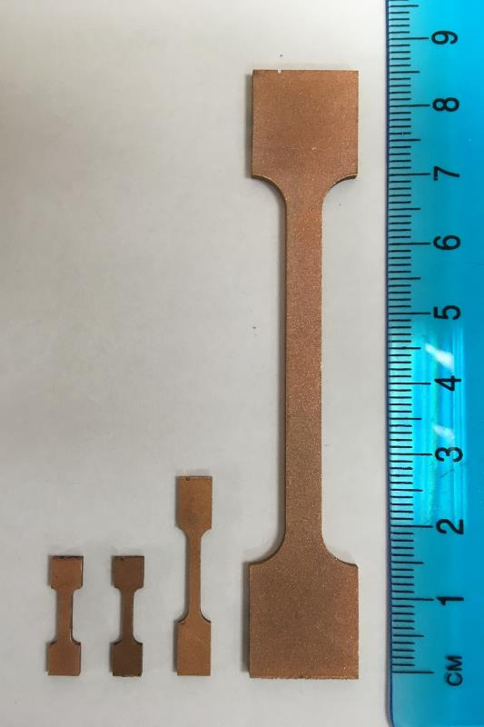
Summary
Scope and goals of EUROfusion activities
SSTT for Low Cycle Fatigue
SSTT for Fracture Toughness
SSTT for Fatigue Crack Growth
SSTT for Tensile properties
  Results of Pilot Run and proposal for ILS
Conclusions

Slide 3
Motivation for SSTT development
Qualification of structural materials after neutron irradiation
  Steel (Eurofer97)
  CuCrZr ITER grade
  Tungsten
Enable irradiation in Material Test Reactor and Post Irradiation Examination
  Typical useful irradiation channel diameter is ~ 10 mm
  For some test types high number of samples is needed (i.e. LCF)
Enable usage of multi-sample test techniques (MSTT)
  Re-use fracture toughness/Charpy samples for tensile/LCF/creep

Slide 4
SSTT for Fusion Materials in Europe
EUROfusion – main project WPMAT 2021-2027 (6 EU labs)
  Properties
    Tensile, Fracture Toughness (master curve and ductile crack growth)
    Low Cycle Fatigue, Fatigue Crack Growth
    Creep
  Participants
    Germany, KIT / Belgium, SCK CEN / UK, UKAEA
    Hungary, EK / Spain, CIEMAT and UGR / Poland, WTU
IAEA CRP on SSTT (tensile and fracture toughness)
Other EU projects containing SSTT elements (fracture toughness, fatigue)

Slide 5
WPMAT Project Objectives
Review current small tensile specimen testing methods and samples geometries used by previous programs
Identify and propose SSTT methods for tensile, fatigue, creep and fracture, and respective sample geometry
Execute experimental programs to validate (minimum) allowable size (at given shape)
Propose a set of guidelines for SSTT methods with the validation of the minimum allowable size
Prepare the guidelines (and recommendations) for ISO/ASTM review/approval

Slide 6
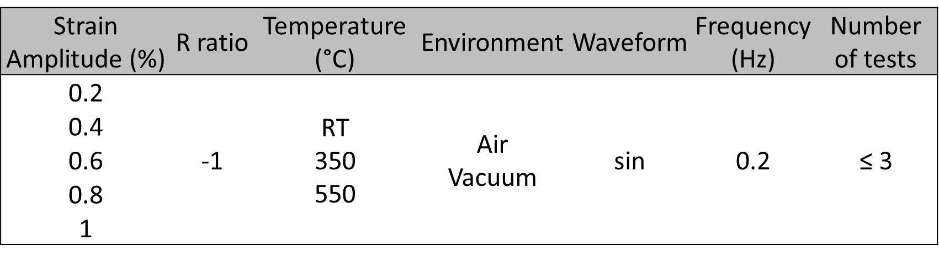
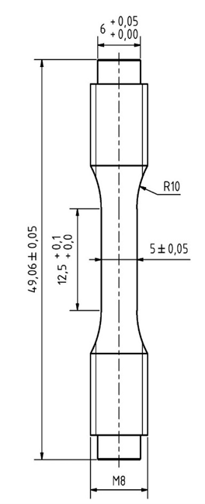
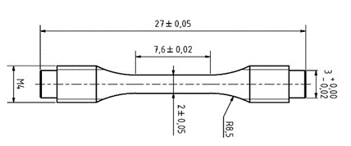
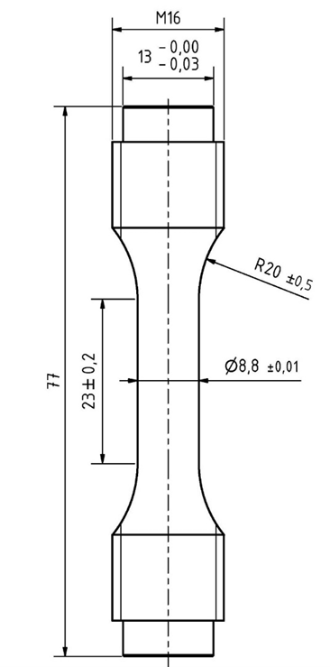
Low Cycle Fatigue
Materials: EUROFER97-3 & F82H-BA07
Test performance according to: EN ISO 12106, ASTM E606M
Tests on:
lab-specific sub-sized specimens (D = 2 mm & 5 mm)
standard sized specimens (D = 8.8 mm)
with:
L/D ≤ 3 to avoid buckling
axially (at least radially) polished surface
Strain controlled LCF tests in air at RT & 550°C:
→ determination of Woehler curves
3 tests under equal test conditions
Total number of tests: 66 for each material
J. Aktaa et al., EFDA_D_2NM9AT, 2020
6

Slide 7
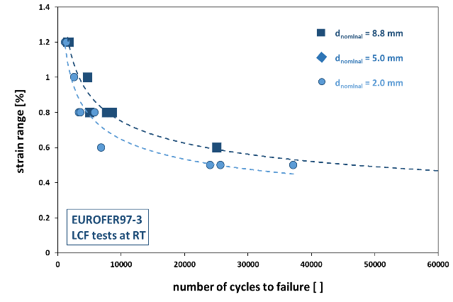
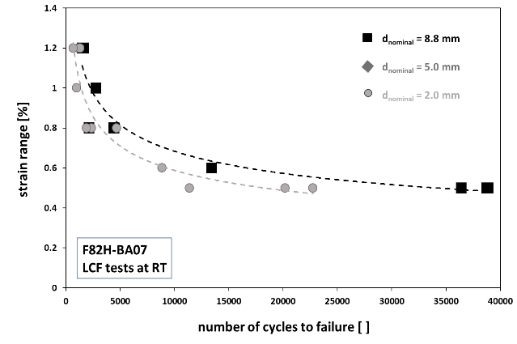
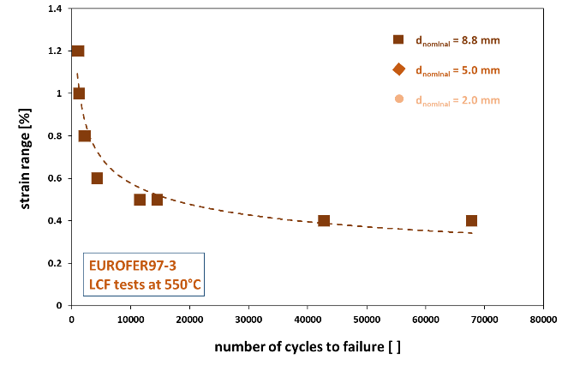
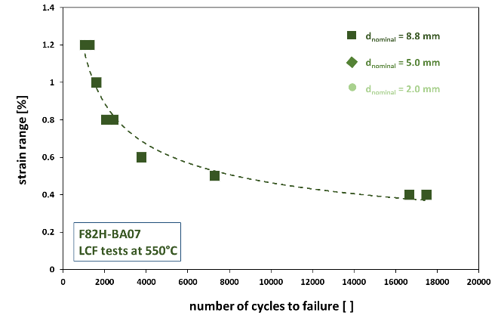
Intermediate LCF results
RT
550C

Slide 8
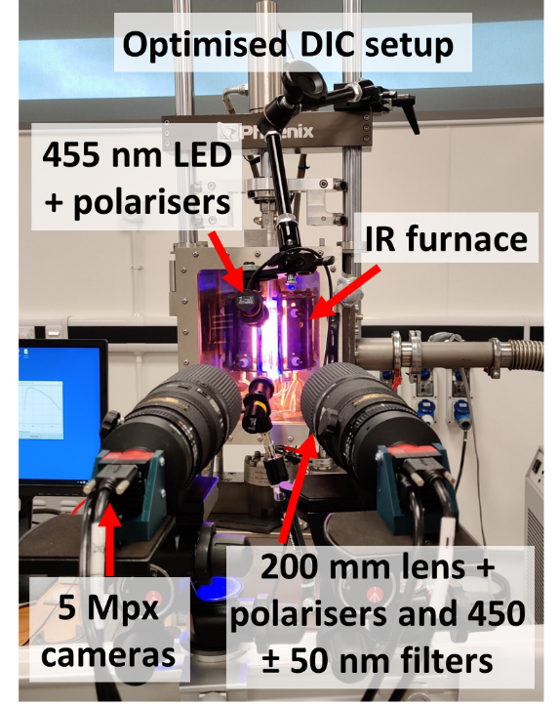
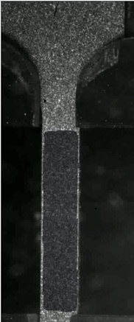

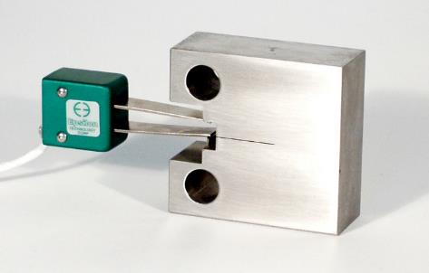
Development of DIC monitoring and control
DIC setup
316L at -150 °C
Important for high-T tests
Tensile
Fracture toughness
LCF
FCG
Combination of matched wavelength LEDs and filters has minimised the glare from the IR furnace
8

Slide 9


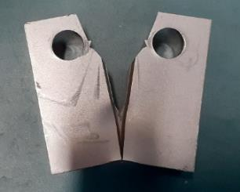



Ductile Fracture Toughness
IAEA CRP Participants
  E. Gaganidze (KIT) →Test matrix, see below
  M. Ohata (Osaka University) →Test matrix, slightly different (see report)
  Y. Shen (SJTU) →Test matrix, same as KIT
Materials
  Eurofer97 batch-3
  F82H-BA12
Material | Specimen | Number | Orient.
Participant: E. Gaganidze (KIT)
Eurofer97 batch-3 & F82H-BA12 | Smooth round tensile ø2 | 6 | L
 | Notched round tens. ø1.5-R0.5 | 3 | L
 | Notched round tens. ø1.5-R0.2 | 3 | L
 | Notched flat tens. 1.5x1.0-R0.5 | 3 | L
 | Notched flat tens. 1.5x1.0-R0.2 | 3 | L
 | KLST, a/W=0.25, 20%SG | 9 | LT
 | 0.5TCT, 20%SG | 3 | LT

Slide 10
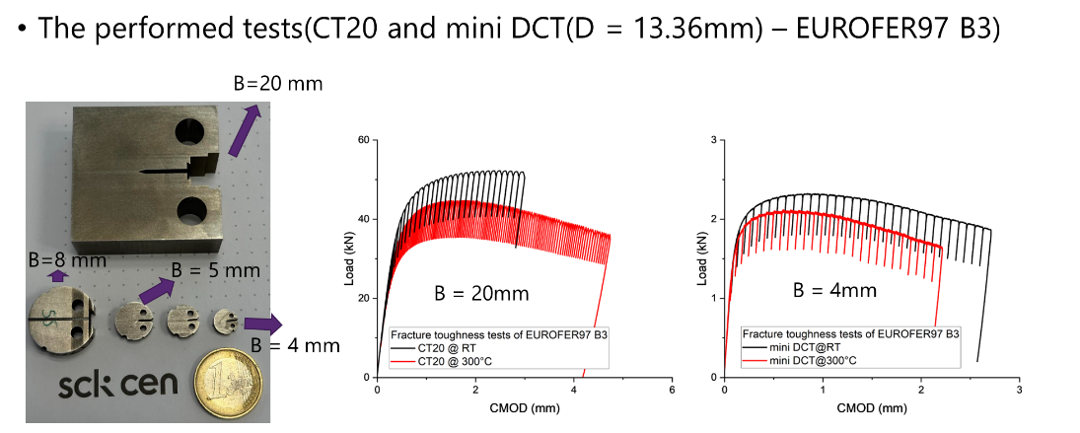
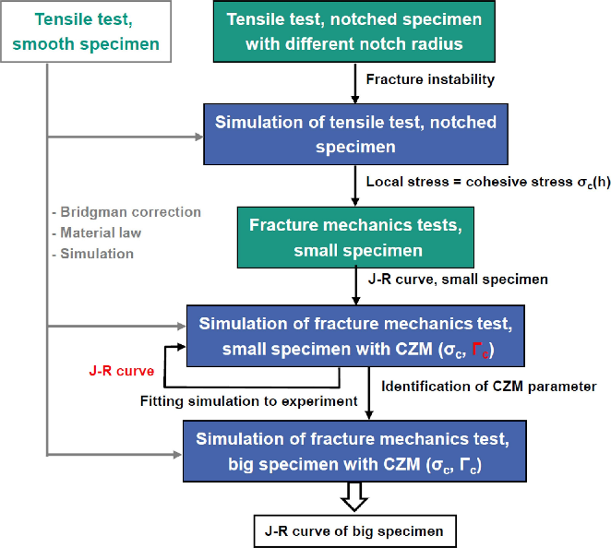
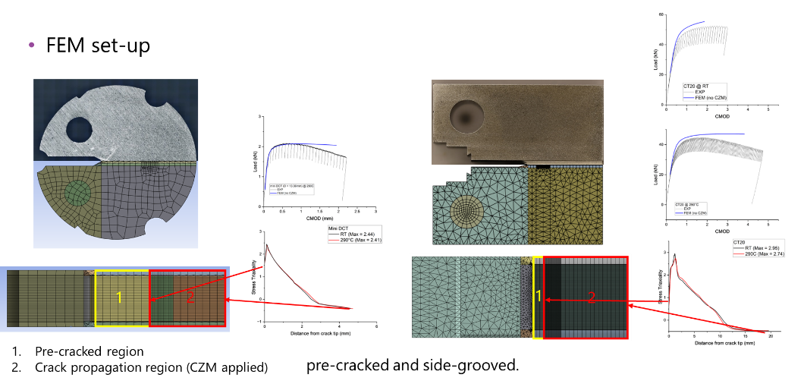
Fracture Toughness: approach & results
Mahler, M., Fessi, S., & Aktaa, J. (2021). Simplified approach for ductile fracture mechanics SSTT and its application to Eurofer97. Nuclear Materials and Energy, 26, 100799.

Slide 11
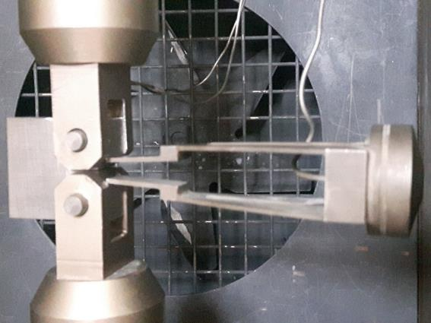
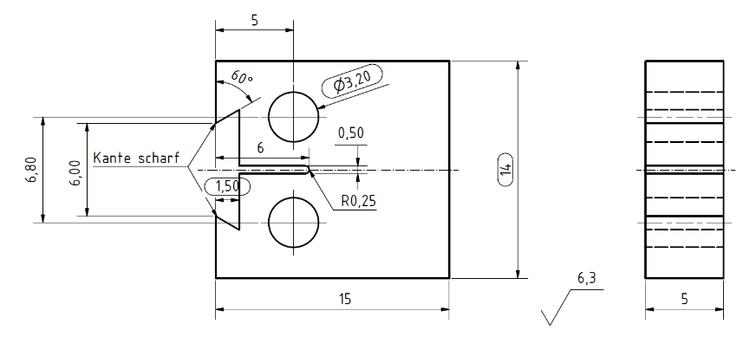
Fatigue Crack Growth (FCG)
Initial tests and their evaluation revealed:
Non-linear hysteresis behavior in the COD and consequently compliance measurements at high frequencies due to the long arms and mass of the clip gauge
need to reduce frequency to 5 Hz
Excessive plastic deformation around the pins holes of the small CT specimens
reinforcement by slight modification of the geometry
Technical drawing of the modified small CT specimen for FCG SSTT, dimensions changed are framed.
11

Slide 12
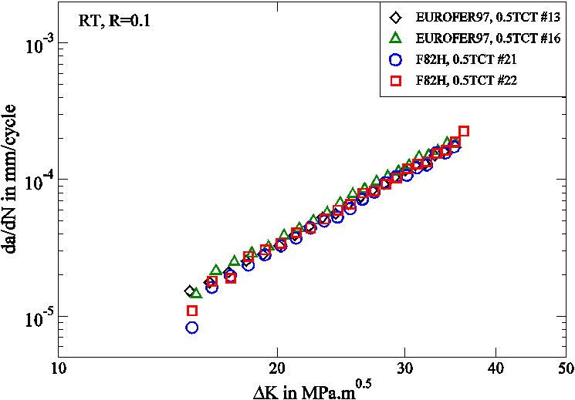
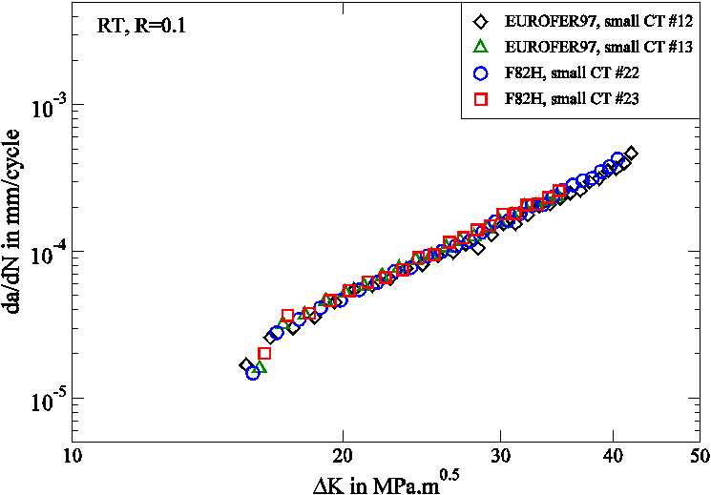
FCG results
Similar FCG behavior observed for EUROFER97 and F82H at both specimen sizes
12

Slide 13
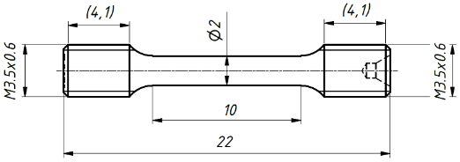
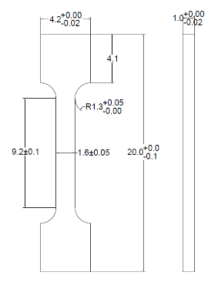
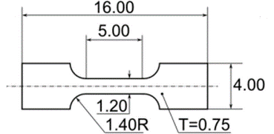
Tensile properties: Inter Laboratory Study – Pilot Run
Interlaboratory study – ASTM E691 − 19 An American National Standard Practice for Conducting an Interlaboratory Study to Determine the Precision of a Test Method
  Minimum laboratories: 6
  Minimum materials representing different test levels: 3
  Minimum nº of tests per laboratory: 3
  “Before investing laboratory time in the full scale ILS, it is usually wise to conduct a pilot run with only one, or perhaps two, material(s)”
  Main statistics
    h = the between-laboratory consistency statistic
    k = the within-laboratory consistency statistic
    r= Repeatability ranges
    R= Reproducibility ranges
ROUND
EUFLAT
SS-J3
PILOT RUN: 6 laboratories, 3 geometries, 1 material (E97)
PILOT RUN TASK GROUP
Role | Name | Laboratory | Acronym
Coordinator | Rafael Gallego | University of Granada | UGR
Member | Marta Serrano | Center of Energy, Environmental and Technological Research | CIEMAT
Member | David Cinger | Center of Energy Research | EK-CER
Member | Ermile Gagandize | Karlsruhe Institute of Technology | KIT
Member | Dmitry Terentyev, Alexander Zinovev | Belgian Nuclear Research Centre | SCK CEN
Member | John Echols | United Kingdon Atomic Energy Authority | UKAEA
Member | Rafał Molak | Warsaw University of Technology | WUT
Statistician | Juan M. Melchor | Dept. Statistics and Operational Research | UGR

Slide 14
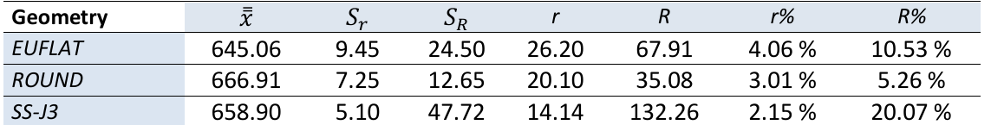
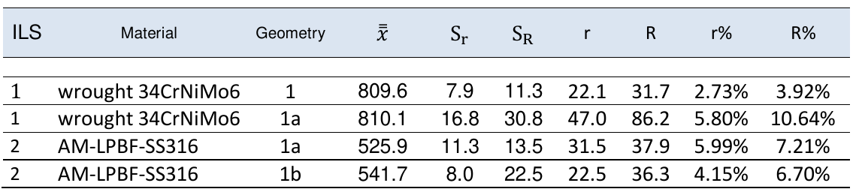
Pilot Run: results at RT
PRECISION STATEMENT: variability that can be expected between test results when the method is used
ULTIMATE TENSILE STRENGTH: results from PR-2023
ULTIMATE TENSILE STRENGTH: Statement included in ASTM E8/E8M_24
14

Slide 15
Conclusions of Pilot Run at RT
In a view of the statistics %r and %R (expected variability of the results within 95% under repeatability and reproducibility conditions), none of the specimen geometries is better than the others in general, nor in particular for the YS and UTS quantities.
The statistics %R is large (from 25 to 70%) for all specimens for Uniform Elongation (ε_{u}) and Elongation after Fracture (ε_{t}).
The repeatability (%r) and reproducibility (%R) limits obtained in this PR and those included in the ASTM E8/E8M_24 are similar for the Ultimate Tensile Strength (UTS), but are larger for the Yield Strength (YS).
Continuation of EUROfusion Pilot Run in 2024-2025:
Tensile test on EUROFER97 at 300°C and 500°C

Slide 16
Proposal for an ILS on tensile properties
2025-ILS proposed test matrix
CuCrZr
CuCrZr
CuCrZr

Slide 17
Conclusions
SSTT geometries are defined for Tensile, LCF, Fracture Toughness, FCG
  Experimental testing for validation of selected geometries are on-going
  Tensile samples are taken as 1st step to update ASTM E8 standard
  Fracture toughness is the next step
Digital Image Correlation and Finite Element Modelling practice & tools still to be improved
  Especially important for LCF and Fracture Toughness

Slide 18
Next Steps
Validation Irradiation programme still to be developed
  Validation programme for tensile samples to compare precision statement in hot cell environment
  Fracture toughness (for EUROFER97 and CuCrZr) ductile crack growth
  Low cycle fatigue
Best practice for handling of SSTT samples in Hot Cell environment
  Design of grippers and sample mounting systems for remote handling
  Reduced round robin to compare precision statement in hot cell environment

Slide 20
COMPLEMENTARY SLIDES

Slide 21
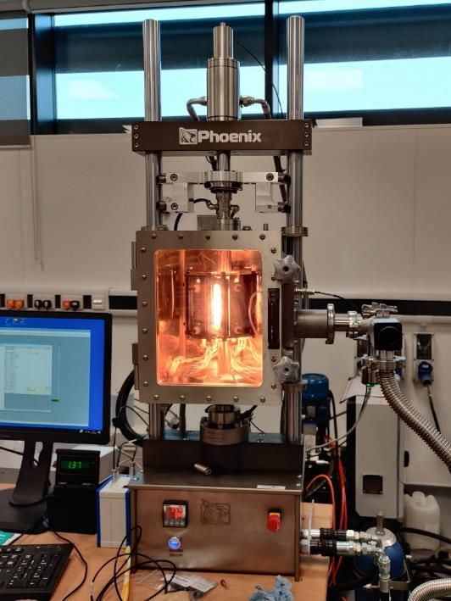
Low Cycle Fatigue
7
Floating crosshead
Upgraded vacuum system (10⁻⁵ mbar)
Extended columns
High temperature extensometer feed through
Stiffer pull bars
Revised gripping solution for increased stability
Uprated load capacity (20 kN)
3
1
5
6
4
2

Slide 22
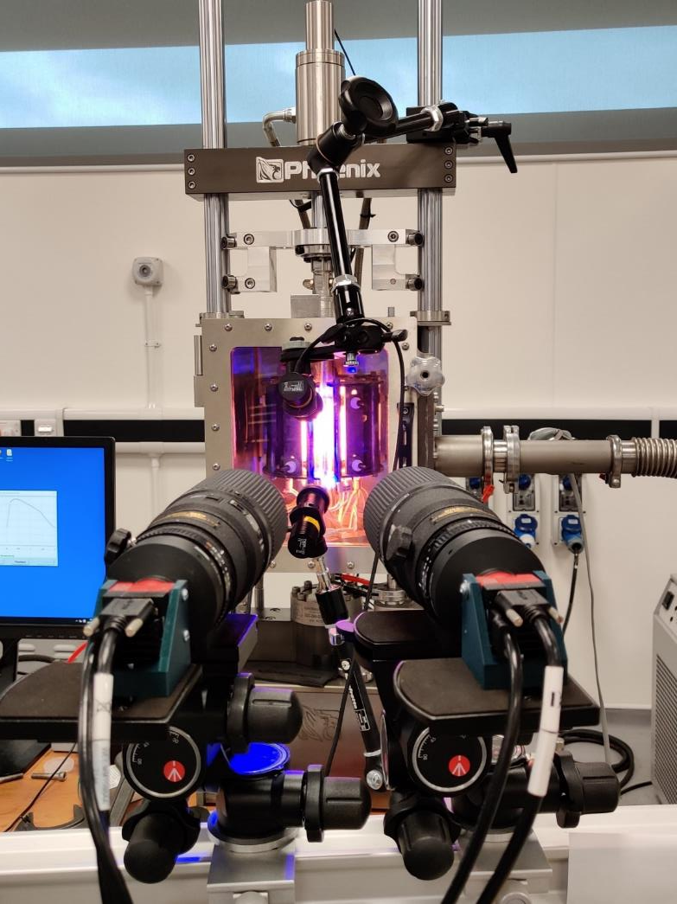
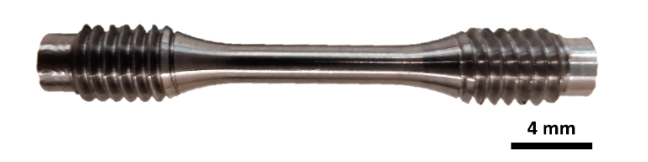
Low Cycle Fatigue
Optimised DIC setup
455 nm LED + polarisers
Combination of matched wavelength LEDs and filters has minimised the glare from the IR furnace → oscillations in furnace IR control do not influence DIC image accusation.
Minimise specular reflection from round specimens using polarisers.
This setup has been successfully deployed on mini LCF specimen at 350 °C in vacuum.
IR furnace
200 mm lens + polarisers and 450 ± 50 nm filters
5 Mpx cameras

Slide 23

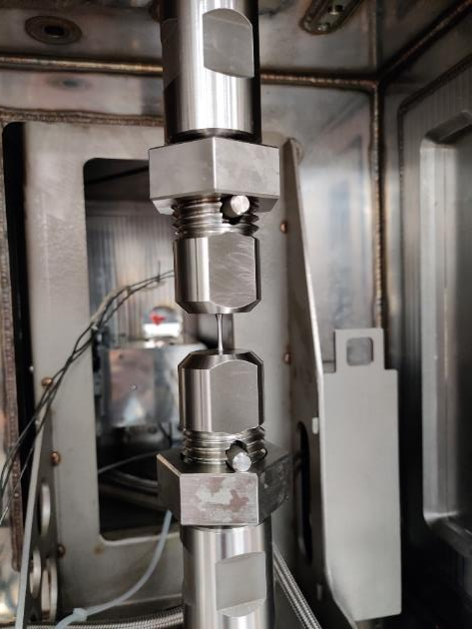
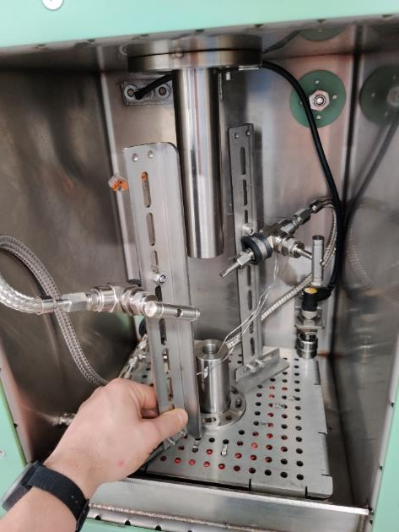
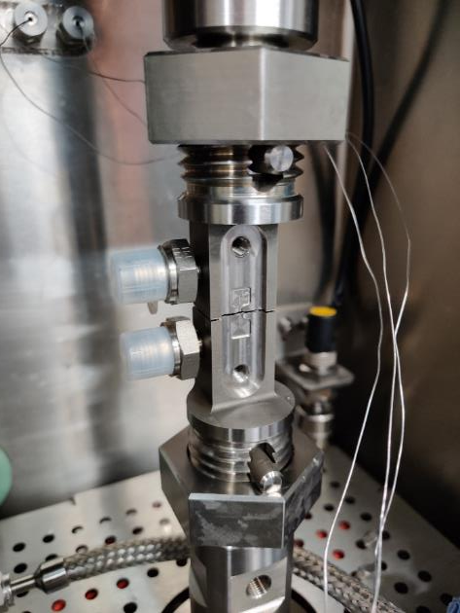
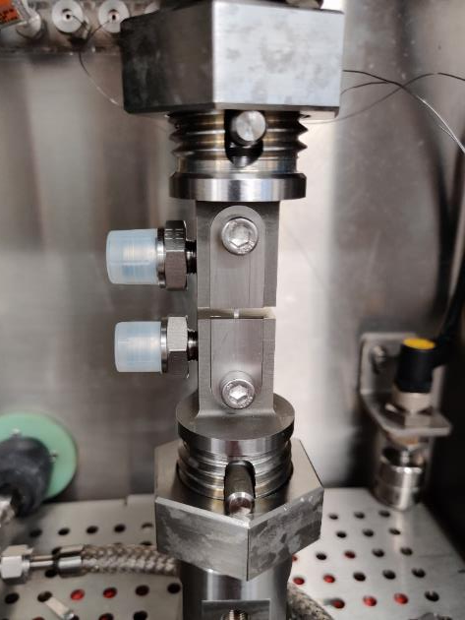
Low Cycle Fatigue
Load frame: 50 kN servo hydraulic (5 and 50 kN load cells)
Colling options:
Conduction through grips
Conduction via cooling collars
direct liquid nitrogen spray
Combined cooling
Direct LN2 spray jets
Direct cooled SSJ3 grips
Cryo mini LCF
LN2 Spray Nozzles

Slide 24
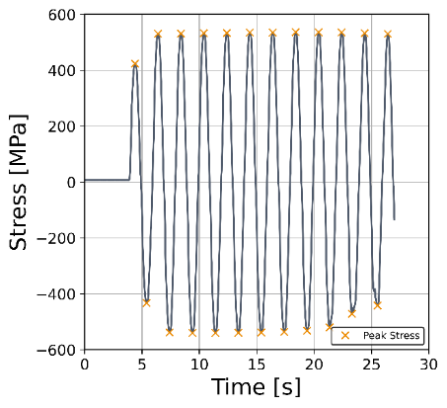
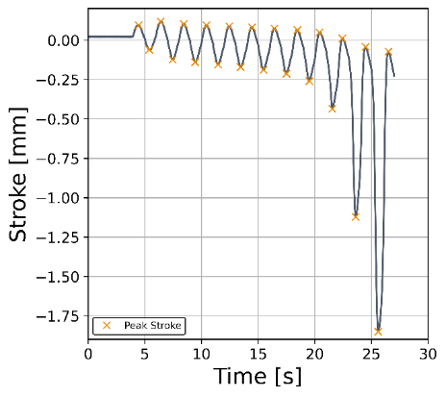
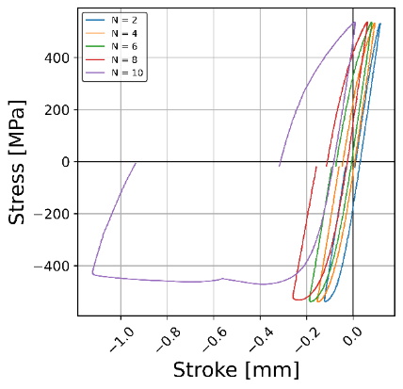
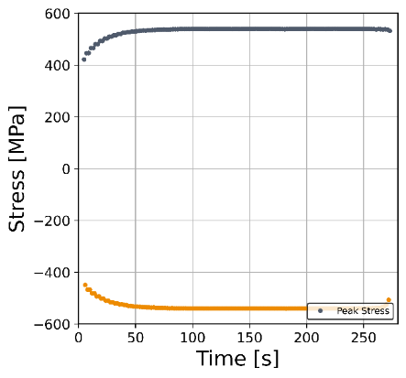
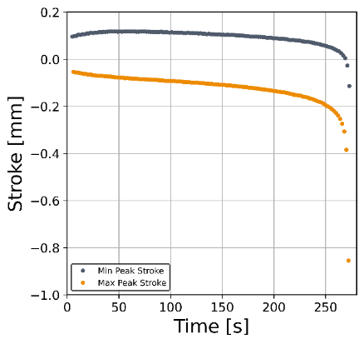
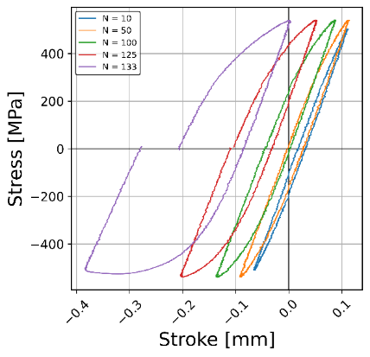
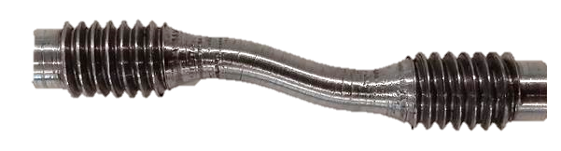
Low Cycle Fatigue
Commissioning experiment conducted using a Gr.91 IFMIF-DONES cylindrical fatigue specimen.
Both tests exhibit unacceptable misalignment issues.
Further rig development required.
Test Parameters
Material | Gr.91
Stress amplitude | 540 MPa
R ratio | -1
Frequency | 0.5 Hz
Waveform | sinusoidal
Test B: Improved alignment first iteration
4 mm

Slide 25
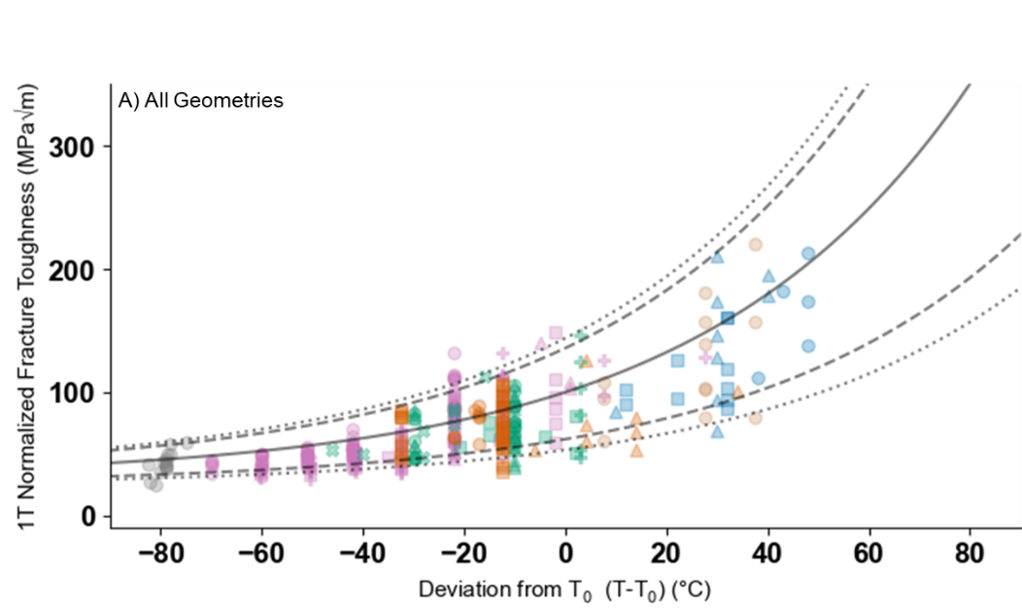
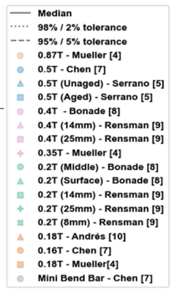
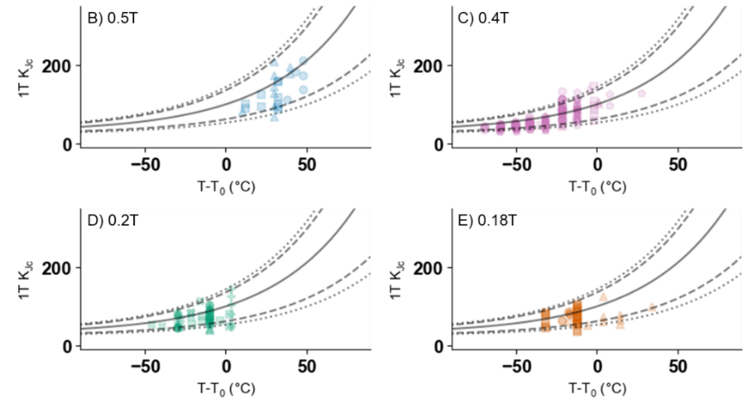
Fracture toughness
EUROFER 97 Data and analysis of miniature geometries
Majority of individual tests for all sizes fall below the median curve
Work published in past proposed altering slope of Master Curve [1]
[1] Andres, David, et al. "Determination of Eurofer97 Fracture Toughness by Testing Small C (T) Specimens." Pressure Vessels and Piping Conference. Vol. 85314. American Society of Mechanical Engineers, 2021.

Slide 26
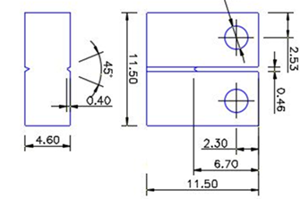
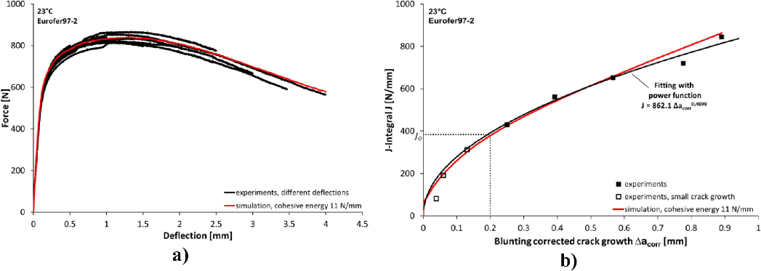

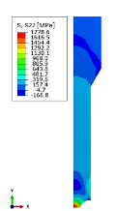
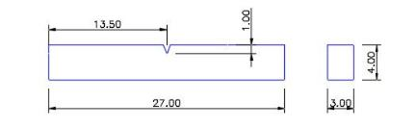
Fracture toughness
MAX B=b₀=4.6 mm | E399 | E1820
 | ISO 12135 | ISO 12135
T | K_{IC max} MPa√m | J_{max} (kJ/m²)
22 | 23 | 279
300 | 20 | 234
500 | 17 | 187
550 | 15 | 165
Valid values could be obtained by testing 0.5TCT specimens B=12.5 mm
Approach
Mahler, M., Fessi, S., & Aktaa, J. (2021). Simplified approach for ductile fracture mechanics SSTT and its application to Eurofer97. Nuclear Materials and Energy, 26, 100799.
+

Slide 27
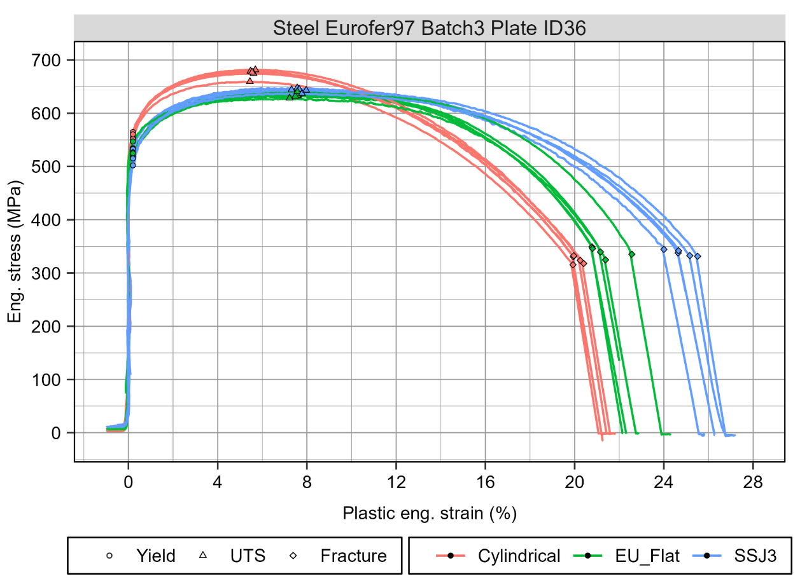
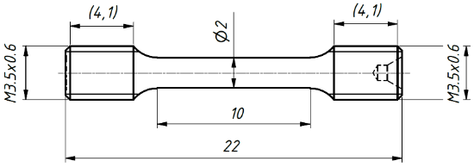

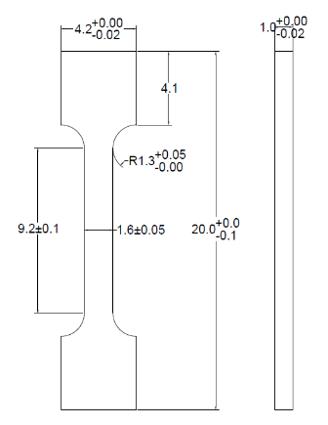
Tensile

Slide 28
Tensile
IAEA CRP SSTT
PILOT RUN
MAX standard size
Yield strength RP02 | Average | 2SD
Round Standard | 518,23 | 25,20
Flat Standard | 521,37 | 28,72
SSJ3_MTS | 511,07 | 38,29
SSJ3_PILOT | 507,71 | 20,74
EU_FLAT_PILOT | 483,75 | 30,11
M3.5_PILOT (round SSTT) | 548,06 | 37,28
Min standard size

Slide 29
Tensile
MAX standard size
Elongation after fracture % | Average | 2SD
Round Standard | 29,66 | 0,80
Flat Standard | 28,76 | 5,99
SSJ3_MTS | 27,92 | 7,12
SSJ3_PILOT | 24,40 | 1,10
EU_FLAT_PILOT | 26,80 | 2,61
M3.5_PILOT | 33,00 | 3,65
Min standard size

Slide 30
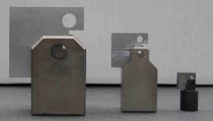







Approach for regulatory body
Challenges for a new standard
Effect of specimen size
Testing procedure
Data analysis
  Tensile
  Impact
  Fracture toughness
    DBTT / Ductile
  Creep
  LCF
  FCG
  Specimen preparation
  Dimensional control
  Testing parameters
  Monitoring
  ..
  FEM analysis
  Uncertainty analysis
  Precision and bias
  Interlaboratory exercises
Serrano
Michael Mahler
Lucon
WangziZhang
Lucon
Wawrzyniak

Slide 31

Approach for regulatory body: EN standard
~ 5 years
02-Mar-2016
14-Apr-2021
CWA 15627:2007 - Small Punch Test Method for Metallic Materials
EN 10371:2021 - Metallic materials - Small punch test method

Slide 32

Approach for regulatory body: ASTM
~ 6 years
Standardization Schedule (small punch)
SMALL PUNCH standards
6th International Symposium Small Specimen Test Techniques (ASTM), Houston
Decision on the start of R-R as a basis for the standard preparation
ILS1408 results submitted to the ASTM ILS section for approval
Start of ILS1408
Data collection and evaluation
Standard in the
ASTM Book of Standards
Ballotting of the draft standard
2014
2017
2018
2020
2019
2016
Draft standard in the ASTM format
1st draft of the WK47431 document (draft standard)
4th version of the document WK47431
Working item number changed to WK61832
Draft report of the ILS1408 to be approved by the ASTM and after that to be balloted in the sub-commíttee E10.02 (06/2018)
Standard available
~ 3 years

Slide 33
Approach for regulatory body

Slide 34
Approach for regulatory body
An interlaboratory study (ILS) is a multi lab study done for the specific purpose of producing data that will be used to develop a Precision & Bias statement and
Research Report in order to demonstrate the expected variability of a test method.
ASTM Work Item
  1. Scope
  2. Referenced Documents
  3. Terminology
    3.1 Definitions
  4. Significance and Use
  5. Apparatus
  6. Test Specimens
  7. Procedure
  8. Post-Test Examination
  9. Report
  10. Precision and Bias (MANDATORY)
  11. Keywords
Where numerical data have been
generated to establish the precision
and bias of a test method, a
research report is required

Slide 35

Approach for regulatory body
Interlaboratory study – ASTM E691 − 19 An American National Standard Standard Practice for Conducting an Interlaboratory Study to Determine the Precision of a Test Method
  Minimum laboratories: 6
  Minimum materials representing different test levels: 3
  Minimum nº of tests per laboratory: 3
  “Before investing laboratory time in the full scale ILS, it is usually wise to conduct a pilot run with only one, or perhaps two, material(s)”
  Main statistics
    h = the between-laboratory consistency statistic
    k = the within-laboratory consistency statistic
    r= Repeatability ranges
    R= Reproducibility ranges

Slide 36
Approach for regulatory body
Pilot Run
  The objective of the Pilot Run (PR) is to perform an Interlaboratory Study (ILS) on a smaller scale than that required for a full ILS, in terms of number of laboratories involved and number of materials to be tested, in order to assess whether the test procedure and protocols for test execution and data collection are clear, and can be executed by the laboratories involved, gaining experience on all this during its development.
Complete Interlaboratory Study

Slide 37
Approach for regulatory body
The results provided by the Laboratories hav been analysed according to ASTM-E691 to provide:
• Statistical Consistency Analysis of the results for all specimens geometries and mechanical magnitudes: determine whether the collected data are adequately consistent to form the basis for a test method precision statement, to investigate and act on any data considered to be inconsistent. The statistical consistency analysis provide information about the adequacy of the results both intra-laboratory and inter-laboratory.
• Precission Statement: variability that can be expected between test results when the method is used in one, or in two or more, reasonably competent laboratories.

Slide 38
Approach for regulatory body
• Repeatability conditions: conditions where independent test results are obtained with the same method on identical test items in the same laboratory by the same operator using the same equipment within short intervals of time.
(same lab-equipment-bench-operator-time)
• Reproducibility conditions: conditions where test results are obtained with the same method on identical test items in different laboratories with different operators using different equipment.
(different lab-equipment-bench-operator-time)

Slide 39
Approach for regulatory body
The consistency analysis flags the results that deviate significantly from the expected ones:
• h-consistency statistics: is a measure of between-laboratory consistency in reproducibility conditions*. It reflects the deviation of a single laboratory’s mean test results from the overall mean results obtained from all participating laboratories. h-critic value: limit above which the results of a given lab are flagged as inaccurate (0.5% significance level).
• k-consistency statistics: is a measure of within-laboratory consistency in repeatability conditions**. It compares the single lab’s repeatability (standard deviation of results) against the average repeatability of all participating laboratories. k-critic value: limit above which the results of a given lab are flagged as inaccurate (0.5% significance level).
* repeatability conditions: results with the same method, laboratory, operator, equipment within short intervals of time.
** reproducibility conditions: results with the same method but different laboratories, operators and equipment.

Slide 40
Approach for regulatory body
• reproducibility limit (R): Absolute difference between two test results obtained under reproducibility conditions** that may be expected to occur with a probability of 95 %.
• Reproducibility standard deviation (sR): the standard deviation of test results obtained under reproducibility conditions.**
• Repeatability limit (r): Absolute difference between two test results obtained under repeatability conditions* that may be expected to occur with a probability of 95 %.
• Repeatability standard deviation (sr): the standard deviation of test results obtained under repeatability conditions.*
* repeatability conditions: results with the same method, laboratory, operator, equipment within short intervals of time.
** reproducibility conditions: results with the same method but different laboratories, operators and equipment.

Slide 41
Approach for regulatory body
CONSISTENCY ANALYSIS YIELD STRENGTH for EUFLAT

Slide 42

Approach for regulatory body
CONSISTENCY ANALYSIS YIELD STRENGTH for EUFLAT

Slide 43

Approach for regulatory body
CONSISTENCY ANALYSIS UNIFORM ELONGATION for EUFLAT

Slide 44

Approach for regulatory body
CONSISTENCY ANALYSIS REDUCTION IN AREA for CYLINDRICAL specimen

