Slide 1

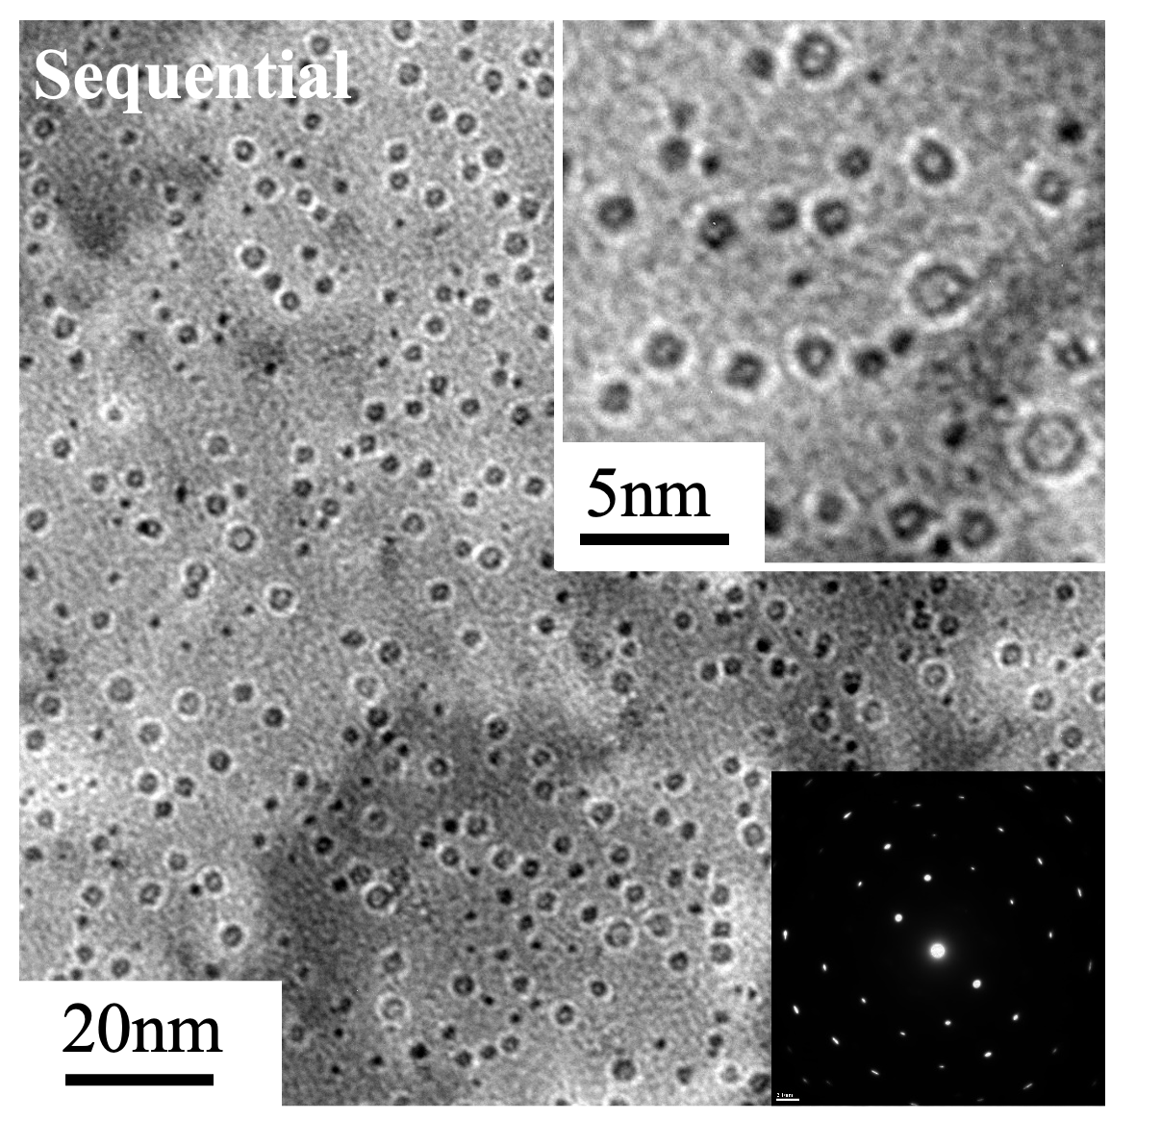
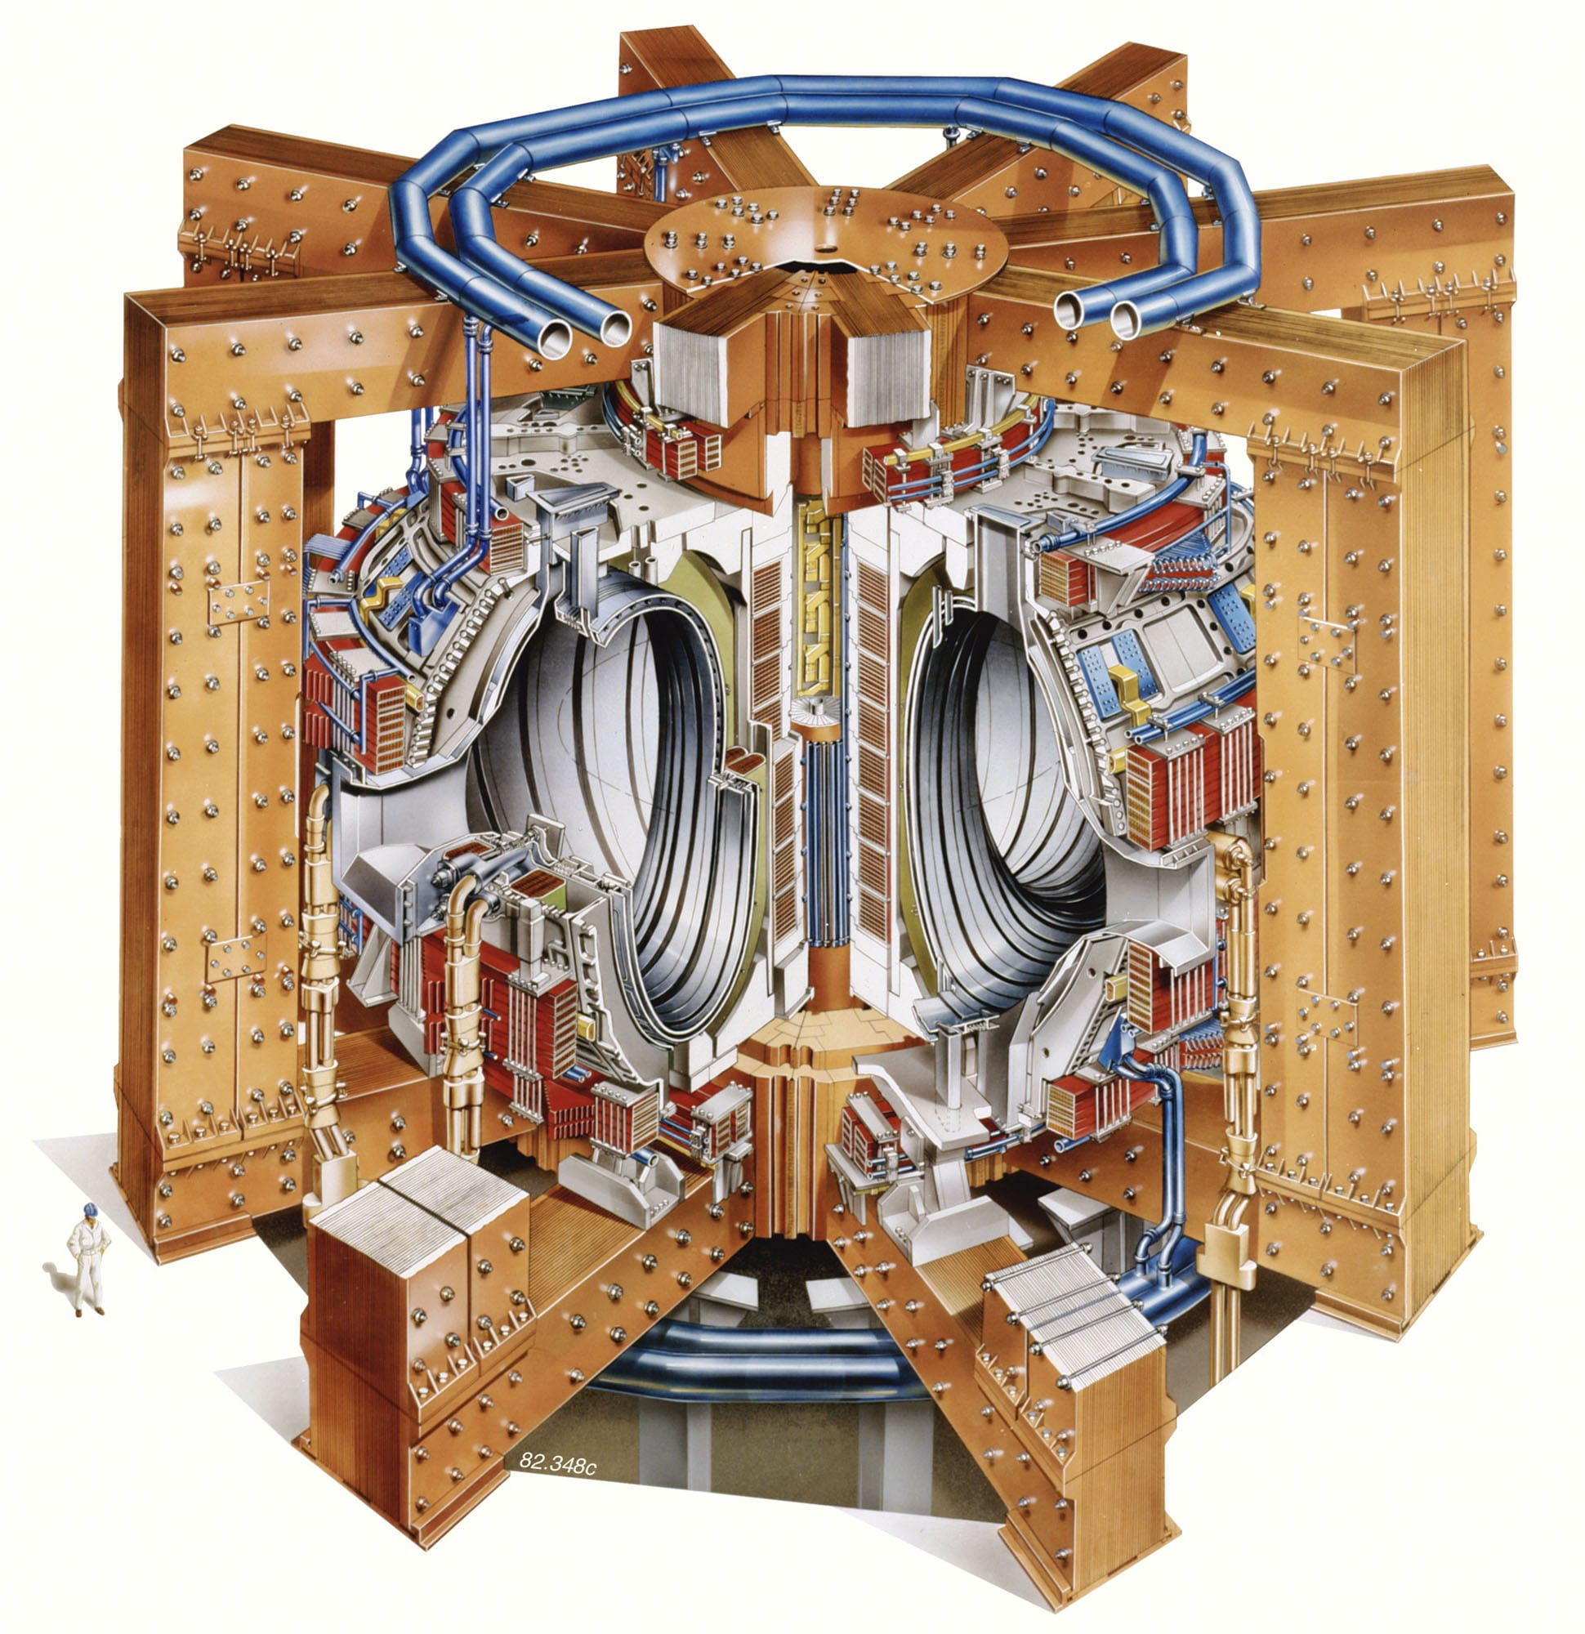
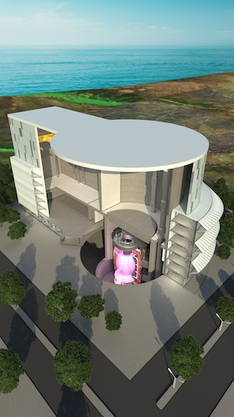
Ion irradiation effects in plasma-facing tungsten and its potential alloys
Prof. Enrique Jimenez-Melero
UKAEA Joint Chair in Materials for Fusion
School of Metallurgy and Materials
University of Birmingham
e.jimenez-melero@bham.ac.uk
Presentation at Third DONES Users Workshop
Tuesday 2nd October 2024, 15:45-16:00h
Zagreb (Croatia)

Slide 2
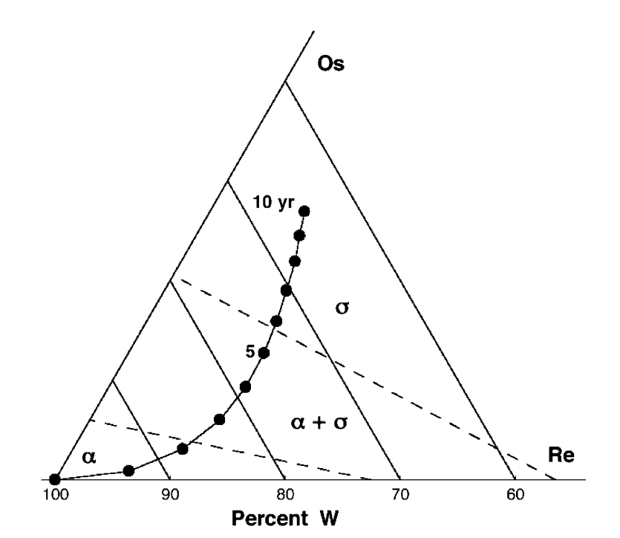
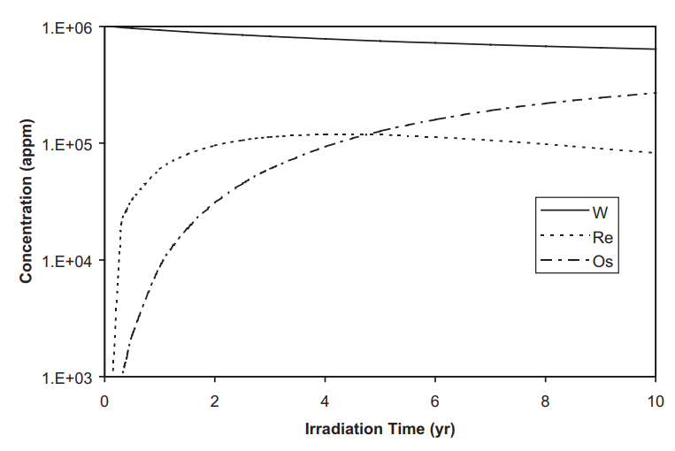
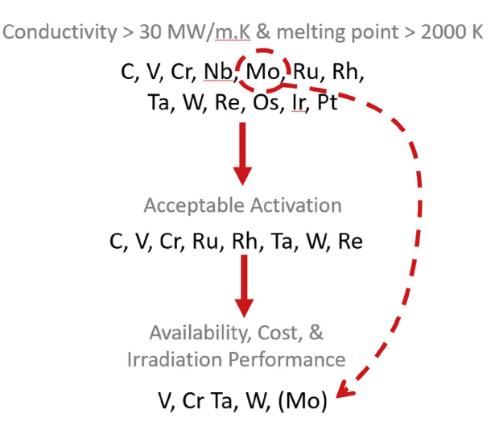
Transmutations & alloy strategies in W
Composition change due to 14 MeV neutron
irradiation of W (wall loading of 2 MW m⁻²)
G.A. Cottrell, J. Nucl. Mater. 334 (2004) 166-168
D. Hancock, J. Nucl. Mater. 512 (2018) 169-183
I. Ipatova, E. Jimenez-Melero et al., J. Nucl. Mater. 501 (2018) 329-335

Slide 3
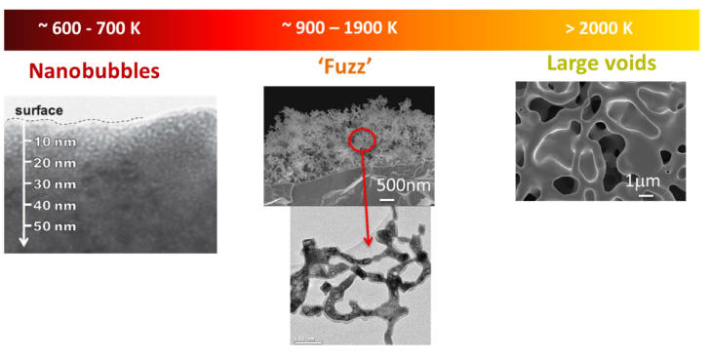
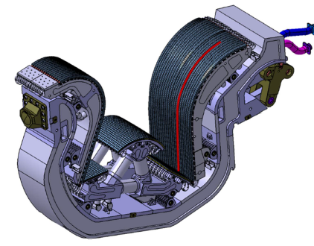
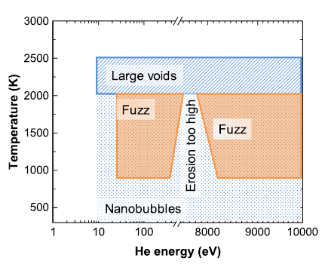
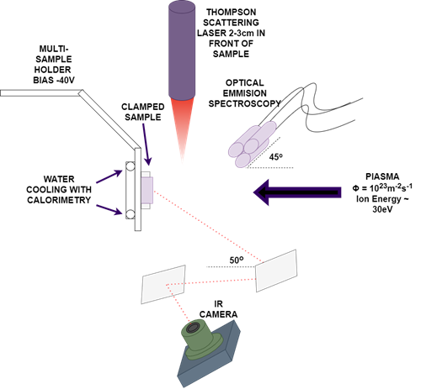
Can Ta alloying in W influence low-energy/high-fluence He bubble formation?
Single ITER divertor
cassette
G. De Temmerman, Plasma Phys. Control. Fusion 60 (2018) 044018
30 eV He plasma exposures
at ∼ 400 °C
DIFFER
(Netherlands)
He energies: eV regime

Slide 4
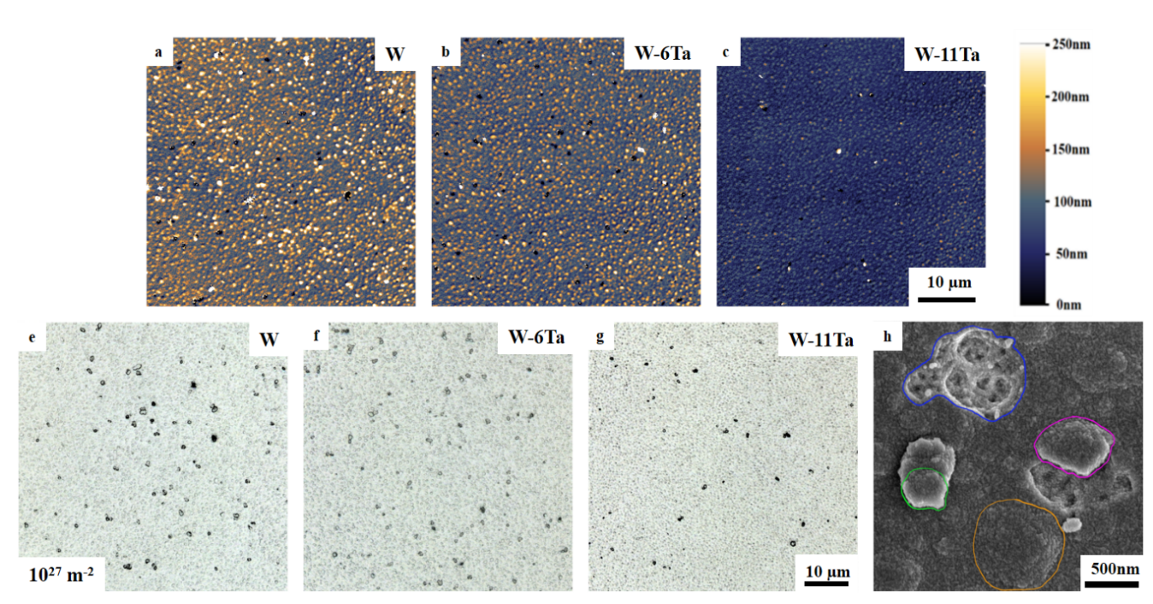
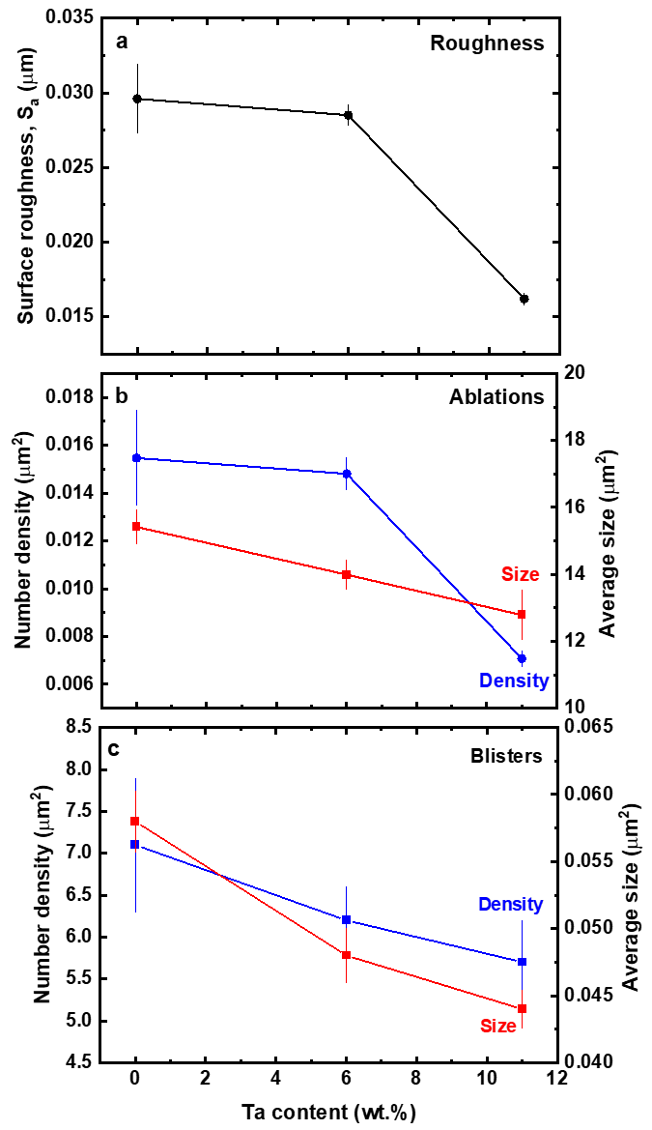
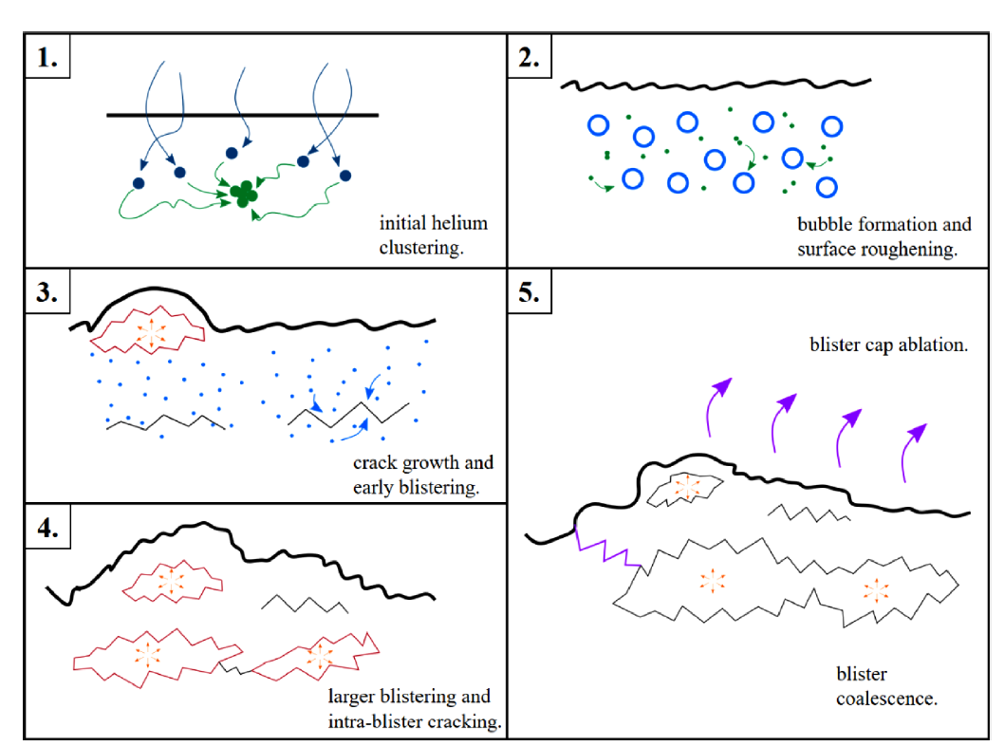
Can Ta alloying in W influence low-energy/high-fluence He bubble formation?
Surface
He fluence ∼10²⁷ m⁻²
E. Yildirim, E. Jimenez-Melero, Fusion Eng. Des. 197 (2023) 114061

Slide 5
He bubble formation at 800 °C
Unalloyed W
He energies: keV regime
I. Ipatova, E. Jimenez-Melero, J. Nucl. Mater. 550 (2021) 152910

Slide 6
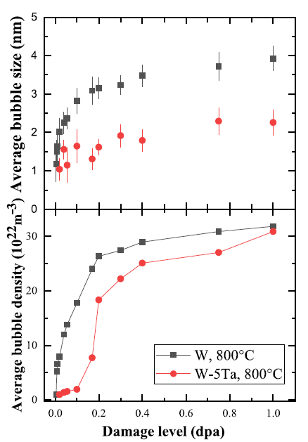
He bubble formation at 800 °C
W-5Ta
I. Ipatova, E. Jimenez-Melero, J. Nucl. Mater. 550 (2021) 152910

Slide 7
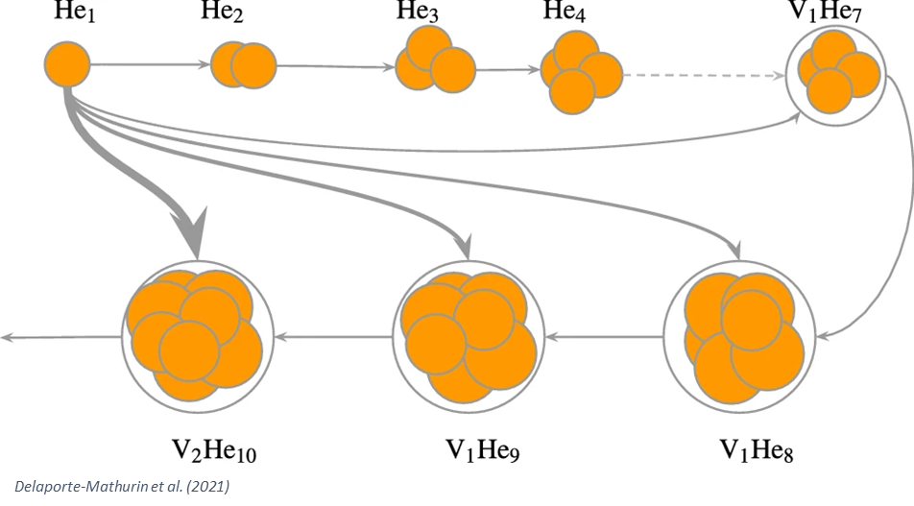
Mechanism of He bubble formation
Interstitial He atoms are mobile (E_{m} = 0.06 eV) and aggregate to form clusters
Self-trapping mechanism: x He^{i} + He^{i} → (x+1) He-vac + SIA
E (He^{i}-He^{i}) = 1.03 eV (1.64 eV for a 4He^{i} cluster)
Trap mutation mechanism: x He-vac + He^{i} → (x+1) He-2vac + SIA
E (He^{i}-vac) = 4.57 eV (decreases with a higher He/vac ratio in the cluster)
E (He^{i}-SIA) = 0.94 eV → He de-trapped from SIAs are trapped by vacs
SIAs are mobile below RT, whereas single vacs start to be mobile at T ≥ 200-300 °C
He-vac clusters present significant mobility at T ≥ 600 °C → growth by cluster coalescence

Slide 8
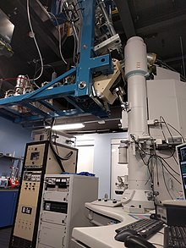
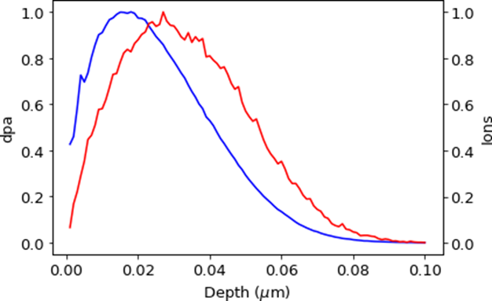
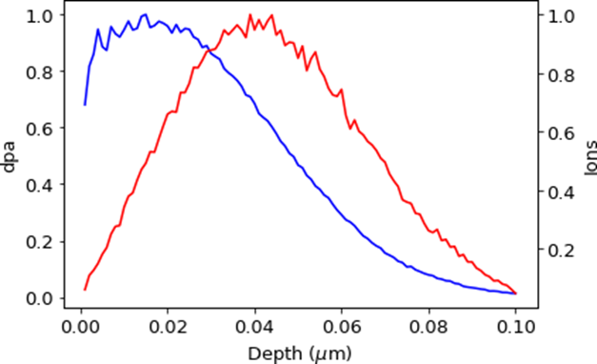
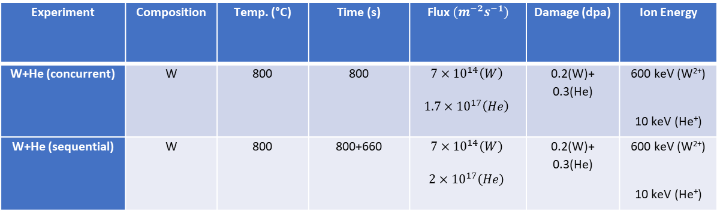
Dual beam irradiations in tungsten at 800 °C
Experiment | Composition | Temp. (°C) | Time (s) | Flux${(m}^{−2}s^{−1})$ | Damage (dpa) | Ion Energy
W+He (concurrent) | W | 800 | 800 | $$7×{10}^{14}\left(W\right)$$ $$1.7×{10}^{17}\left(He\right)$$ | 0.2(W)+ 0.3(He) | 600 keV (W²⁺) 10 keV (He⁺)
W+He (sequential) | W | 800 | 800+660 | $$7×{10}^{14}\left(W\right)$$ $$2×{10}^{17}\left(He\right)$$ | 0.2(W)+ 0.3(He) | 600 keV (W²⁺) 10 keV (He⁺)
10 keV He⁺
600 keV W²⁺
In-situ TEM under dual irradiations
300 kV Hitachi H-9500 TEM
(Univ. Huddersfield, UK)
E. Yildirim, E. Jimenez-Melero, Nucl. Mater. Energy 39 (2024) 101672

Slide 9
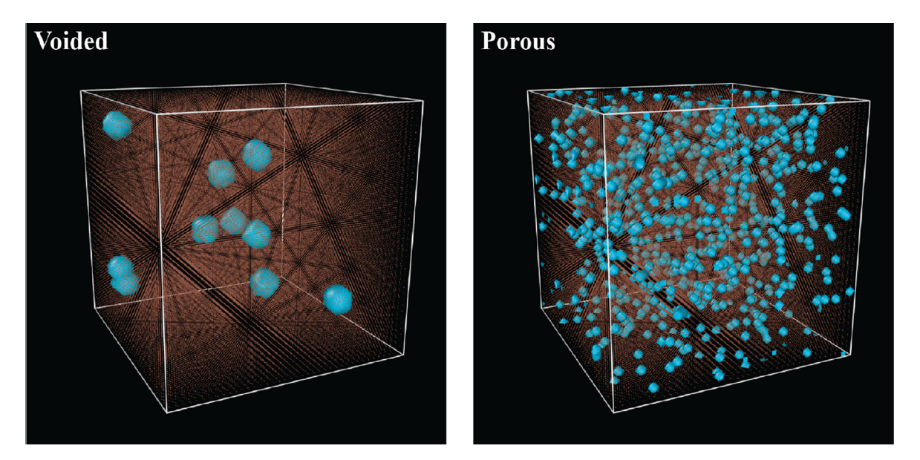
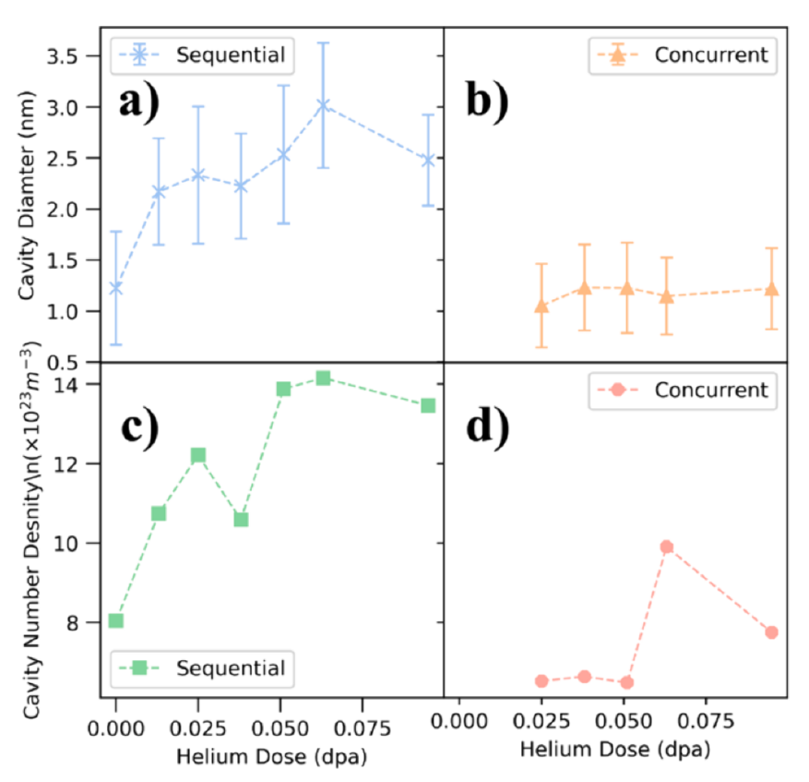
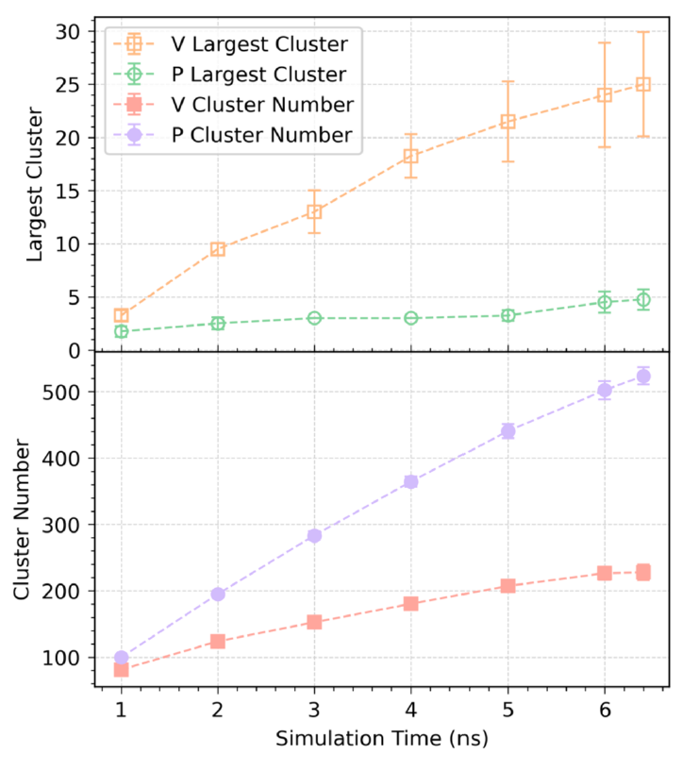
Dual beam irradiations in tungsten at 800 °C

Slide 10
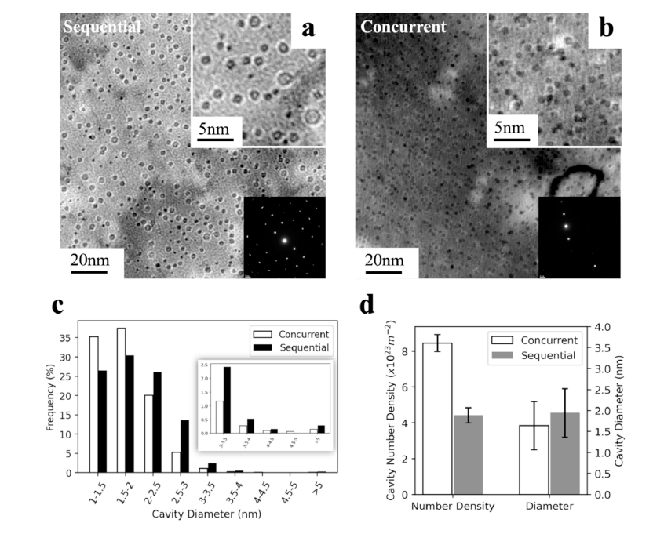
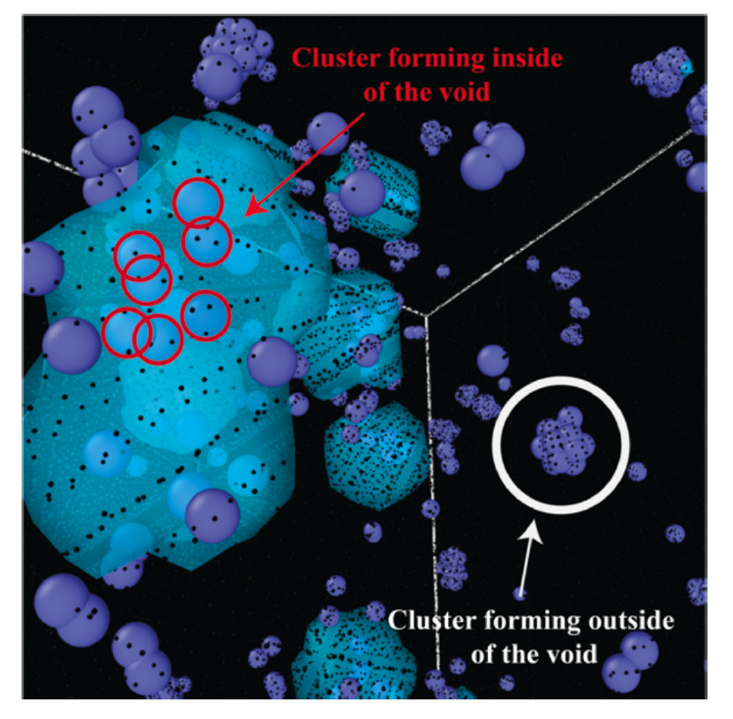
‘Post-mortem’ characterizations
of irradiated tungsten
Sample | Time (s) | Flux (m⁻² s⁻¹) | Damage (dpa) | Ion energy (keV) | Void diameter (nm) | Bubble density (m⁻²)
WSQN | 800 660 | 7 × 10¹⁴ 2 × 10¹⁷ | 0.2 0.3 | 600 W²⁺ 10 He⁺ | 2.0 ± 0.6 | 6.7 ± 0.6
WCON | 800 | 7 × 10¹⁴ 1.7 × 10¹⁷ | 0.5 | 600 W²⁺ 10 He⁺ | 1.7 ± 0.5 | 11.1 ± 0.7

Slide 11
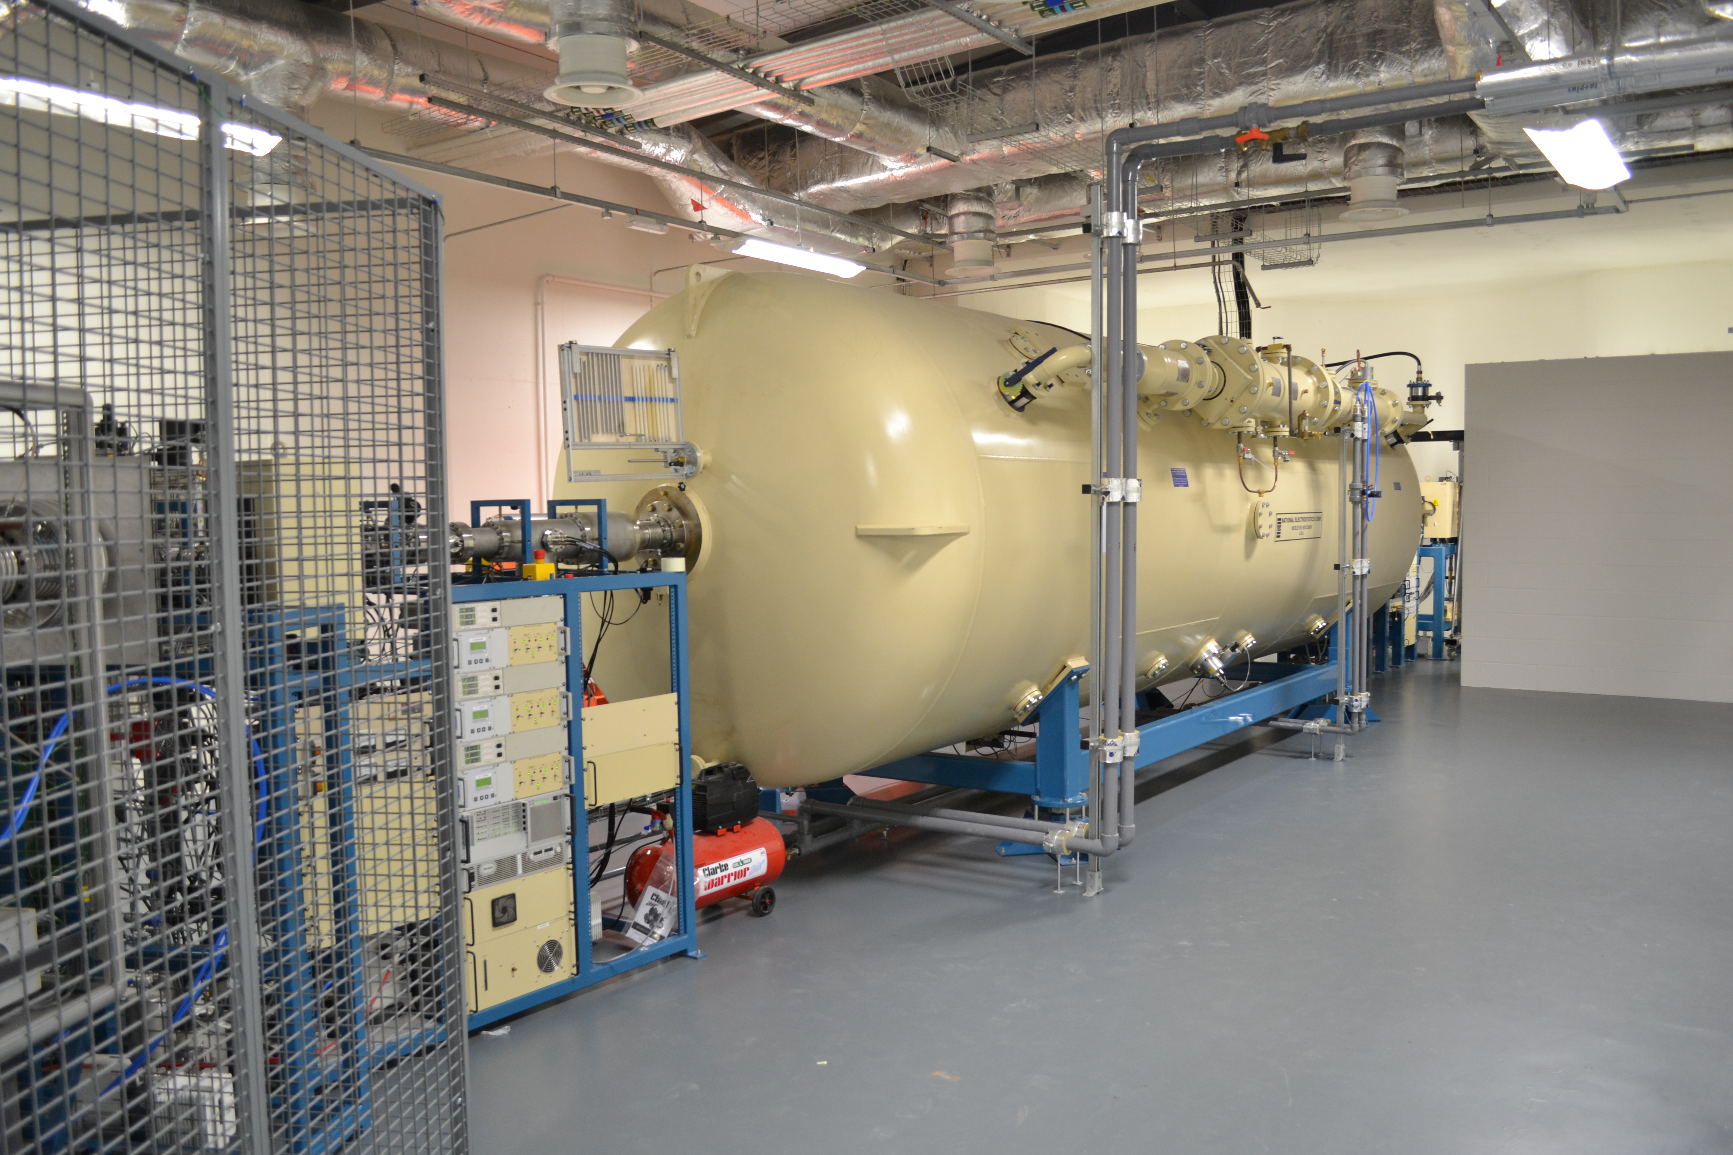
Beam line development – radiation damage to materials
P. Wady, E. Jimenez-Melero, Nucl. Inst. Meth. Phys. Res. B 806 (2016) 109

Slide 12
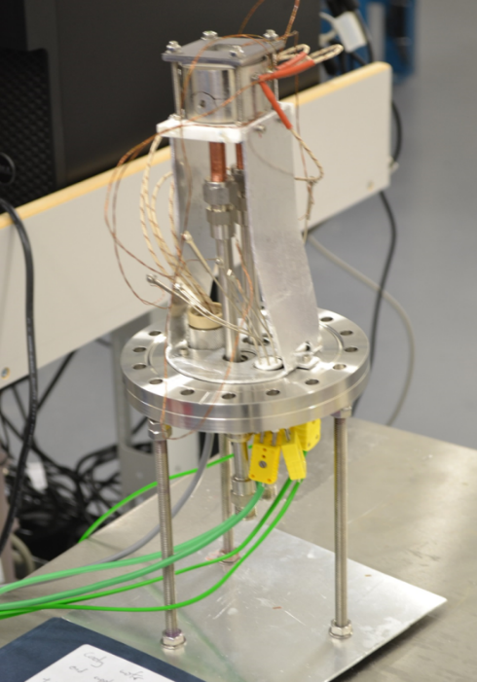
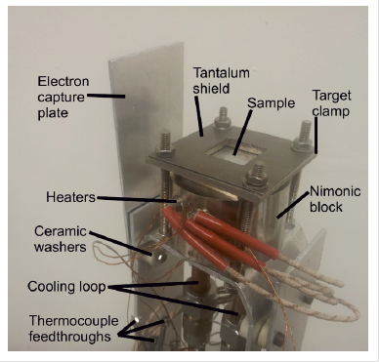
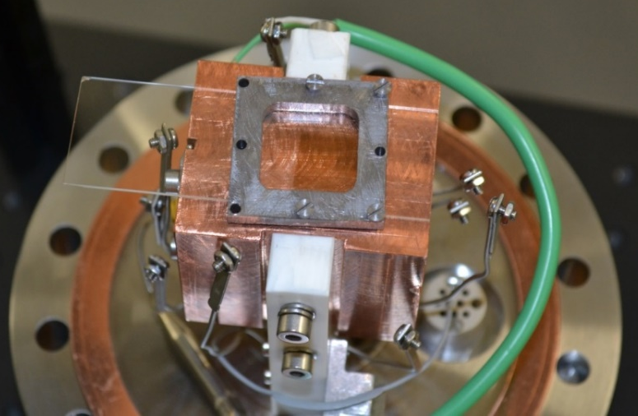
Motorized slit system
Define the sample
irradiated area
Independent current
integration
Beam alignment
a
Sample stages
b
P. Wady, E. Jimenez-Melero et al., Accelerated radiation damage test facility using a 5MV
tandem ion accelerator, NIMPRB 806 (2016) 109-116

Slide 13
Proton energies: MeV regime
W
3MeV Proton irradiations
T = 350 °C
W-5Ta

Slide 14
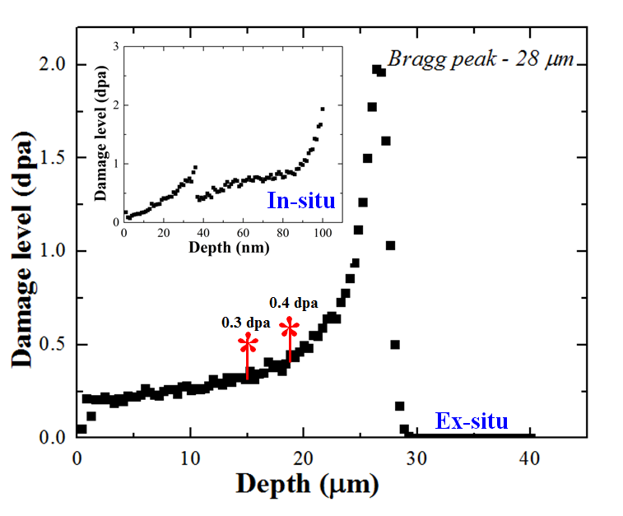
W-base alloys as plasma
facing materials
(40 keV)
(3 MeV)
I. Ipatova, E. Jimenez-Melero et al., J. Nucl. Mater. 501 (2018) 329-335

Slide 15
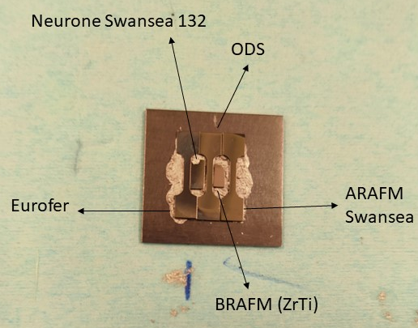
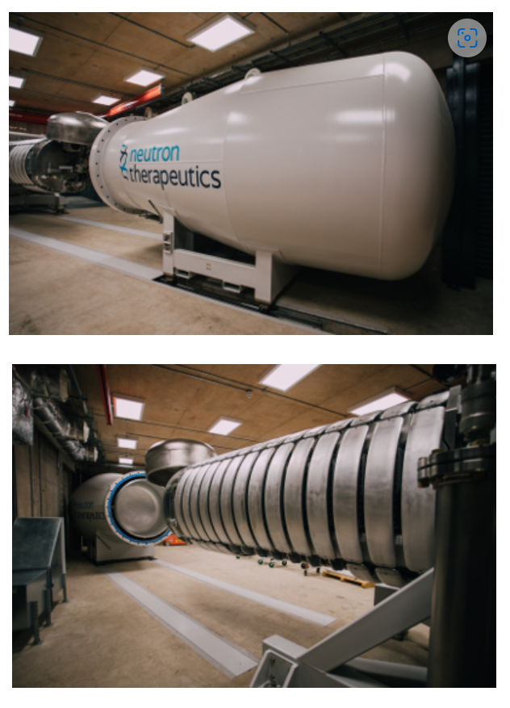
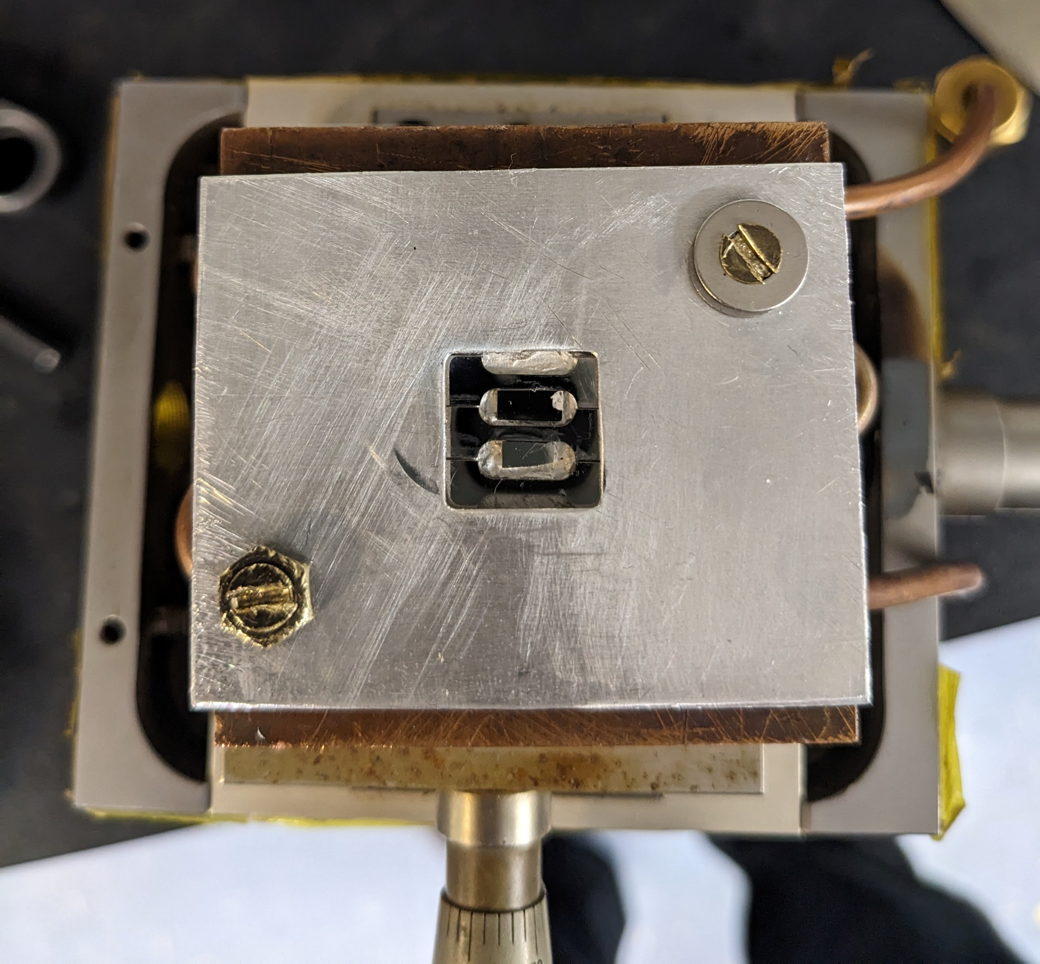
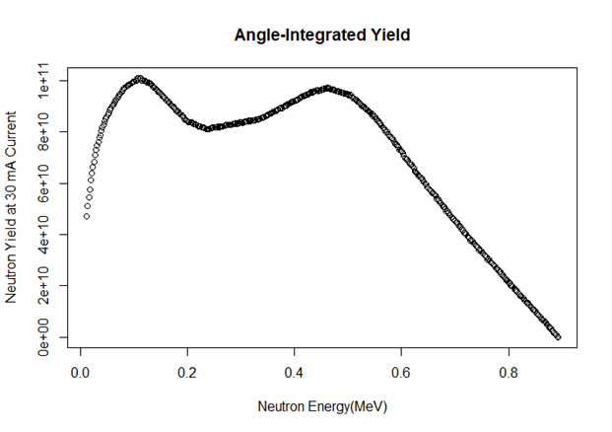
Proton Irradiations
Neutron irradiations
MC40 cyclotron
Fusion Steels (0.5mm thick)
1. coupons (thermal testing)
2. dog-bone SSJ2 specimens
Li(p,n) source (possibly also d,n)
Proton energies: ∼3-38 MeV
3 MeV H → ∼35 µm
10 MeV H → ∼257 µm
28 MeV H → ∼ 1.5 mm
Irradiated area: 1 cm²
2.6 MeV p -> neutrons < 0.9MeV
T_{irr} ∼ 500 °C

Slide 16


