Slide 1
Detector development and characterisation for neutron- and gamma-based radiography and spectroscopy for NDT
J. Peñas, C. Cabo-Landeira, B. Fernández, C. Guerrero, M.A. Millán-Callado, Y. Ayyad
3rd DONES Users Workshop
Zagreb – October 2024

Slide 2
Outline
Neutrons for Non-Destructive Testing (NDT).
Neutron and gamma imaging. Detectors description and validation.
Gaseous detector for neutron spectroscopy. Overview, features and performance.
Prospects at IFMIF-DONES facility.
Conclusions.
J.Peñas | 3rd DONES Users Workshop | Zagreb | October 2024

Slide 3
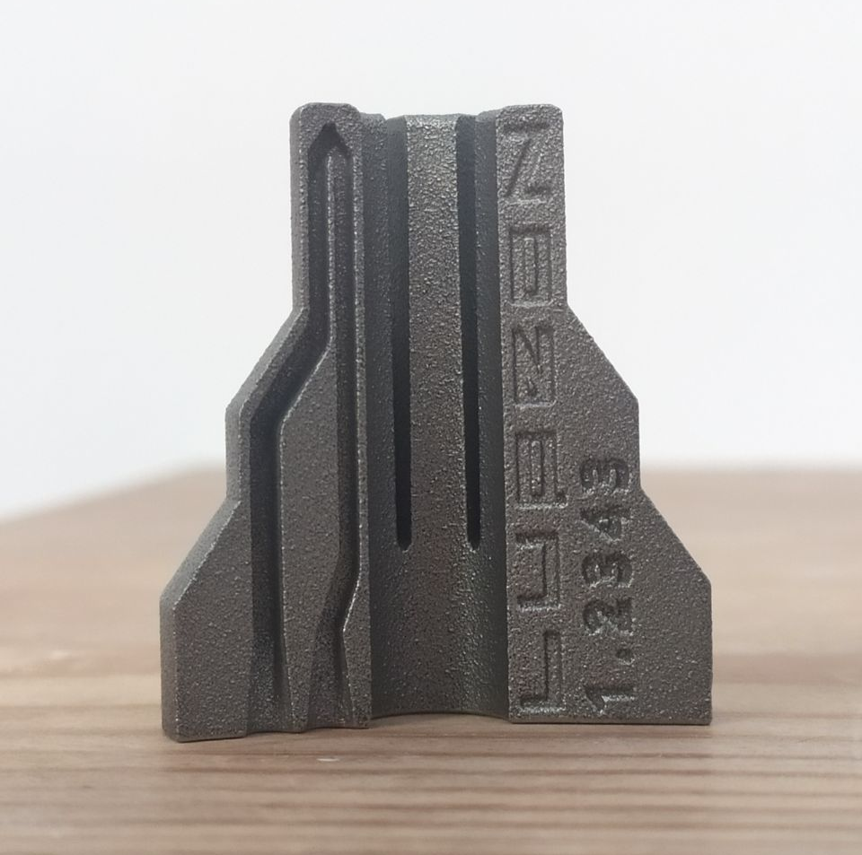
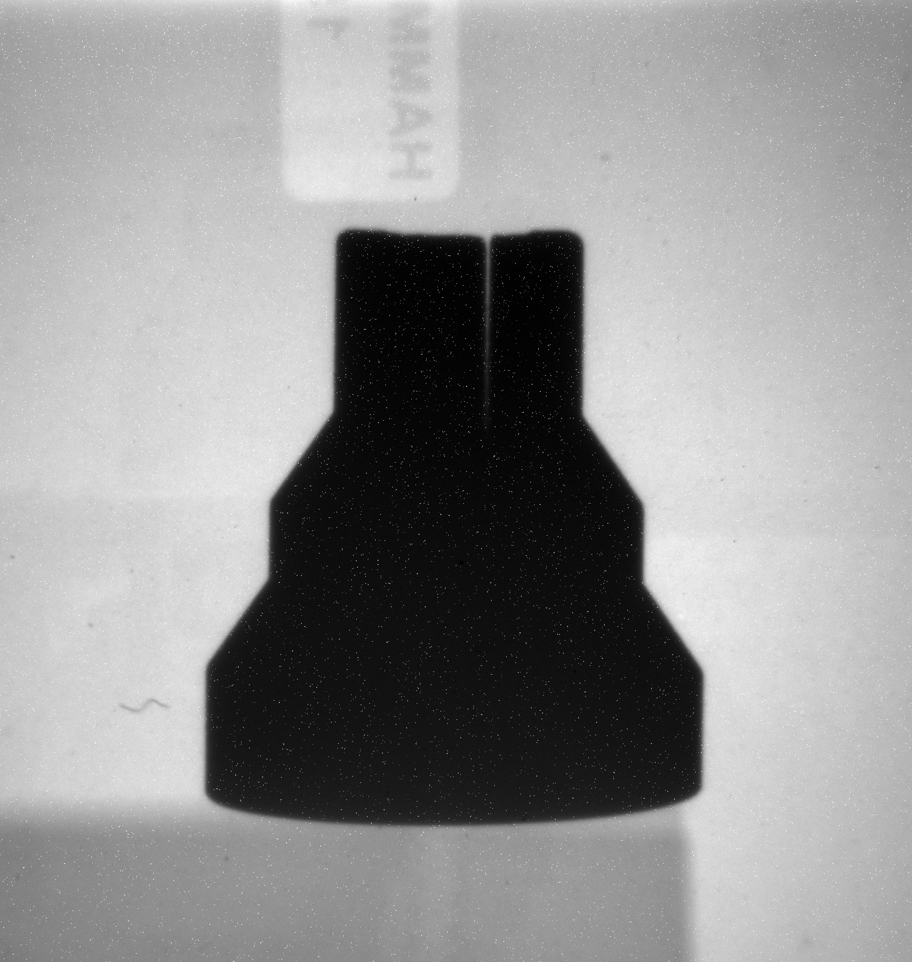
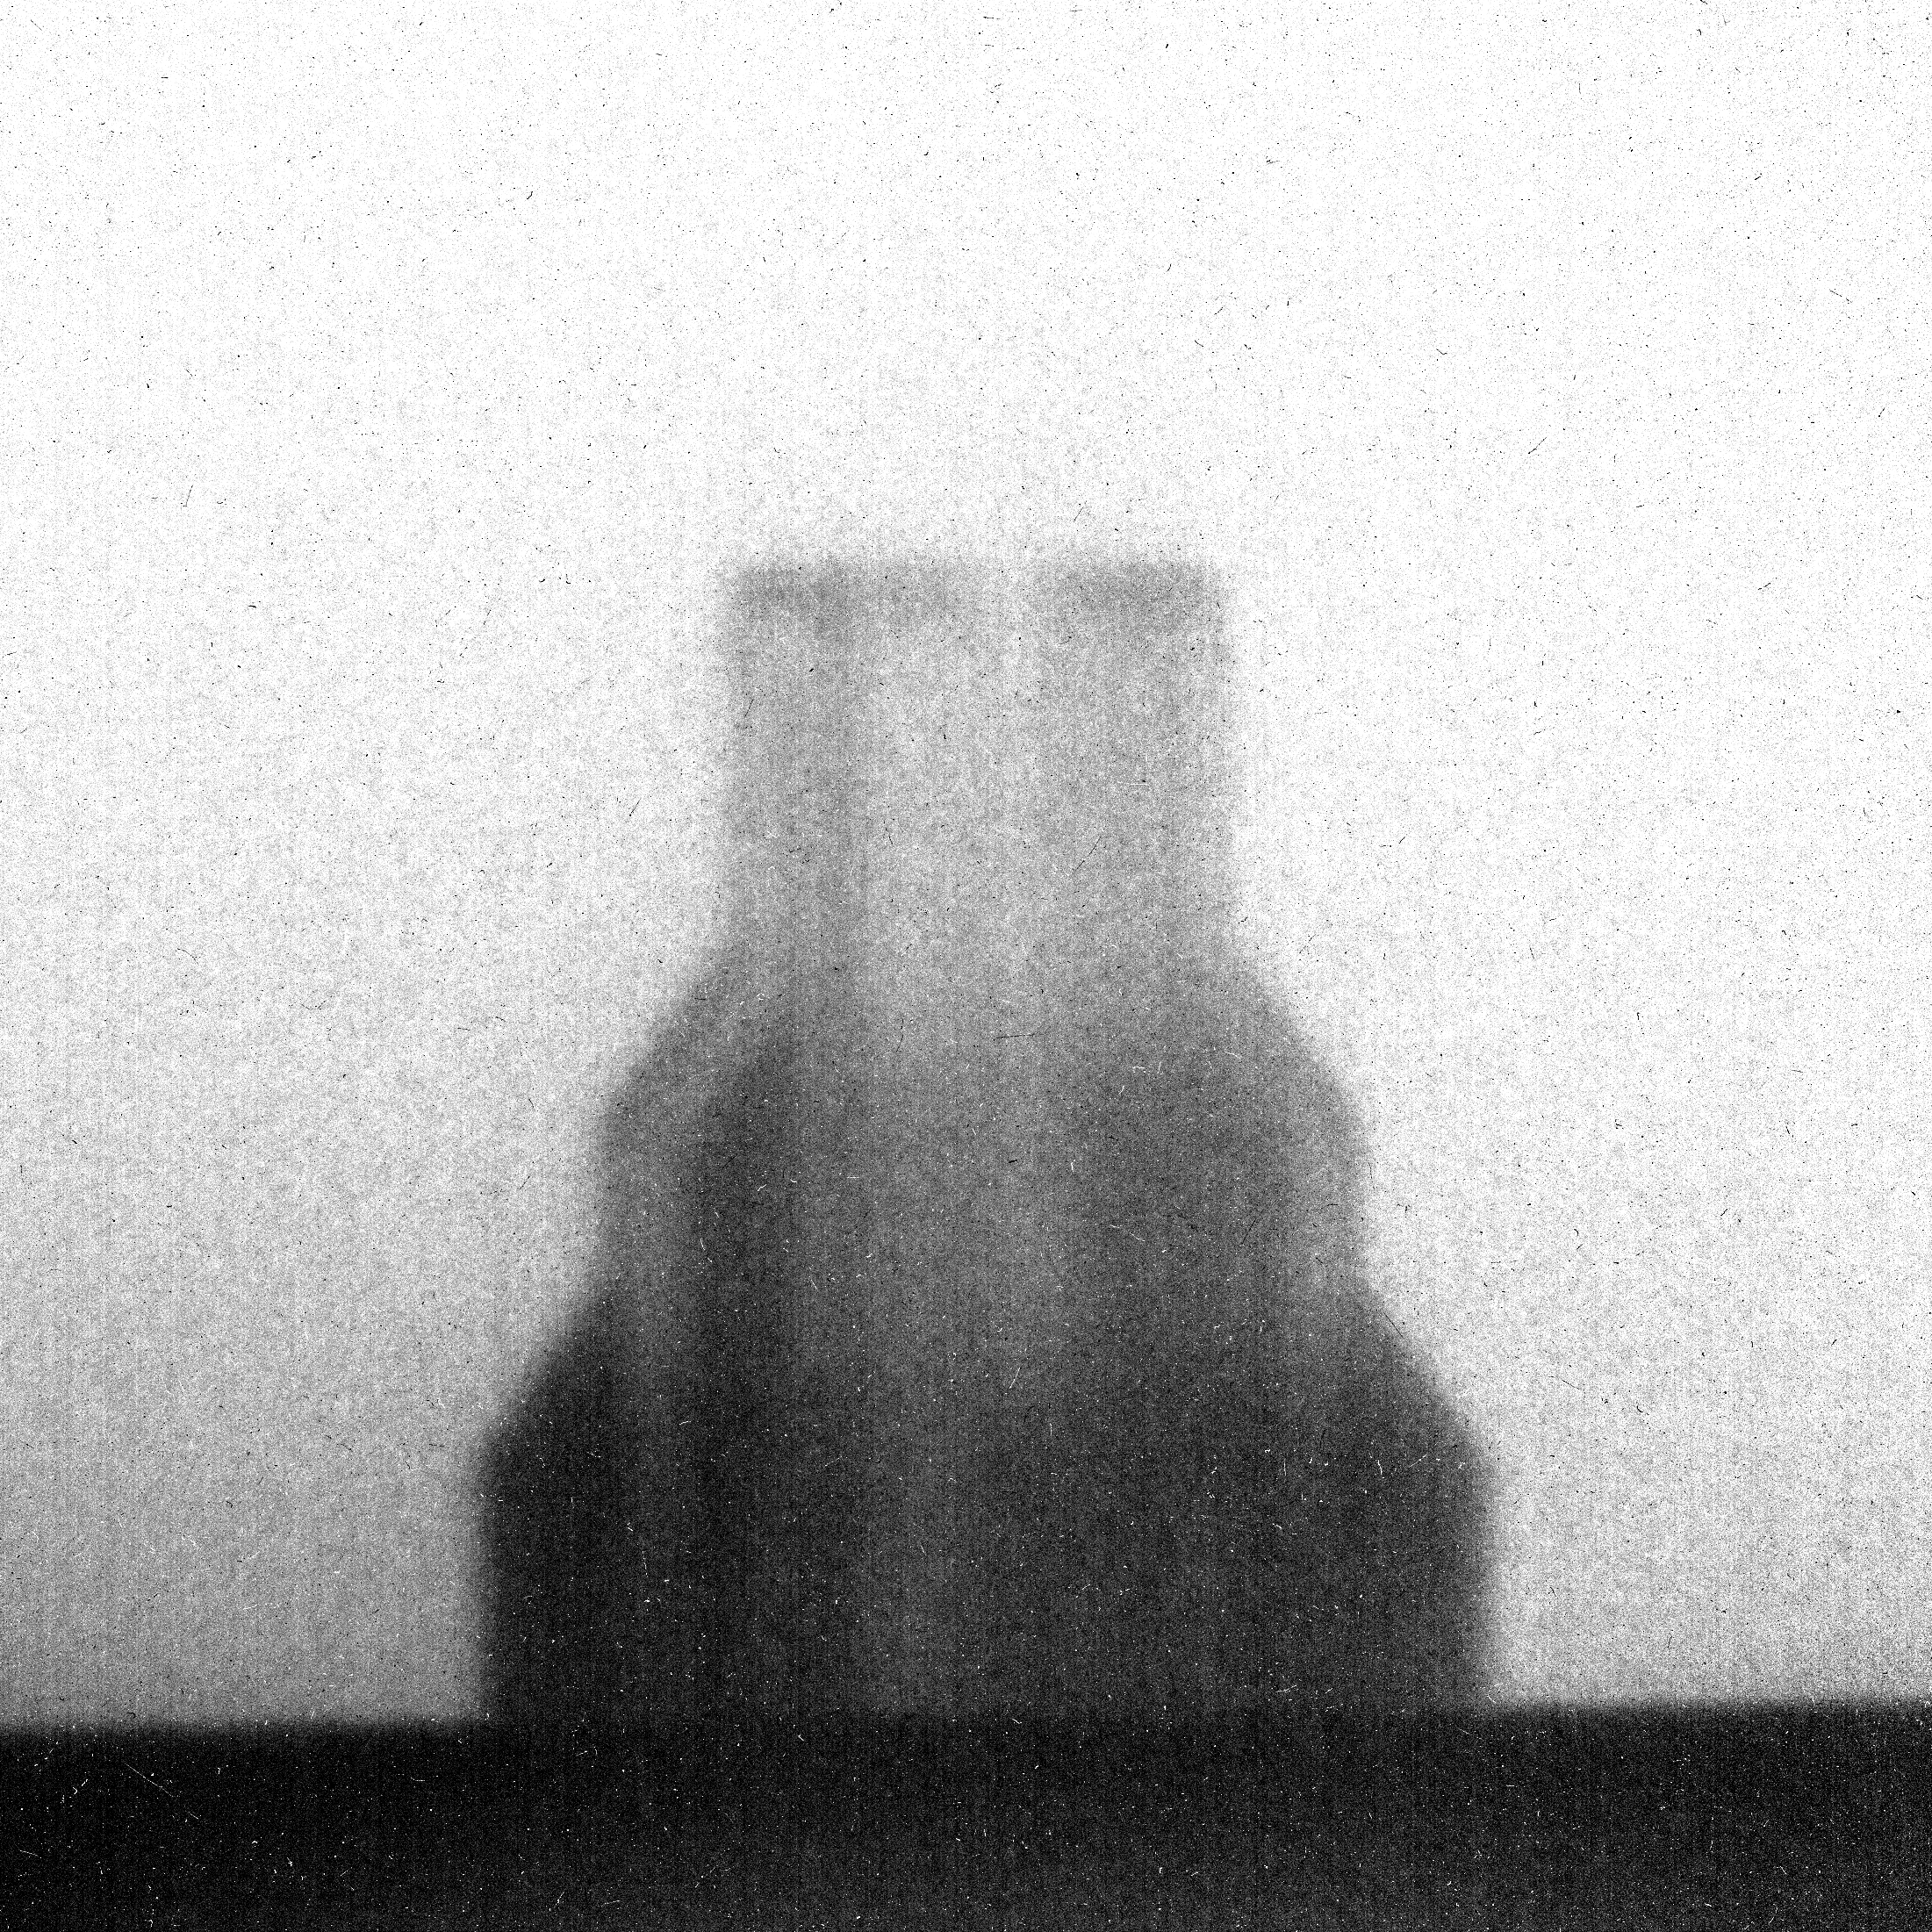
Non-Destructive Testing
Conventional NDT techniques involve X-rays and gamma rays for transmission radiography. Several limitations:
Dense and/or high-atomic number materials.
Thick objects.
NDT with neutrons constitute a valuable technique:
Low interaction with heavy nuclei.
Enhanced absorption of light elements and others (B, Gd, Cd,...).
Not limited to radiography: PGAA, BETI, FNAA,...
Other properties of matter: composition, internal stress or inclusions, thickness, etc, of interest in NDT.
Several applications in industry: MAM, quality control, pipeline maintenance, etc.
X-rays
Gamma
(¹³⁷Cs)
Thermal neutrons
J.Peñas | 3rd DONES Users Workshop | Zagreb | October 2024

Slide 4
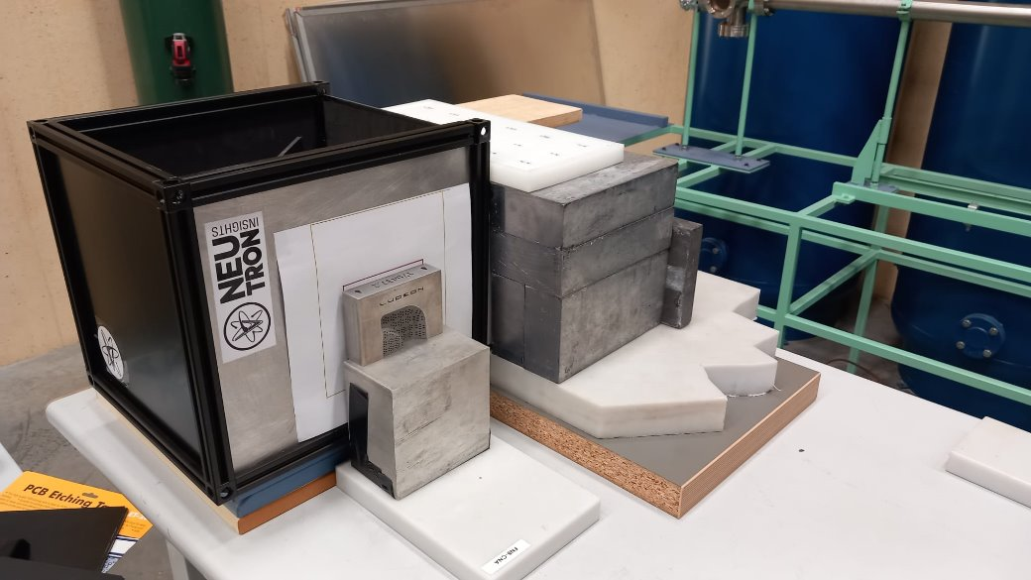
Gamma and neutron imaging - Detector
Most common design based on a scintillator and a camera.
Frame-based cameras (CCD/CMOS).
Event-driven camera (Timepix).
Flexible to different types of radiation (neutrons or photons) by exchanging the scintillator.
CsI or NaI for gamma rays.
ZnS:Cu for neutrons. Polypropylene layer for n-p conversion.
GADOX for both radiation types.
Mirror
Scintillator
Sample
Black Box
Radiation
Pb & HDPE shielding
Lens
CMOS
camera
Optional image intensifier for low flux conditions.​
Rotary stage for tomographic measurements.
J.Peñas | 3rd DONES Users Workshop | Zagreb | October 2024

Slide 5
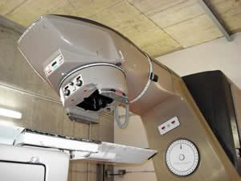
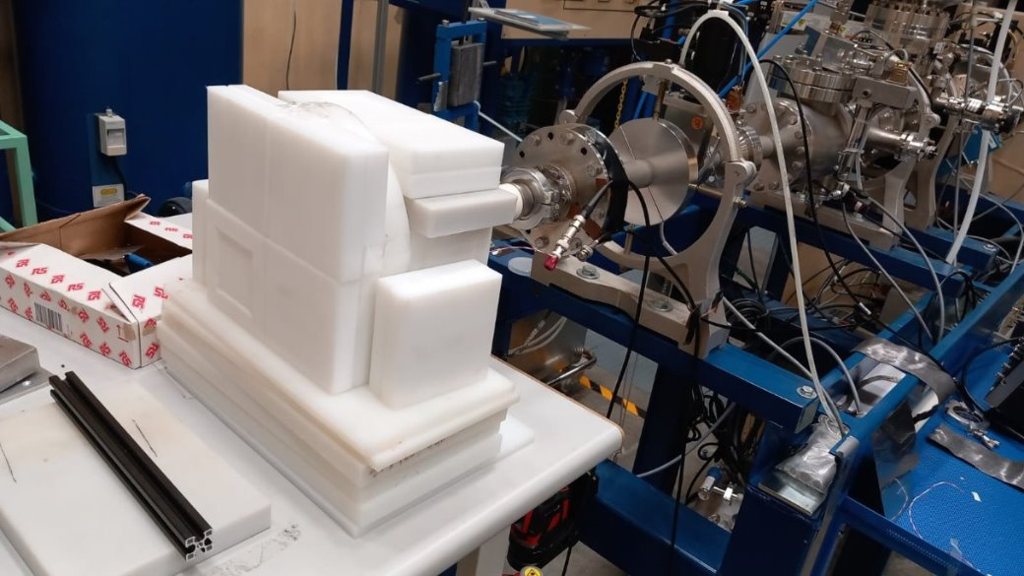
Gamma and neutron imaging
Gamma radiography
⁶⁰Co gamma irradiator (~47 TBq) at USC, Santiago de Compostela.
AECL Theatron 780 therapy unit.
Adjustable source size (lead plates) and beam directionality (rotary axis).
Device specifications:
GADOX scintillating sheet, 10x20 cm area.
Hamamatsu Orca-Flash4.0 v2 CMOS camera: 2048x2048 pixels with 6.5x6.5 µm pixel size. Optical lens f/1.3.
Neutron radiography
HiSPANoS neutron beamline at Centro Nacional de Aceleradores (CNA), Seville.
Proton or deuterium beams delivered by 3MV tandem accelerator.
Fast neutrons through (p,n) and (d,n) reactions on a Be target. Flux: ~5·10⁶ n/s/cm² above 1.3 MeV @1.5 m.
Moderation with HDPE blocks down to thermal energies.
Device specifications:
ZnS:Cu scintillator, 10x12 cm area and 2 mm thickness.
ASIO ZWO ASI533MM CMOS camera: 3000x3000 pixels with 3.7x3.7 um pixel size. Optical lens f/1.8.
J.Peñas | 3rd DONES Users Workshop | Zagreb | October 2024

Slide 6
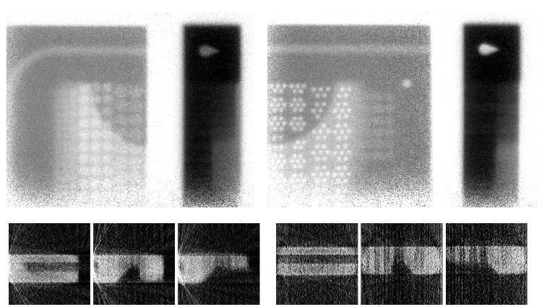
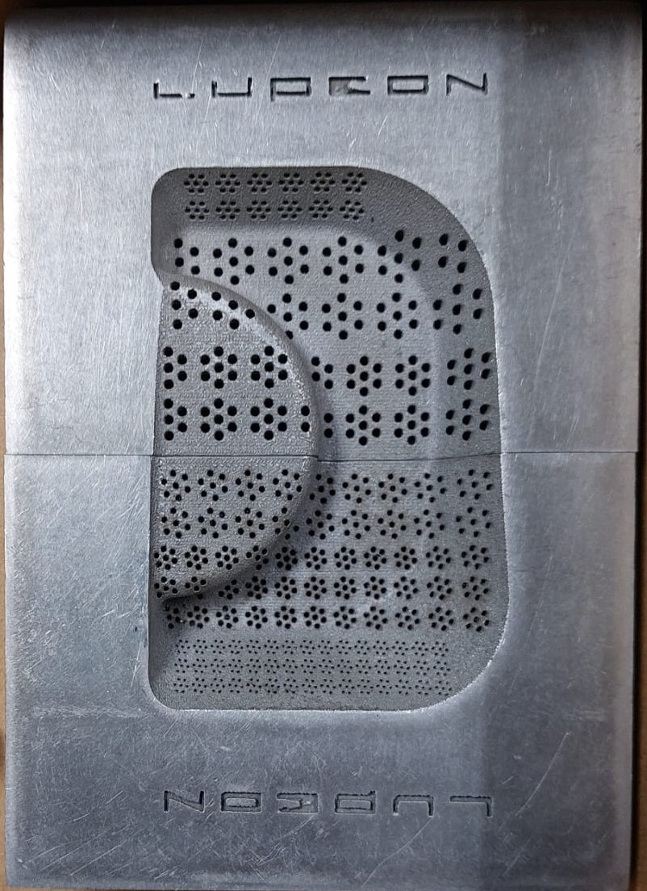
Gamma radiography
1.5 mm
MAM steel sample.
2.5 cm thickness.
Holes with 0.5 - 1.5 mm diameter.​
Source size: 7x7 cm
Exposure time: 5x7 s
Flux: 5·10⁸ ph/s/cm²
Source-object dist.: ~80 cm​
Spatial resolution (edges): 0.9 mm
20 – 36 projections.
J.Peñas | 3rd DONES Users Workshop | Zagreb | October 2024

Slide 7
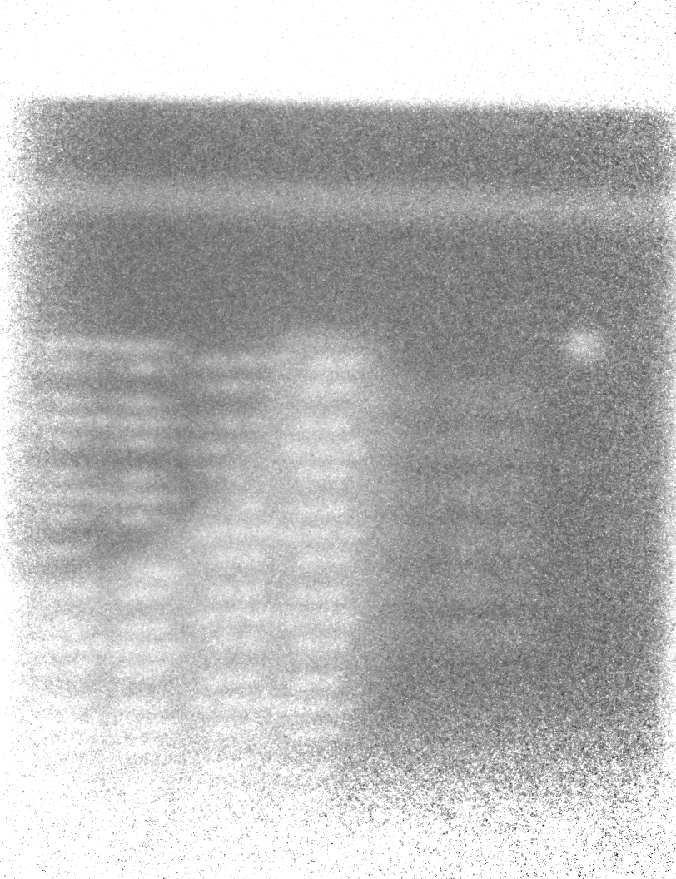
Gamma radiography
MAM steel sample.
2.5 cm thickness.
Holes with 0.5 - 1.5 mm diameter.​
Source size: 7x7 cm
Exposure time: 5x7 s
Flux: 5·10⁸ ph/s/cm²
Source-object dist.: ~80 cm​
Spatial resolution (edges): 0.9 mm
20 – 36 projections.
J.Peñas | 3rd DONES Users Workshop | Zagreb | October 2024

Slide 8
Neutron radiography (thermal)
1.0 mm
Highly neutron- absorbing material
Exposure time: 100x10 s
Source-object dist.: ~80 cm
Spatial resolution (edges): 1.4 mm
Gamma rays
J.Peñas | 3rd DONES Users Workshop | Zagreb | October 2024

Slide 9
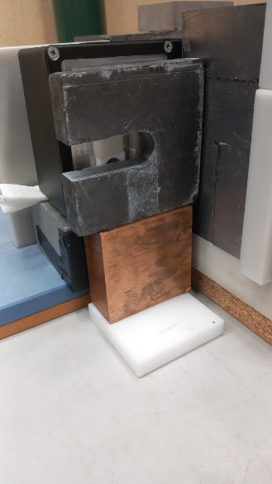
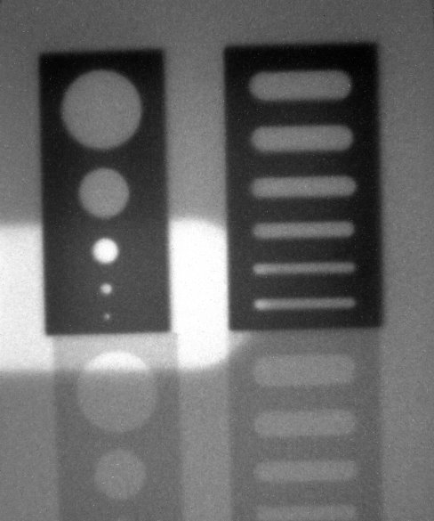
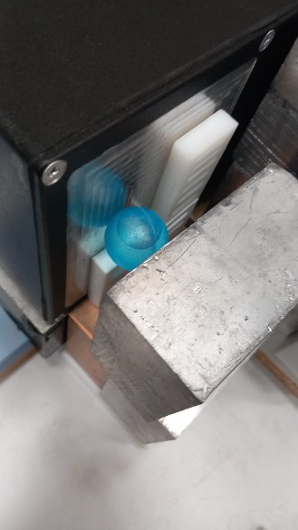
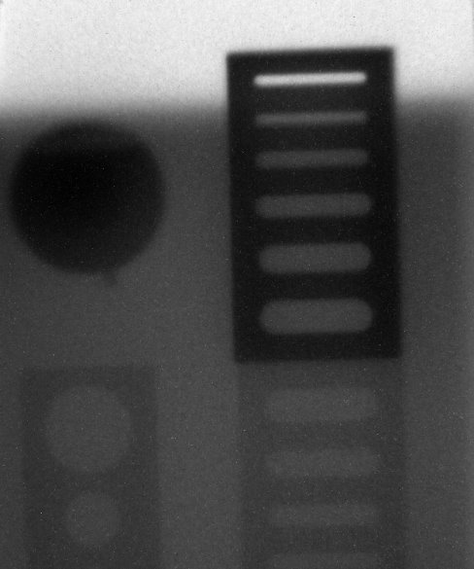
Neutron radiography (thermal)
1.0 mm
Lead thickness: 2.5 cm
Lead thickness: 5 cm
Exposure time: 100x10 s
Source-object dist.: ~80 cm
Spatial resolution (edges): 1.4 mm
Highly valuable for NDT inspection!
J.Peñas | 3rd DONES Users Workshop | Zagreb | October 2024

Slide 10
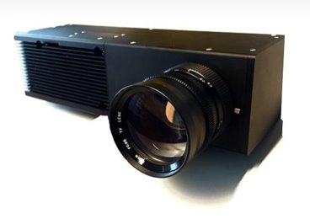
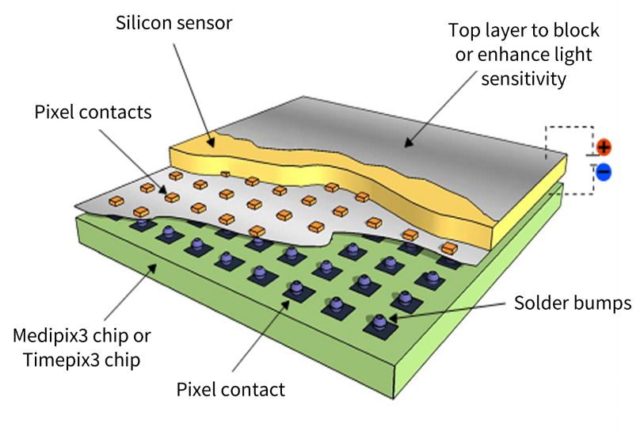
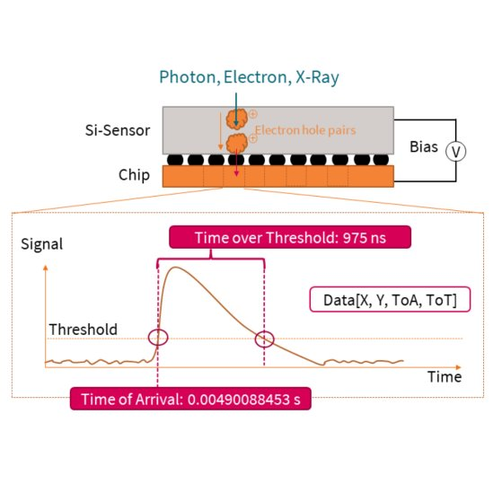
Event-driven image adquisition
Timepix3 detector
Array of 256x256 pixels of 5.5x5.5 µm size. Each pixel constitutes a separate acquisition with its own electronics.
Provides additional timing information associated to each singular event:
(x,y)-coordinates.
Time-of-arrival (ToA).
Time-over-threshold (ToT).
Intrinsic temporal resolution of 1.56 ns.
Silicon sensor sensitive to photons and charged particles. Adaptable to neutrons through a conversion layer (polyethylene, paraffin, etc) and/or detector (MCP, GEMs,...).
J.Peñas | 3rd DONES Users Workshop | Zagreb | October 2024

Slide 11
Event-driven image adquisition
Main advantages over frame-based imaging:
Better image reconstruction methods: improved spatial resolution and noise reduction.
Pulsed sources: relevant timing information derived from ToF techniques.
For neutrons, energy-resolved neutron imaging. Fast, thermal, or at resonance band.
Pulse Shape Discrimination (PSD) on each signal, allowing for simultaneous imaging using different radiation types.
J.Peñas | 3rd DONES Users Workshop | Zagreb | October 2024

Slide 12
Prospects at the IFMIF-DONES facility
Complementary Experiments Hall
R160
(J.Hirtz et al., 2022)
40 MeV deuterons to <55 MeV neutrons. Peak at about 15 MeV.
Fast neutron flux: 10¹⁰ n/s/cm².
Thermal neutron flux:
10⁷ n/s/cm² (no collim.)
10⁴ n/s/cm² (L/D = 200)
(20 – 25% fast-to-thermal ratio after moderation)
TOF-DONES
R026
(D.Cano-Ott talk @ IFMIF-DONES Workshop, 2022)
40 MeV deuterons to <55 MeV neutrons. Peak at about 15 MeV.
Deuteron pulses of 5.6 ns evenly spaced 5.7 us (1:1000) ratio -> Up to 175 kHz.
Total neutron flux: 10⁶ n/s/cm² at 22 m ToF distance.
J.Peñas | 3rd DONES Users Workshop | Zagreb | October 2024

Slide 13
Prospects at the IFMIF-DONES facility
Neutron imaging
Improved conventional imaging due to beam properties:
High fast neutron flux
High fast neutron energy
High spatial resolution and Signal-to-Noise Ratio (SNR). Shorter exposure times.​
10¹⁰ n/s/cm²@R160, orders of magnitude higher than @CNA
Deep penetration on thick and dense objects.
Energy-selective imaging (Timepix, LEELA) at TOF-DONES provides additional information:
Bragg-edge transmission imaging (BETI)
Fast Neutron Resonance Radiography (FNRR)
Composition and stress map of the sample (>10³ n/s/cm²).
Attenuation of low-energy neutrons due to cryst. lattice.
Composition of the sample.
Material-specific resonances at fast neutron energies
PSD processing (Timepix) allows for radiation type specific imaging.
J.Peñas | 3rd DONES Users Workshop | Zagreb | October 2024

Slide 14
Prospects at the IFMIF-DONES facility
Complementary techniques – Material characterisation
Neutron spectroscopy (Timepix, LEELA) at TOF-DONES enable several techniques:
Neutron Resonance Transmission Analysis (NRTA)
Neutron back-diffusion
Thickness of the sample.
Other techniques based on gamma spectroscopy also available (Timepix):
Prompt Gamma Activations Analysis (PGAA)​
Gammas from fast neutron inelastic scattering​
Neutron Activation Analysis (NAA)
Fast Neutron Activation Analysis (FNAA)
Deexcitation gammas
Neutron flux:
PGAA ~10⁸ n/s/cm²
NAA ~10¹²⁻¹⁴ n/s/cm²
FNAA ~10⁸ n/s/cm²
Decay gammas after activation
Detector calibration and characterisation
LEELA: efficiency, light yield, energy resolution, etc.
J.Peñas | 3rd DONES Users Workshop | Zagreb | October 2024

Slide 15
Conclusions
Neutron sources are valuable for NDT.
Frame-based and event-driven (Timepix) cameras.
Gaseous spectroscopic detector based on stacks of O-PPACs.
Several techniques and experiments available at IFMIF-DONES facility!
J.Peñas | 3rd DONES Users Workshop | Zagreb | October 2024

Slide 16
Thank you for your attention!

Slide 17
Back-up

Slide 18
Summary
Gaseous spectroscopic detector
Imaging
Material char.
Both
Frame-based imaging system
Event-driven imaging system
High resolution thermal and fast imaging
High resolution thermal and fast imaging
Energy-resolved neutron imaging
BETI
FNRR
High resolution thermal and fast imaging
Energy-resolved neutron imaging
BETI
FNRR
Complementary Experiments Hall R160
All of the above
All of the above
ToF imaging
NAA, FNAA, PGAA
NRTA
Neutron back-diffussion
All of the above
NRTA
Neutron back-diffussion
TOF-DONES R026
J.Peñas | 3rd DONES Users Workshop | Zagreb | October 2024

Slide 19
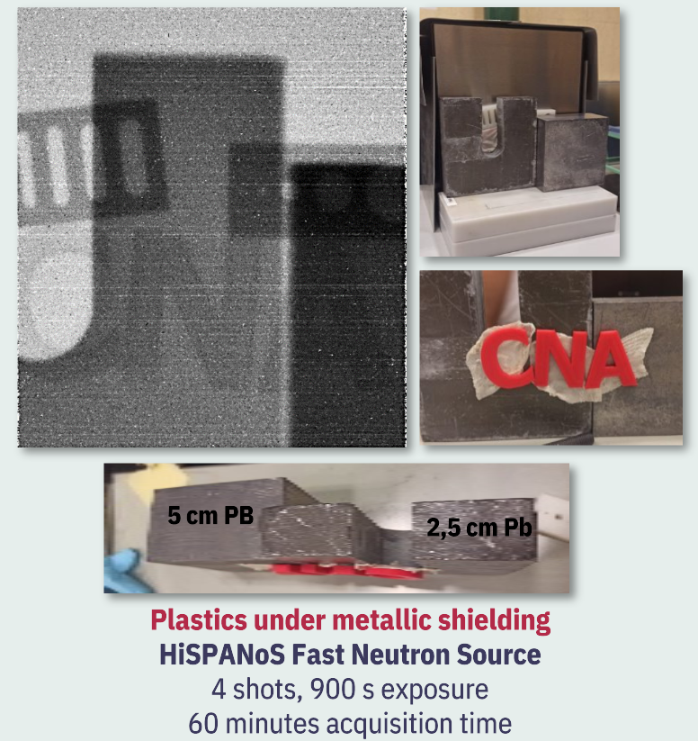
Other results from CNA
Thermal neutrons
Fast neutrons
J.Peñas | 3rd DONES Users Workshop | Zagreb | October 2024

