Slide 1




Deuteron- versus neutron-induced radioisotope production for medicine at IFMIF-DONES
Third DONES Users Workshop, Zagreb
M.E. López Melero* (PhD DONES-UGR)
F. García-Infantes (PhD n_TOF-CERN)
J. Praena (Supervisor)
F. Mota, M.I. Ortíz, I. Porras, F. Arias de Saavedra, A. Roldán
*(melopez@ugr.es)

Slide 2

Index:
The rise of radiopharmaceuticals in Nuclear Medicine
Radioisotope Production at IFMIF-DONES
  Why is it necessary?
  Location of the production at DONES (d and n)
  Nuclear data needs for deuterons and neutrons
  ¹⁷⁷Lu with neutrons at Test Cell: ¹⁷⁶Yb(d,γ)¹⁷⁷Yb→¹⁷⁷Lu
  ¹⁷⁷Lu with deuterons at R026: ¹⁷⁶Yb(d,x)¹⁷⁷Lu
  First prototype of target for deuterons
Conclusions and outlook
Third DONES Users Workshop, Zagreb
M. Elena López Melero

Slide 3
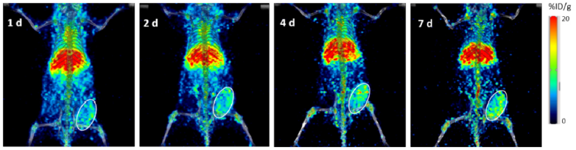
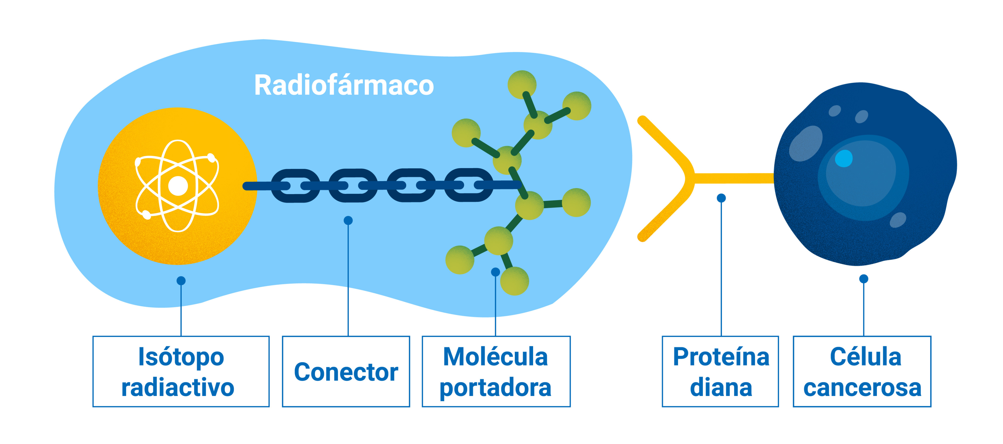
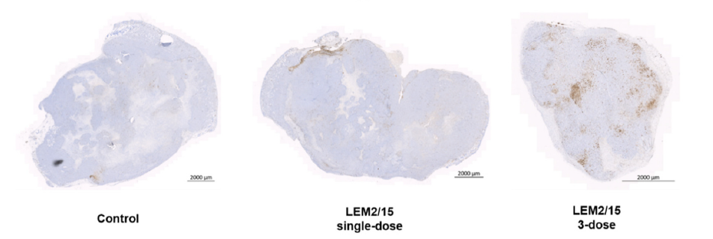
1. The rise of radiopharmaceuticals in Nuclear Medicine
Diagnostic
̴85%
(⁹⁹Mo; ⁸⁹Zr; ¹⁸F)
Radiopharmaceutical
[⁸⁹Zr]Zr-Df-LEM2/15
Therapy
Radioisotope
Linker
Vector
Molecule
Target Molecule
Tumour Cell
(¹³¹I; ⁹⁰Y)
IHQ image corresponding to DNA double-strand break damage as measured by γH2AX-positive cells compared to both the control group, [177Lu]Lu-DOTA-LEM2/15 single-dose and [¹⁷⁷Lu]Lu-DOTA-LEM2/15 3-dose. https://doi.org/10.1016/j.nucmedbio.2024.108930
Third DONES Users Workshop, Zagreb
M. Elena López Melero

Slide 4
1. The rise of radiopharmaceuticals in Nuclear Medicine
Diagnostic
̴85%
(⁹⁹Mo; ⁸⁹Zr; ¹⁸F)
Radiopharmaceutical
[⁸⁹Zr]Zr-Df-LEM2/15
Therapy
Radioisotope
Linker
Vector
Molecule
Target Molecule
Tumour Cell
(¹³¹I; ⁹⁰Y)
Theragnostic
¹⁷⁷Lu !!
IHQ image corresponding DNA double-strand break damage as measured by γH2AX-positive cells compared to both the control group, [177Lu]Lu-DOTA-LEM2/15 single-dose and [177Lu]Lu-DOTA-LEM2/15 3-dose.
Third DONES Users Workshop, Zagreb
M. Elena López Melero

Slide 5
Index:
The rise of radiopharmaceuticals in Nuclear Medicine
Radioisotope Production at IFMIF-DONES
  Why is it necessary?
  Location of the production at DONES (d and n)
  Nuclear data needs for deuterons and neutrons
  ¹⁷⁷Lu with neutrons at Test Cell: ¹⁷⁶Yb(d,γ)¹⁷⁷Yb→¹⁷⁷Lu
  ¹⁷⁷Lu with deuterons at R026: ¹⁷⁶Yb(d,x)¹⁷⁷Lu
  First prototype of target for deuterons
Conclusions and outlook
Third DONES Users Workshop, Zagreb
M. Elena López Melero

Slide 6
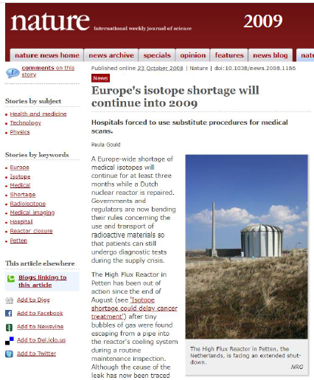
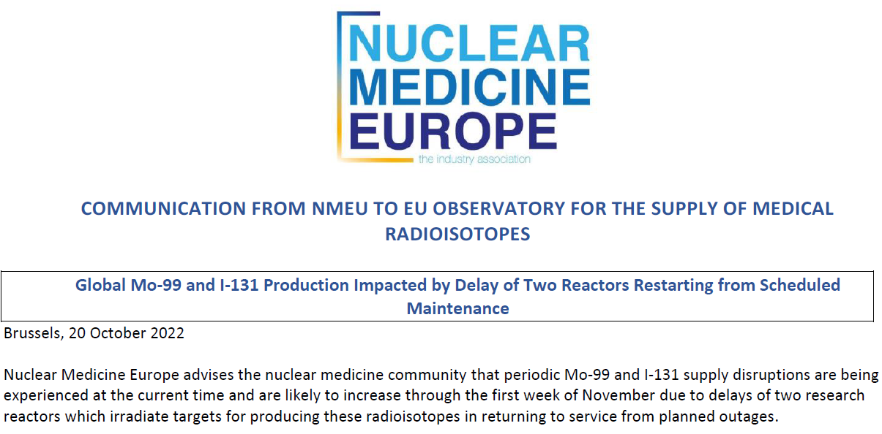
2. Radioisotope Production at IFMIF-DONES
Why is it necessary?
According to the IAEA, more medical isotope facilities are needed to secure supply in the face of growing demand.
Third DONES Users Workshop, Zagreb
M. Elena López Melero

Slide 7
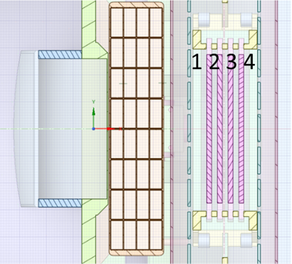
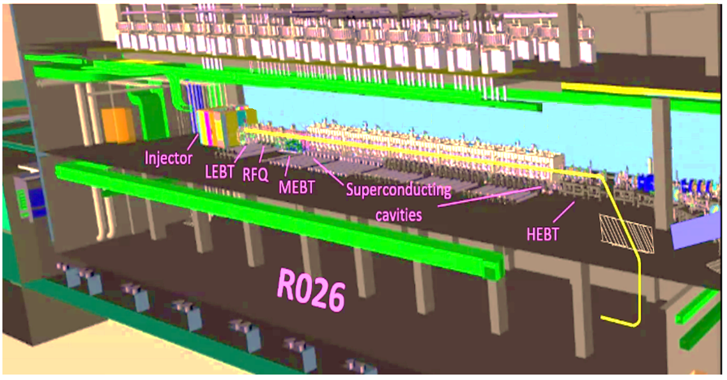
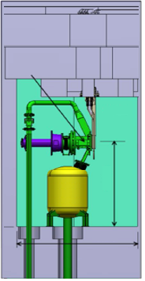
2. Location of the production at DONES (d and n)
Samples inside RIPD
HFTM
D⁺ (40 MeV; 125 mA)
Lithium
Loop
0.1
8.3
Target Assembly
5
13.9
21.3
30.3
40 MeV
HFTM
0.1 %
̴3.3 m
Quench
Tank
D⁺ (40 MeV; 125 µA)
4.0 m
Test Cell Floor
Schematic view courtesy of M. Vázquez
Deuteron Production
Neutron Production
Third DONES Users Workshop, Zagreb
M. Elena López Melero

Slide 8
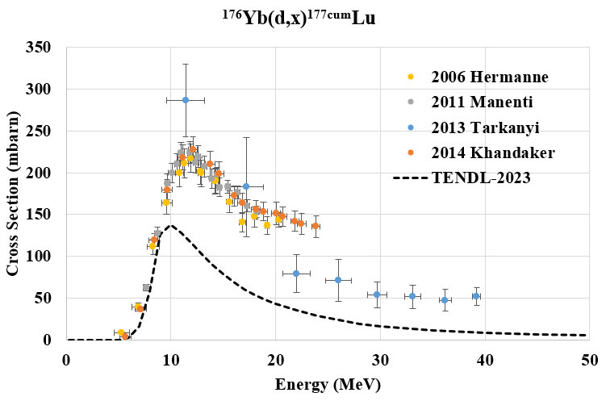
2. Nuclear data needs for deuterons and neutrons
¹⁷⁶Yb(d,x)^{177cum}Lu
Third DONES Users Workshop, Zagreb
M. Elena López Melero

Slide 9
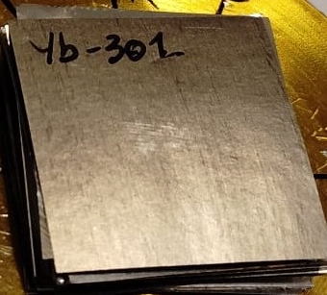
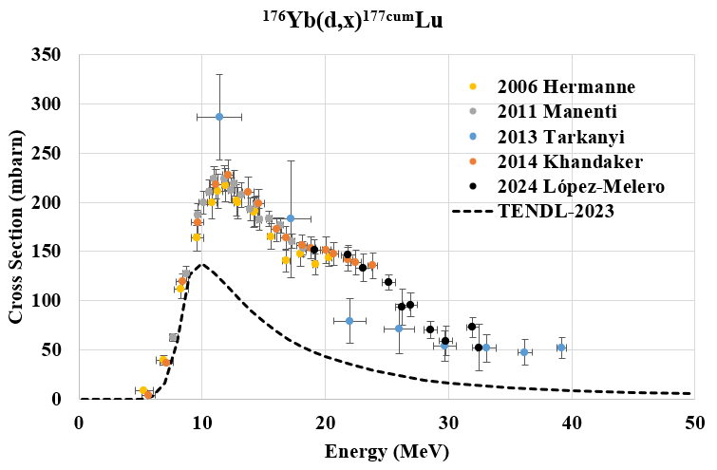
2. Nuclear data needs for deuterons and neutrons
Yb foils
ARRONAX cyclotron (Nantes, France)
¹⁷⁶Yb(d,x)^{177cum}Lu
Experimental data measured by E. López-Melero in collaboration with E. Nigron and F. Haddad. 25.8 MeV deuterons on ^{nat}Yb targets at 100-nA beam intensity.
Third DONES Users Workshop, Zagreb
M. Elena López Melero

Slide 10
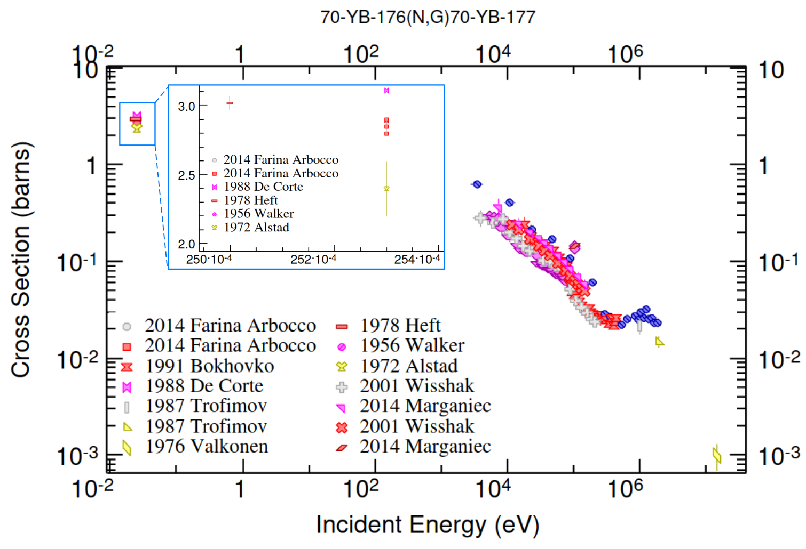
2. Nuclear data needs for deuterons and neutrons
Yb foils
ARRONAX cyclotron (Nantes, France)
¹⁷⁶Yb(n,γ)¹⁷⁷Yb → ¹⁷⁷Lu
¹⁷⁶Yb(d,x)^{177cum}Lu
No resonances resolved
Experimental data measured by E. López-Melero in collaboration with E. Nigron and F. Haddad. 25.8 MeV deuterons on ^{nat}Yb targets at 100-nA beam intensity.
Third DONES Users Workshop, Zagreb
M. Elena López Melero

Slide 11
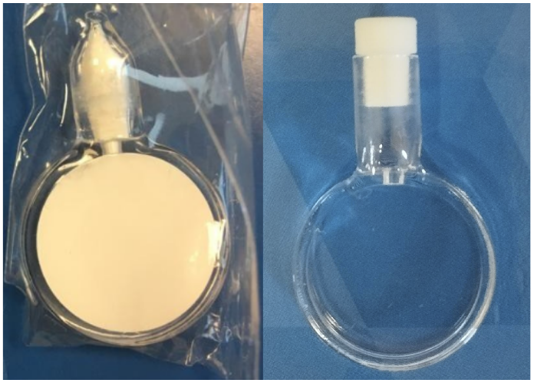
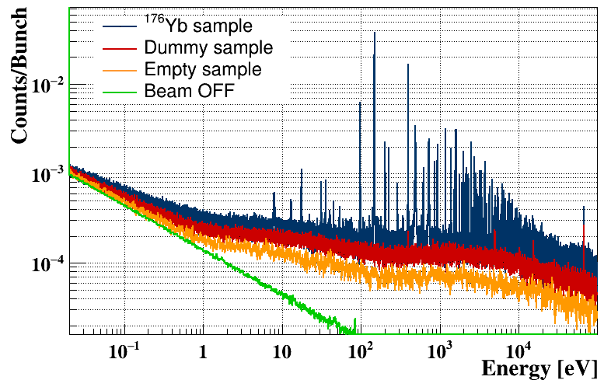
2. Nuclear data needs for deuterons and neutrons
Yb foils
¹⁷⁶Yb₂O₃
ARRONAX cyclotron (Nantes, France)
n_TOF at CERN
¹⁷⁶Yb(d,x)^{177cum}Lu
¹⁷⁶Yb(n,γ)¹⁷⁷Yb → ¹⁷⁷Lu
Experimental data measured by E. López-Melero in collaboration with E. Nigron and F. Haddad. 25.8 MeV deuterons on ^{nat}Yb targets at 100-nA beam intensity.
Experimental data measured by F. García-Infantes at Neutron Time-of-Flight facility (CERN) with enriched ¹⁷⁶Yb₂O₃ (99,43%) sample.
Third DONES Users Workshop, Zagreb
M. Elena López Melero

Slide 12
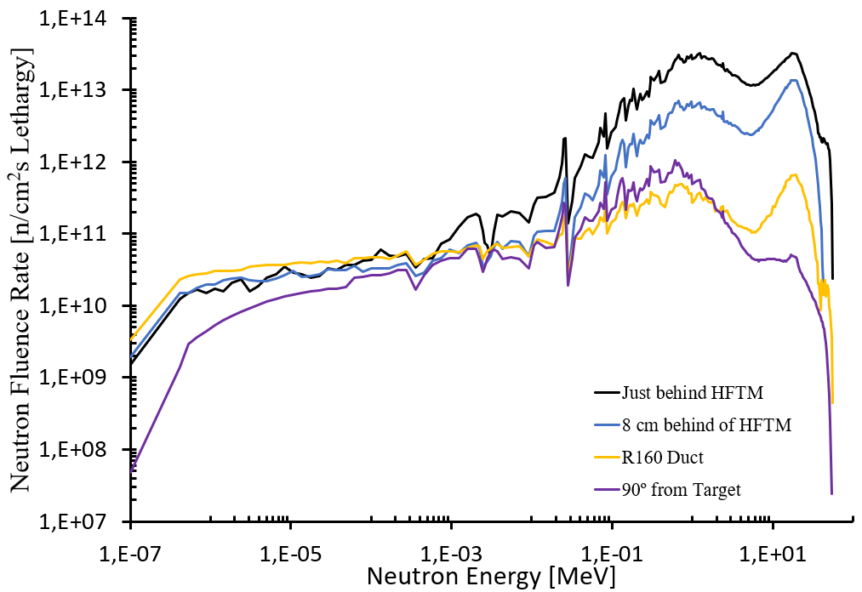
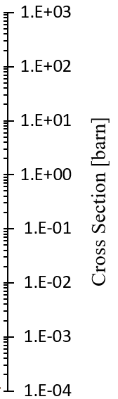

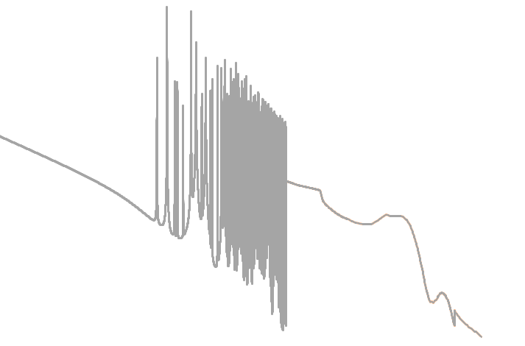
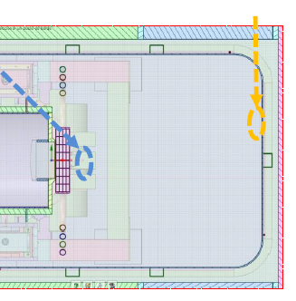
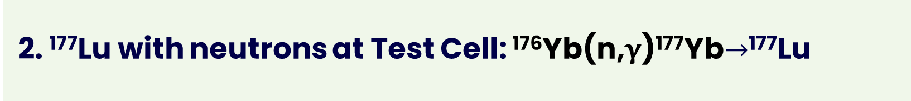
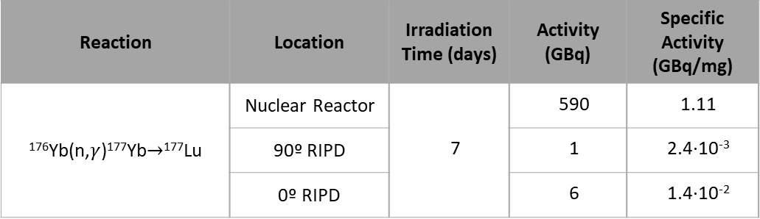
2. ¹⁷⁷Lu with neutrons at Test Cell: ¹⁷⁶Yb(n,γ)¹⁷⁷Yb$→$¹⁷⁷Lu
RadioIsotope Production Device (RIPD)
90º from Target
Inlet of the R160 duct
¹⁷⁶Yb(n,γ)¹⁷⁷Yb
¹⁷⁶Yb₂O₃
8 cm Behind the HFTM
HFTM
Reaction | Location | Irradiation Time (days) | Activity (GBq) | Specific Activity (GBq/mg)
¹⁷⁶Yb(n,$γ$)¹⁷⁷Yb$→$¹⁷⁷Lu | Nuclear Reactor | 7 | 590 | 1.11
 | 90º RIPD |  | 1 | 2.4·10⁻³
 | 0º RIPD |  | 6 | 1.4·10⁻²
Test Cell
Third DONES Users Workshop, Zagreb
M. Elena López Melero

Slide 13
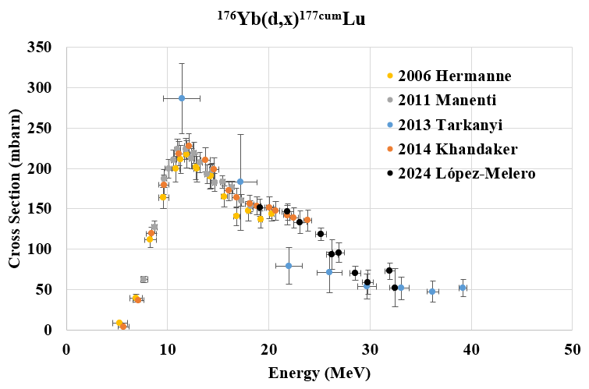
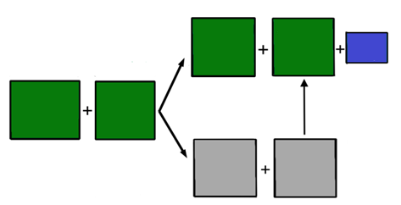
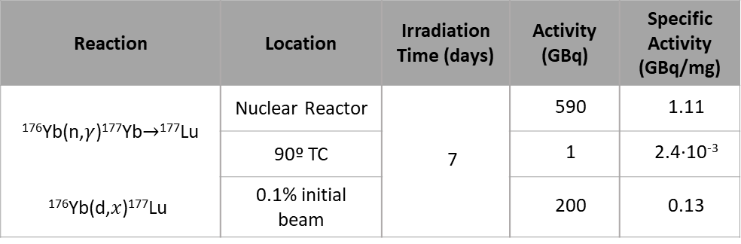
2. ¹⁷⁷Lu with deuterons at R026: ¹⁷⁶Yb(d,𝑥) ¹⁷⁷Lu
Yb foils
¹⁷⁶Yb(d,x)^{177cum}Lu
Direct Route “Carrier added”
n
^{177g}Lu
<0.0037%
n
^{177m}Lu
(160 days)
(6.65 days)
¹⁷⁶Yb
d
(12,7%)
p
¹⁷⁷Yb
(1.9 hours)
Indirect Route “Carrier free”
Reaction | Location | Irradiation Time (days) | Activity (GBq) | Specific Activity (GBq/mg)
¹⁷⁶Yb(n,$γ$)¹⁷⁷Yb$→$¹⁷⁷Lu | Nuclear Reactor | 7 | 590 | 1.11
 | 90º TC |  | 1 | 2.4·10⁻³
¹⁷⁶Yb(d,$x$)¹⁷⁷Lu | 0.1% initial beam |  | 200 | 0.13
Measurements were carried out at the ARRONAX cyclotron (Nantes, France) using 25.8 MeV deuterons on ^{nat}Yb targets at 100-nA beam intensity, in collaboration with E. Nigron and F. Haddad.
Third DONES Users Workshop, Zagreb
M. Elena López Melero

Slide 14
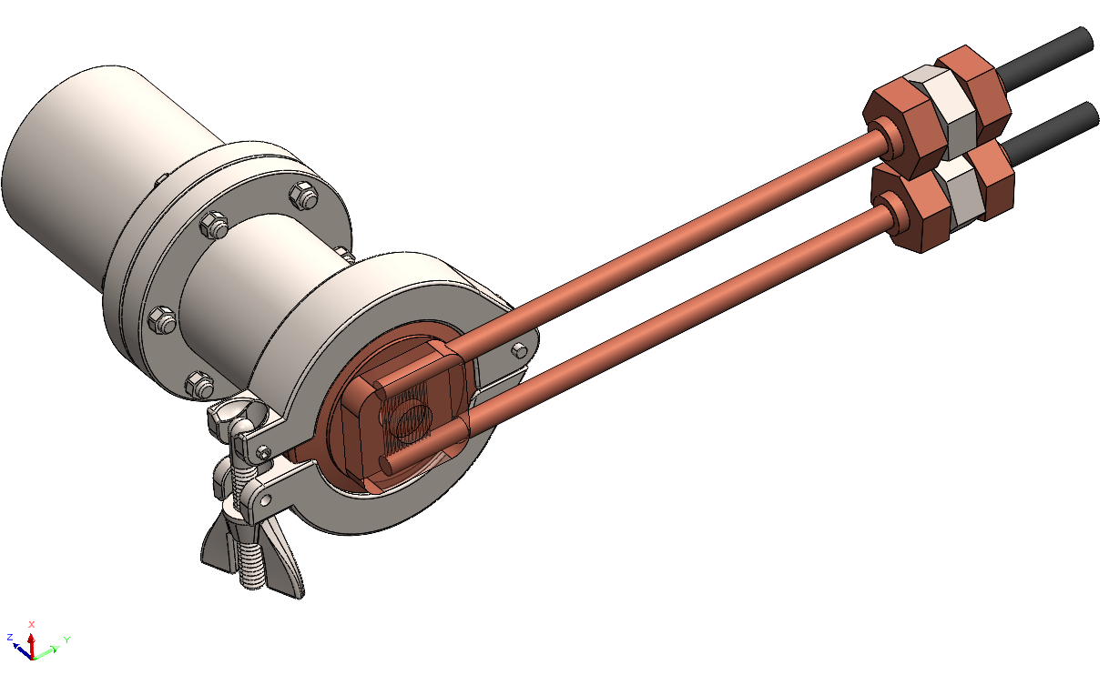
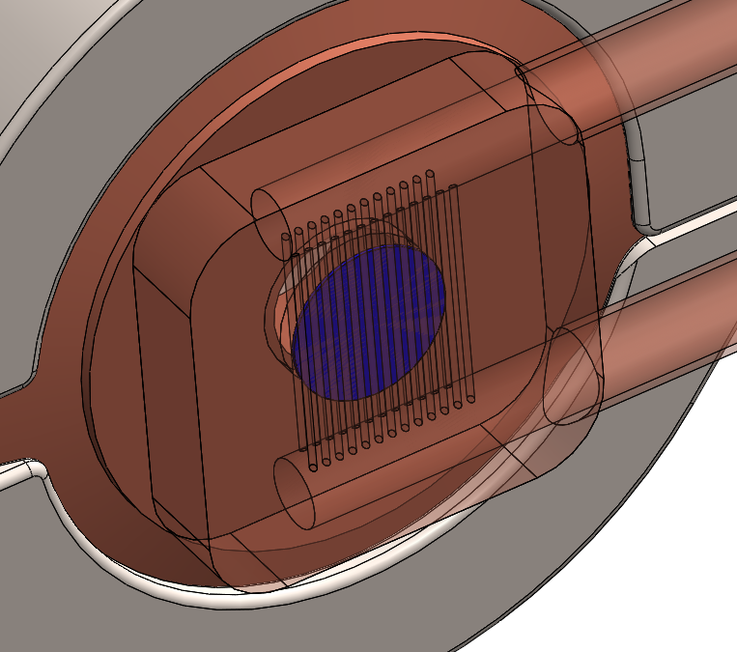
2. First prototype of target for deuterons
Deuteron
Beam (0.1%)
D+ (0.1%)
Inlet Water
¹⁷⁶YbO₃
Oulet Water
¹⁷⁶Yb₂O₃ :
Φ =20 mm, t=0.6 mm
Third DONES Users Workshop, Zagreb
M. Elena López Melero

Slide 15
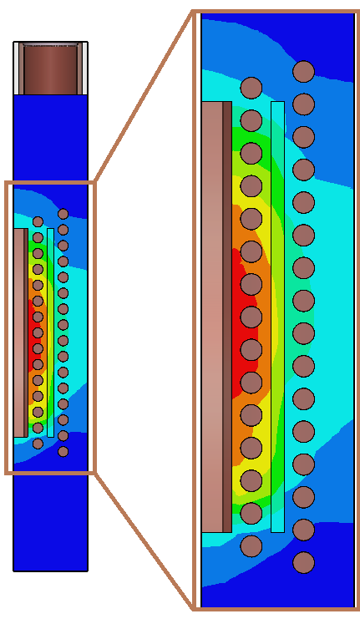
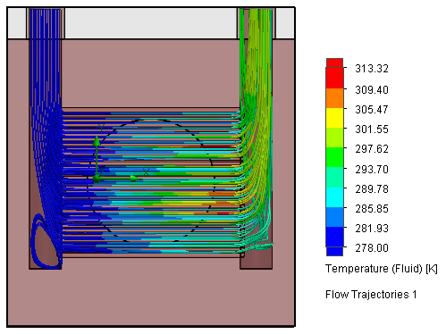
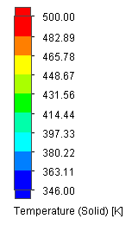
2. First prototype of target for deuterons
Flow Simulation with SolidWorks tools.
Temperature distributions:
Temperatures below melting points !
3.5 l/min Fluid Flow Rate
¹⁷⁶Yb₂O₃ :
Φ =20 mm, t=0.6 mm
Third DONES Users Workshop, Zagreb
M. Elena López Melero

Slide 16
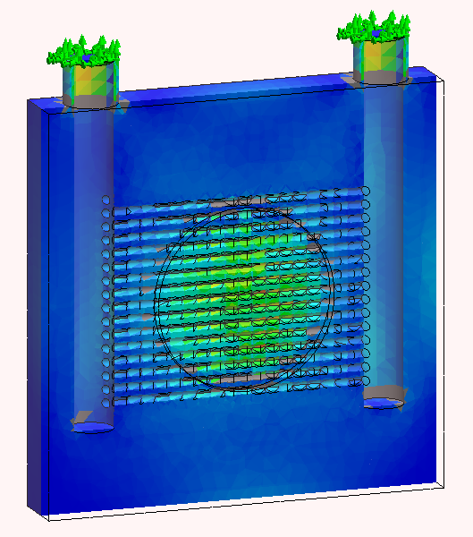
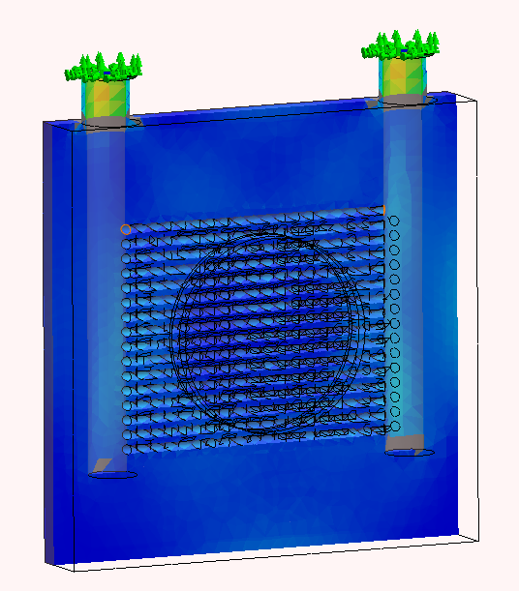
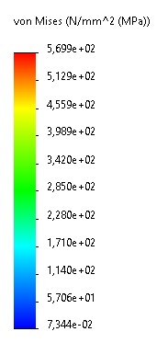
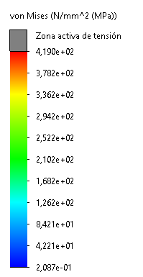
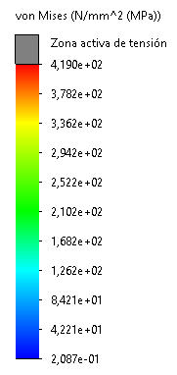
2. First prototype of target for deuterons
Structural Simulation with SolidWorks tools.
Stress studies:
Von Mises stress limit 200-300 MPa for natural copper !
Active stress zone
Active stress zone
Pre-sample cut plot
Post-sample cut plot
Third DONES Users Workshop, Zagreb
M. Elena López Melero

Slide 17
Index:
The rise of radiopharmaceuticals in Nuclear Medicine
Radioisotope Production at IFMIF-DONES
  Why is it necessary?
  Location of the production at DONES (d and n)
  Nuclear data needs for deuterons and neutrons
  ¹⁷⁷Lu with neutrons at Test Cell: ¹⁷⁶Yb(d,γ)¹⁷⁷Yb→¹⁷⁷Lu
  ¹⁷⁷Lu with deuterons at R026: ¹⁷⁶Yb(d,x)¹⁷⁷Lu
  First prototype of target for deuterons
Conclusions and outlook
Third DONES Users Workshop, Zagreb
M. Elena López Melero

Slide 18
3. Conclusions and outlook
The prototype for the production of RI with deuterons allows the encapsulation of the sample and being the first thermal and structural controls carried out with SolidWorks passed.
Taking into account both the 0.1% initial reflection of the deuteron beam and that the activity per treatment dose with conventional radiopharmaceuticals such as [¹⁷⁷Lu]Lu-DOTA-TATE is 7.4 GBq/dose, it would be possible to cover 6 full ¹⁷⁷Lu treatments per week.
IFMIF-DONES can help to reduce the problem of lack of facilities for the production of RI.
Nuclear measurements have been done in order to have a better knowledge about ¹⁷⁷Lu production yield.
Production via deuterons would be competitive with conventional ¹⁷⁷Lu production routes in nuclear reactor
Third DONES Users Workshop, Zagreb
M. Elena López Melero

Slide 19


Thank you for your attention.

Slide 20
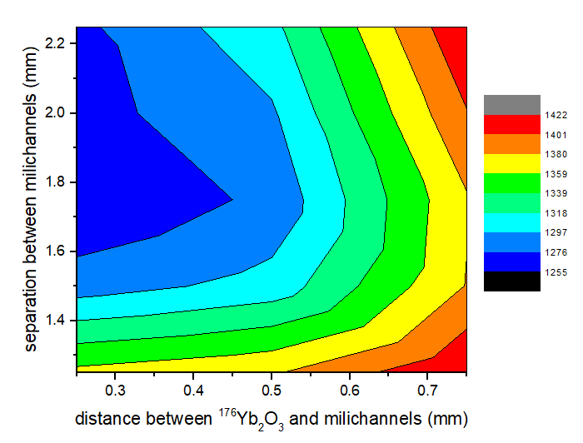
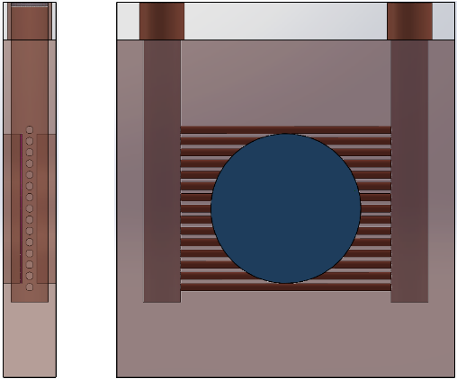
X. Optimisation of Backing design
Inlet Water
Distance between millichannels vs. millichannel-sample distance.
Melting points : ¹⁷⁶Yb₂O₃ , 2628K
Backing, Cu , 1358 K
Oulet Water
Simulation for 1.25 mA
Deuteron
Beam
Temperature (Solid) [K]
Third DONES Users Workshop, Zagreb
M. Elena López Melero

Slide 21
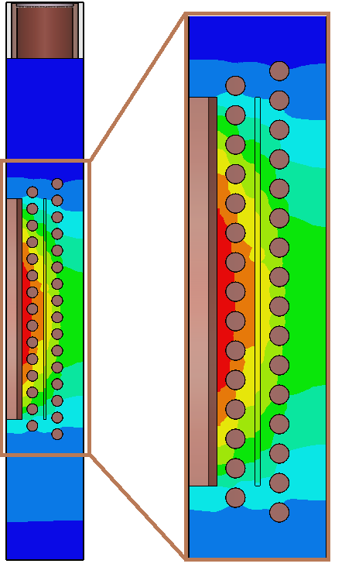
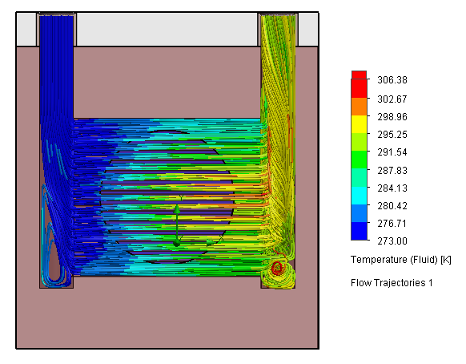
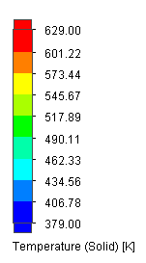
2. Radioisotope Production at IFMIF-DONES
Proposal of realistic targets and cooling system design for deuterons
Flow Simulation with SolidWorks tools.
Temperature distributions:
Temperatures below melting points !
3.5 l/min Fluid Flow Rate
¹⁷⁶Yb₂O₃ :
Φ =20 mm, t=0.25 mm
Third DONES Users Workshop, Zagreb
M. Elena López Melero

Slide 22
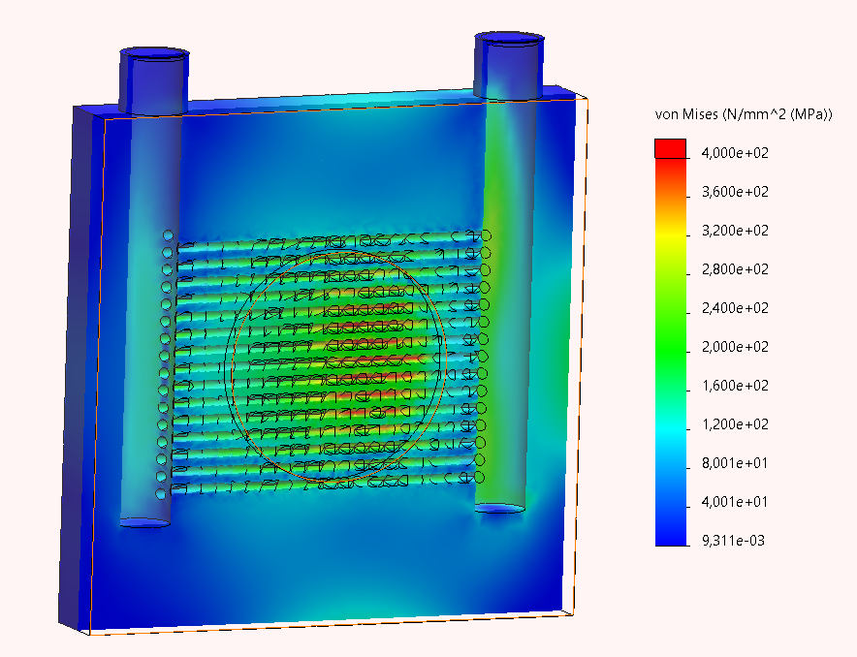
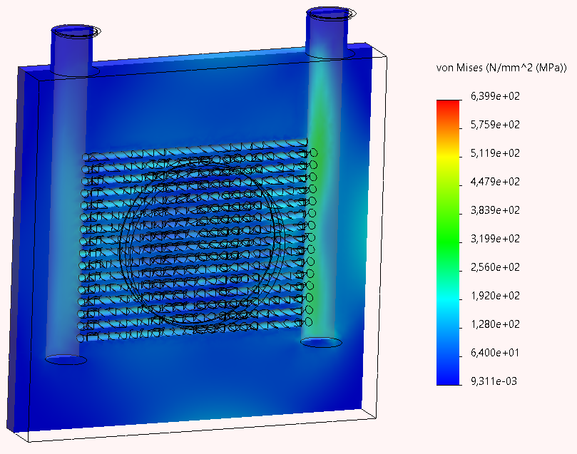
2. Radioisotope Production at IFMIF-DONES
Proposal of realistic targets and cooling system design for deuterons
Structural Simulation with SolidWorks tools.
Stress studies:
Pre-sample cut plot
Post-sample cut plot
Third DONES Users Workshop, Zagreb
M. Elena López Melero

Slide 23
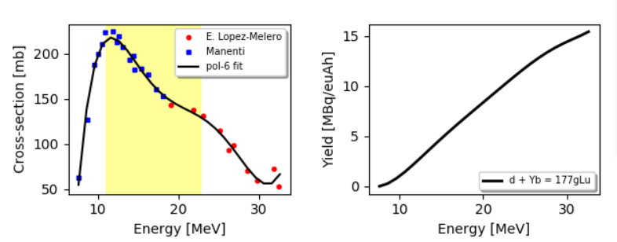
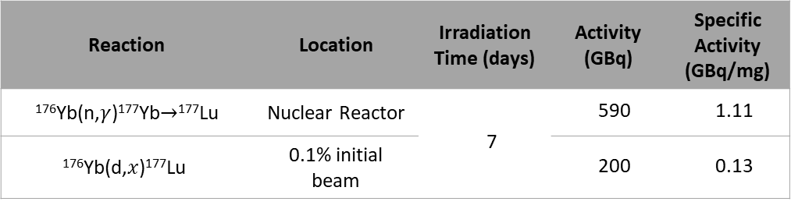
X. ¹⁷⁷Lu Yield with deuterons
600 µm sample thickness
Energy range: [11.0-22.6] MeV
Reaction | Location | Irradiation Time (days) | Activity (GBq) | Specific Activity (GBq/mg)
¹⁷⁶Yb(n,$γ$)¹⁷⁷Yb$→$¹⁷⁷Lu | Nuclear Reactor | 7 | 590 | 1.11
¹⁷⁶Yb(d,$x$)¹⁷⁷Lu | 0.1% initial beam |  | 200 | 0.13
Third DONES Users Workshop, Zagreb
M. Elena López Melero

