Slide 1
3rd DONES User Meeting
1st -2rd October 2024
Zagreb
Technological challenges to supply medical radioisotopes from IFMIF-DONES with neutrons
M.I. Ortiz*, F.Mota, E. López-Melero, I. Porras, J. Praena, M. Alcantud, N. Ballesteros, A. Dilla, E. Fernández, J. Gallo, J.C. Marugan, C. Prieto, I. Cobo, O. Oliva, D. Terán

Slide 2
Outline
What does it mean to obtain 69.80 TBq of molybdenum radioisotope?
Why use the Mo-99 radioisotope for medical use?
How to produce Mo-99 radioisotope?
Why DONES facility? Which is our proposal?
What are the technological challenges in DONES?
What can we conclude?

Slide 3
Outline
What does it mean to obtain 69.80 TBq of molybdenum radioisotope?

Slide 4
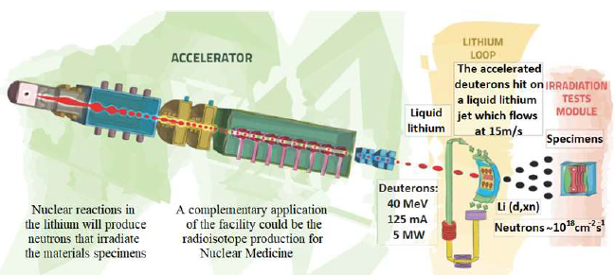
What does it mean to obtain 69.80 TBq of molybdenum radioisotope?
.
Under these irradiation conditions:
→1128 cm³ of Mo target enriched in ¹⁰⁰Mo
→6 days of irradiation
It is possible to produce:
69.80 TBq of ⁹⁹Mo/^{99m}Tc per week
1 2 3 4
But ... What does this number mean?
Is it little or high activity ?
Is it enough? Compared to what?
Notes:
Considering that one ^{99m}Tc generation has about an activity of 46 GBq, which could be equivalent to considering 100 GBq just before taking out the sample.
Taking into account that a hospital could need 2 generators per week, we could supply to 350 hospitals>It means that we could obtain about 700 generators per week
⁹⁹Mo activity obtained in each plate after 6 days of irradiation using an average neutron fluence rate in each plate

Slide 5
Outline
Why use the Mo-99 radioisotope for medical use?

Slide 6
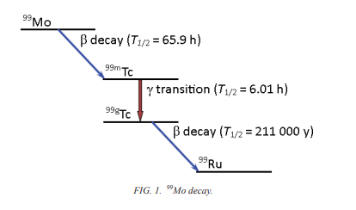
Why use the 99Mo radioisotope for medical use?
⁹⁹Mo is the precursor of Technetium-99m (^{99m}Tc), the most commonly used radioisotope in nuclear medicine diagnostic scans.
^{99m}Tc is used in gammagraphy thanks to its short half-life T_{1/2} (6 h) and the 140 keV γ-ray emission
It is essential for accurate diagnoses of diseases, such as:
cancer
heart disease
and neurological disorders including dementia and movement disorders
Ideal features for imaging and low radiation dose to the patient
Notes:
Technetium-99m (Tc-99m) is the most commonly used radioisotope in nuclear medicine (NM) diagnostic scans. It is essential for diagnostic scans of a broad range of body parts, and thus for accurate diagnoses of diseases, such as cancer, heart disease and neurological disorders including dementia and movement disorders, and effective patient care in health systems of OECD countries. It is also the most common diagnostic radioisotope, estimated to be used in approximately 85% of all nuclear nedicin (NM diagnostic scans worldwide. The properties of Tc-99m, however, make its supply chain complicated. Tc-99m is obtained from radioactive decay of its parent isotope, Molybdenum-99 (Mo-99). Neither of these products can be stored for very long. Mo-99 has a half-life of 66 hours, that is, its radioactivity decreases by half in 66 hours, and the half-life of Tc-99m is only six hours. Therefore, supply is a just-in-time activity, combining a mix of governmental and commercial entities, and requires sufficient capacity for ongoing production of Mo-99 plus a reserve in case of unplanned outages.

Slide 7
Outline
How to produce Mo-99 radioisotope ?

Slide 8
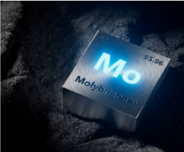
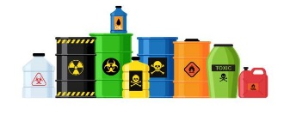
Two different paths to produce ⁹⁹Mo
How to produce Mo-99 radioisotope?
⁹⁸Mo
Enriched target
n, γ
Reactors
Neutron Energy below 7 MeV
95% wordwilde production of Mo-99 ∼
𝞂_{U235}= 581b → High specific activity Mo-99✓
Difficult processing ✘
²³⁵U
HEU / LEU
n, f
γ, n
Accelerators
¹⁰⁰Mo
Enriched target
n, 2n
p , n
Notes:
The cross section of this process has a threshold energy at about 7 MeV. For this reason, this way of production is not reached by conventional reactors.
The ¹⁰⁰Mo(n,2n)⁹⁹Mo reaction induced by neutrons energies higher than 7 MeV has been identified as a possible alternative method to ²³⁵U fission.
Apuntar el nombre del tipo de reacciones: (en ingles)
Captura neutrónica
Fisión

Slide 9
Simplified structure of the Mo-99/Tc-99m supply chain
How to produce Mo-99 radioisotope?
Targets
HEU
Reactors
Mo-99 Processing Facilities
Hospital
Generator facility
LEU
HFR
BR-2
SAFARI-1
OPAL
MARIA
IRE (Belgium)
NTP (South Africa)
ANSTO (Australia)
Covidien (Missouri)
Lantheus (MAssachusetts)
And Others
Pharmacies Hospitals
LVR-15
MURR
RA-3/RA-10
RIAR
KARPOV
Curium
CNEA
MURR/North Star
KARPOV Insitute
Technetium-99m supply is a complex and just-in-time activity, which remains unstable
²³⁵U
⁹⁹Mo
^{99m}Tc
RI-^{99m}Tc
Target irradiation
(5-7 days)
EOB 4.54 Ci
Calibration time
Ci 6-day
1 Ci
Target processing
(1 day)
EOP 4.04 Ci
≃ 12 days
Notes:
Simplified structure of the Mo-99/Tc-99m supply chain
⁹⁹Mo is currently produced in nuclear fission reactors as a by-product of ²³⁵U fission (HEU and LEU)
The number of Ci six days after the end of the production process, which is generally 7 or 8 days from the end of reactor irradiation. Any references to Ci in this publication refer to 6-day Ci, unless specifically stated otherwise.
The supply of Technetium-99m (Tc-99m) requires continuous production in a complicated and aging supply chain that combines a mix of governmental and commercial entities. Governments essentially control both ends of the supply chain, i.e. uranium supply and policy on health care provider payment, as well as the regulatory framework. The central steps of the supply chain are mainly commercial. Tc-99m is obtained from radioactive decay of its parent isotope, Molybdenum-99 (Mo-99). While Mo-99 has a half-life of 66 hours, the half-life of Tc-99m is only six hours. Therefore, these products cannot be stored and supply is a just-in-time activity that requires sufficient capacity for ongoing production plus a reserve in case of unplanned outages. To prepare doses for patient scans, specialised pharmacies, called nuclear pharmacies, elute Tc-99m daily from Mo-99 containers. These containers are called Tc-99m generators and their manufacturers require marketing authorisation by the pharmaceutical regulatory authority responsible for each jurisdiction to sell them. Pharmaceutical companies, which include firms specialised in nuclear medicine as well as large and diversified firms, manufacture and sell Tc-99m generators commercially. They buy Mo-99 in bulk from processing entities that transform irradiated uranium into a Mo-99 liquid used to fill Tc-99m generators. Processors procure uranium as a raw material and contract with nuclear research reactors (NRRs) that perform irradiation services. Figure 1 shows the main steps in the supply chain. NRRs, also referred to as irradiators, have a range of purposes aside from medical isotope production and were not originally designed for the commercial supply of medical isotopes. Their activities include nuclear technology testing, fundamental scientific research and industrial isotope production. Some of these activities are undertaken on a commercial basis; however most commonly they are funded by governments, in part or in full.

Slide 10
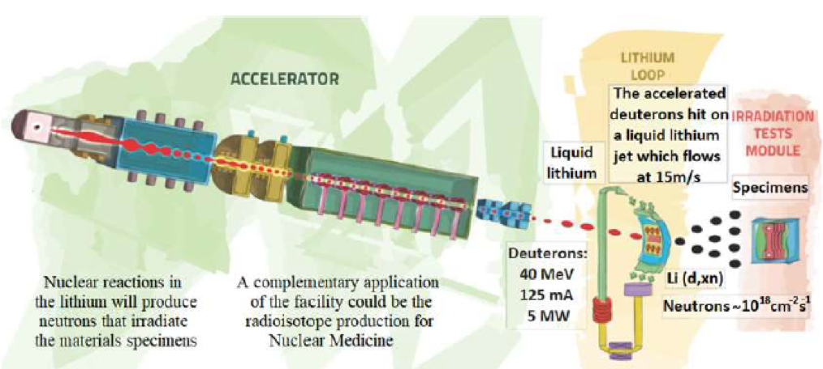
Two different paths to produce ⁹⁹Mo
How to produce Mo-99 radioisotope?
⁹⁸Mo
Enriched target
n, γ
Reactors
Neutron Energy below 7 MeV
95% wordwilde production of Mo-99 ∼
𝞂_{U235}= 581b → High specific activity Mo-99✓
Difficult processing ✘
²³⁵U
HEU / LEU
n, f
γ, n
¹⁰⁰Mo(n,2n)⁹⁹Mo → possible alternative method to ²³⁵U fission ✓
𝞂_{Mo100}= 1.5 b (∼14 MeV) , threshold about 8 MeV → Low specific activity (Need to recover the target) ✘
Easier processing ✓
Accelerators
¹⁰⁰Mo
Enriched target
n, 2n
p , n
It could be on Dones facility!
Notes:
The cross section of this process has a threshold energy at about 7 MeV. For this reason, this way of production is not reached by conventional reactors.
The ¹⁰⁰Mo(n,2n)⁹⁹Mo reaction induced by neutrons energies higher than 7 MeV has been identified as a possible alternative method to ²³⁵U fission.
Apuntar el nombre del tipo de reacciones: (en ingles)
Captura neutrónica
Fisión

Slide 11
Outline
Why DONES facility?
Which is our proposal?

Slide 12
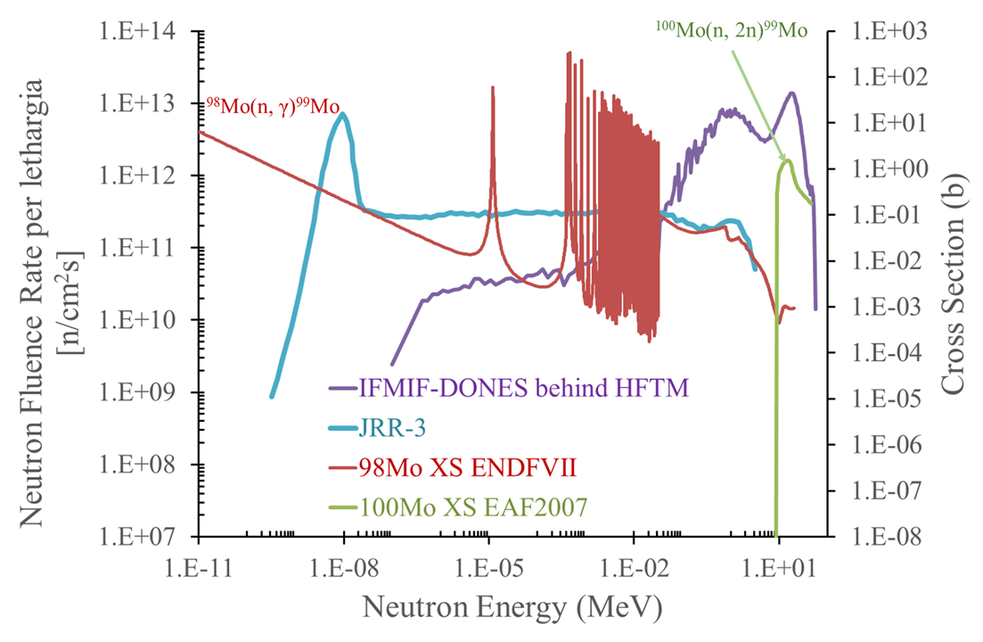
Why to get Mo-99 at DONES?
F. Mota et all, IN-DTF-DONES-EVO-T1-1 (“=“”)
The neutron flux reactor could not achieve the threshold of 8 MeV
The neutron flux peak of DONES coincides with the peak cross section of ¹⁰⁰Mo(n, 2n)⁹⁹Mo
⁹⁸Mo(n, γ)⁹⁹Mo
1.17 %
¹⁰⁰Mo(n, 2n)⁹⁹Mo
98.83 %
Notes:
The cross section of this process has a threshold energy at about 7 MeV. For this reason, this way of production is not reached by conventional reactors.
The ¹⁰⁰Mo(n,2n)⁹⁹Mo reaction induced by neutrons energies higher than 7 MeV has been identified as a possible alternative method to ²³⁵U fission.
Los neutrones de DONES (línea morada HFTM) tienen energías mayores que los reactores (línea azul clara).
En esta gráfica lo que se debe mostrar es que con IFMIF-DONES podemos alcanzar una reacción nuclear que con los reactores de fisión no podemos, porque los reactores de fisión, en el mejor de los casos, tenemos neutrones hasta 7 MeV, y como la reacción de 100Mo es una reacción umbral en 8 MeV, pues no es alcanzable por esta via. Pero IFMIF DONES, como aparece en la gráfica tiene un espectro muy energético que además tiene un pico muy pronunciada en el máximo de la sección eficaz de producción de 99Mo a través del 100Mo.
Con la línea azul se muestra un espectro de neutrones de un reactor típico de fisión y se ve claramente que está perfectamente bien situado para producir 99Mo con la reacción del 98M, pero no llega a alcanzar la sección eficaz del 100Mo. Y la línea morada muestra el espectro de IFMIF-DONES detrás del HFTM, y se ve que está en la zona apropiada para producir 99Mo.

Slide 13
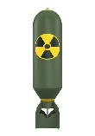
Current irradiators worldwide 2023
Reactor (Fuel) | Current targets | Anticipated ⁹⁹Mo production weeks/year | Expected available capacity per week (6-day Ci ⁹⁹Mo) | Estimated end of operation
BR-2 (HEU) | LEU | 29 | 8 600 | 2036
HFR (LEU) | LEU | 38 | 6 200 | 2030
LVR-15 (LEU) | LEU | 30 | 3 000 | 2028
MARIA (LEU) | LEU | 36 | 2 200 | 2040
MURR (HEU) | EnMo in CRR | 52 | 3 000 | 2037
OPAL (LEU) | LEU | 44 | 3 200 | 2057
RA-3/RA-10 (LEU) | LEU | 46 | 500 | 2027 or earlier based on RA-10 introduction
SAFARI-1 (LEU) | LEU | 44 | 3 000 | 2030
RIAR (HEU) | HEU | 50 | 540 | At least until 2025
KARPOV5 (HEU) | HEU | 48 | 350 | At least until 2025
Notes: EnMo = Enriched Mo98 target, HEU >20% enriched Uranium, LEU <20% enriched Uranium
Reference: OECD/NEA (2023), The Security of Supply of Medical Radioisotopes, OECD Publishing, Paris.
69,80 TBq ¿6-day Ci?
1 Ci = 37 GBq
1Ci=4.54 EOB
69800/(37x4.54) =
415 Ci 6-day
415 Estimated available capacity per week
(6-day Ci ⁹⁹ Mo)
DONES
Enriched ¹⁰⁰Mo target
DONES could be a medium scale producer (200 to 1000 6-day Ci per week )
Notes:
Anticipated ⁹⁹Mo production weeks/year >Producción prevista de 99 Mo de semanas/año
As noted, the majority of major producers of Mo-99 used neutrón fiddióm of U235, in order to maximize their Mo-99 yield, they have historically used HEU targets. For several reason, the internationalcommunity has called on all producers , both, najor and small sacale, to shift to Non-HEU technologies when producing Mo-99
Regionally based includes neighboring countries

Slide 14
Projected demand ⁹⁹Mo Irradiation and processing capacity wordwide
2018 and 2022 > shortages
REDUCED THE LEVEL OF RESERVE IRRADIATION CAPACITY IN EUROPE
Irradiation capacity
Processing capacity
Conversion to LEU targets
Unplanned outage of BR-2 reactor
NEA demand + 35% OCR
(Outage Reserve Capacity)
NEA demand
Major global ⁹⁹Mo shortage in Europe could be happening again in the future →
Reference: OECD/NEA (2023), The Security of Supply of Medical Radioisotopes, OECD Publishing, Paris.
Notes:
Figure shows:
Red line> global NEA demand estimated NEA for ⁹⁹Mo Irradiation and processing capacity wordwide
Green line > global NEA demand estimated NEA for ⁹⁹Mo Irradiation and processing capacity wordwide * ORC (Outage Reserve Capacity)
Blue line>Projected current irradiation capacity
PinlK line> Projected current processing capacity
The Figure also shows the reduction in irradiation capacity (blue line) experienced in 2018 and recovery in 2019. The futher increase in irradiation capacity from 2020 is mainly due to increases in irradiation capacity per week and the number oeraing days available at the BR-2 reactor,
The January-June period shows a mild decline due to the unplanned outage of HFR reactor and the July –december 2022 period shows the significant impact of unplanned outage of BR-2 reactor.
The sharp reduction in irradation capacity in the July –December 2022 periode was partially because the BR´2 Has a very high individual irradiation capacity, Thos Substantial unplanned loss in capcity was compounded by planned maintenance in the july –december period a t both the LVR-15 and the MAROA reactor, ><< THIS SIGNIFICANTLY REDUCED THE LEVEL OF RESERVE IRRADIATION CAPACITY IN EUROPE.
2022 > extended planned maintenance and unplanned outages led to significand global shortages of 99Mo
European Network > A single reactor had been scheduled to operate, but unplanned outages led whith no irradiation capacity ==> Directly blocks significant 99Mo processing Capacity, leading to global supplay shortagess
End 2022> 10 000 6-day Ci 99Mo per week at
During 2023 > Good progres has been made in the conversión from production using HEU targets to production using LEU

Slide 15
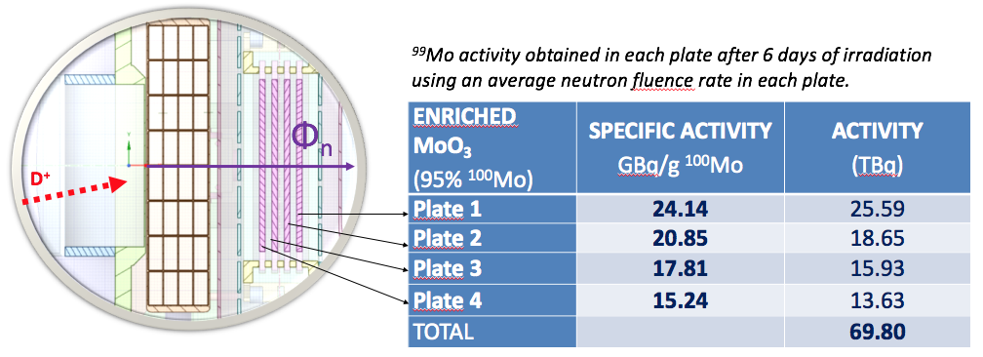
PROPOSAL of lateral mechanical sample insertion device for Radioisotope production
What technological challenges are there?
Proposal DONES EVO PROJECT (2021-2024)
Automatic insertion of samples ✓
Made flexible by using programmable irradiation time ✓
Thus enabling the exploitation of other isotopes, too. ✓
TC de DONES
Shielding plug during irradiation
¹⁰⁰Mo simple holder
Shielding plug during samples extraction
The proposed technical solution implies a change in the design of the IFMIF-DONES test cell ✘
Shielding plug during samples extraction
Notes:
The ⁹⁹Mo production in IFMIF-DONES using our proposed configuration has potential industrial and commercial interest, provided that:
The Mo target is located behind the HFTM, where the highest neutron flux is available
The Mo target is isotopically enriched in ¹⁰⁰Mo, with a 1128cm³ irradiation volumen
6 days of irradiation ΣActivity= 69.80 TBq
Parasitic application of leftover neutron flux after primary use
Under these conditions, it is possible to produce ~ 69.80 TBq de ⁹⁹Mo/^{99m}Tc, which would cover 40% of the needs of the European Union. ( Production per week)
The proposed technical solution to achieve these results implies a change in the design of the IFMIF-DONES test cell, by adding an automatic insertion of samples, made flexible by using programmable irradiation time, thus enabling the exploitation of other isotopes, too.

Slide 16
INDEX
What are the technological challenges in DONES?

Slide 17
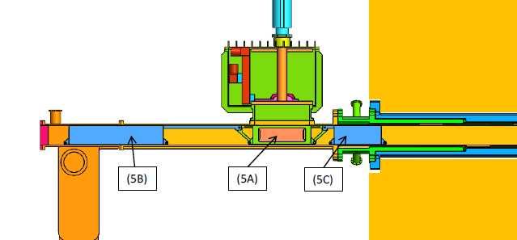
Preserve the He atmosphere and the low pressure of Test Cell
What are the technological challenges in DONES?
First challenge
EAI, report 092-514-E-A40-00001 (2023)
Atmosphere outside Test Cell
He atmosphere, low pressure
Exterior continuity duct of the "Liner"
Through hole in CT
Atmosphere
inside Test Cell
concrete
concrete
Cooling He inlet gaps
Room conditions
Conduit assembly plus transportation guide
BOX TRANSFER
On construction ✓
Material gasket✓
Future test of protocol to test work out of pressure ✓
Notes:
Un carro de transporte de placas (5A),
Un carro exterior (5B) de apantallado frente a la radiación durante operación,
Un carro interior (5C) de apantallado frente a la radiación durante la operación de transferencia.

Slide 18
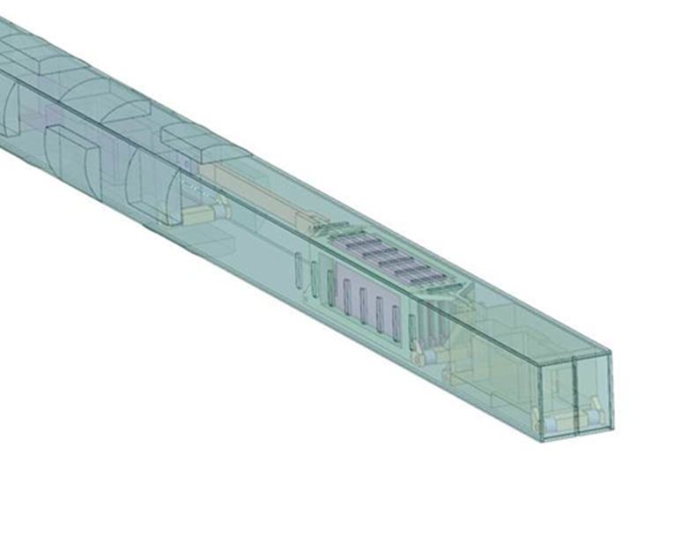
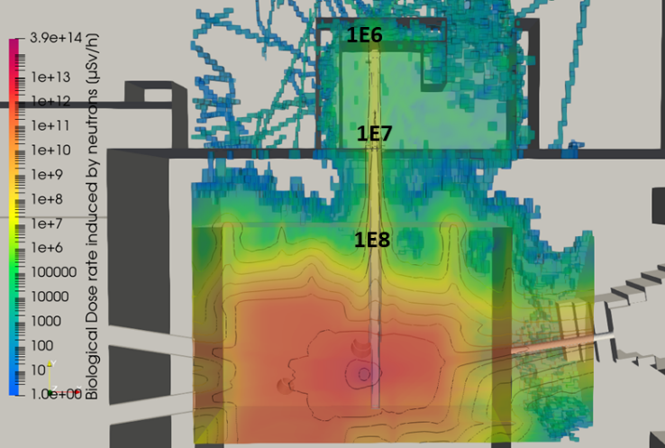
LOSS OF NEUTRONIC FLOW THROUGH THE DUCT
What are the technological challenges in DONES?
Second challenge
Atmosphere
outside TC
Atmosphere
inside TC
concrete
The current design produces an inacceptable neutron flux ✘
→ needs improvement in 2025
NEUTRON LEAK > next Works:
Reduction of the duct diameter
Modify the shape of the inlet tube shield
Check other materials
To improve the design
F.Mota at all., IN-DTF-DONES-EVO-T4, 2024
1st-2nd October 2024
M.I. Ortiz Third DONEs USERS
18
Notes:
INTOLERABLE> NOT ALLOWED FORBIDDEN
BLINDAJE NEUTRÓNICO> NEUTRON SHIELDING

Slide 19
ABOUT THE TARGET
What are the technological challenges in DONES?
Third challenge
TARGET
Purification of ^{99m}Tc post-irradiation
Recovery of non-transmuted ¹⁰⁰Mo
¹⁰⁰Mo synthesis and production
It is on going but very little development so far
ULTRALUTE concentrator device;
ULTRALUTE concentrator device inline-coupled with a 99mTc generator.
MEK extraction of 99mTc using a tandem sorbent column system for nonevaporation removing of MEK from the extracted 99mTc-MEK phase.

Slide 20
Outline
What can we conclude?

Slide 21
What can we conclude?
DONES HAS GREAT POTENTIAL for RADIOISOTOPE PRODUCTION
Could be a medium scale producer (200 to 1000 6-day Ci)
Possible reinforcement of the supply of radioisotopes in Europe
DEEPENING INTO OTHER ASPECTS IS NEEDED
Improve the design
Overcome all the technological challenges presented
THE COST / BENEFIT RELATIONSHIP IS GOOD ENOUGH
Processing facilities
Target
Issues

Slide 22
Thanks you for your attention
Any answer?
Any answer?
Any answers, please?
Any answer?
Any answer?

Slide 23
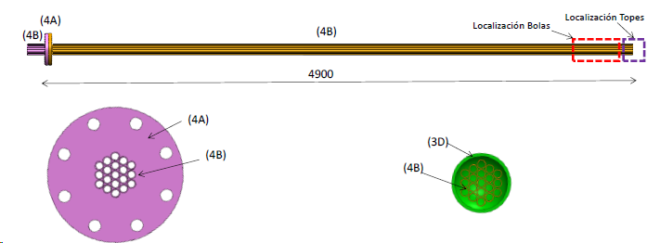
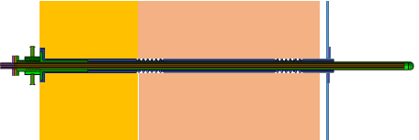
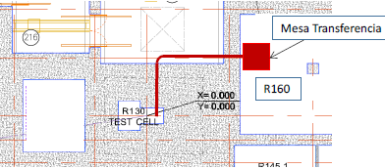
X-Proposal C
Proposals of concepts design for the RIPD
PROPOSAL 2: lateral sample insertion using a Rabbit system
Transverse duct for sample
Inside the duct there are several smaller ducts to transport the spherical specimens. Inner diameter of the duct could be 13 mm
Transference table
Spherical specimens of 10.5 mm diameter
No > pero la vista en planta igual la salvo

Slide 24
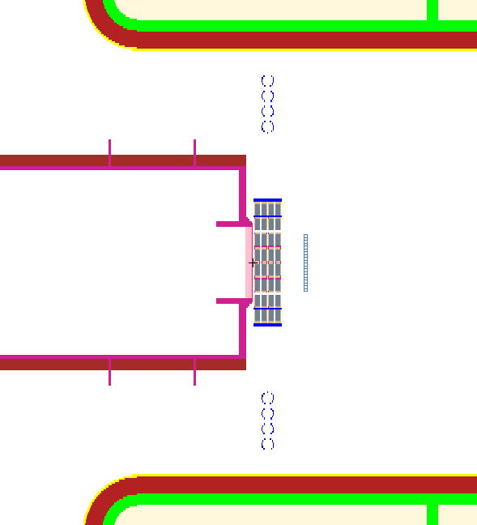
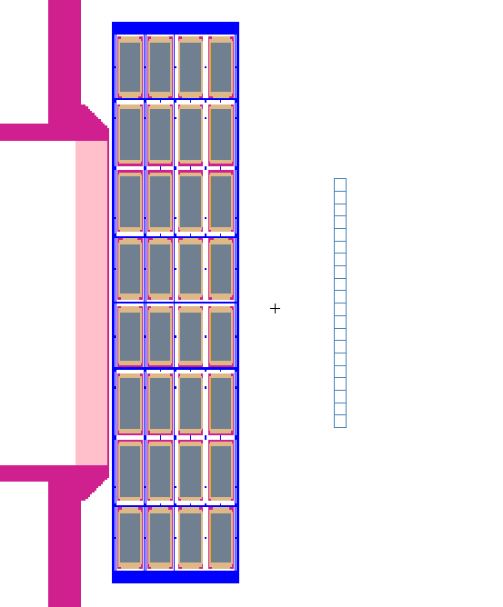
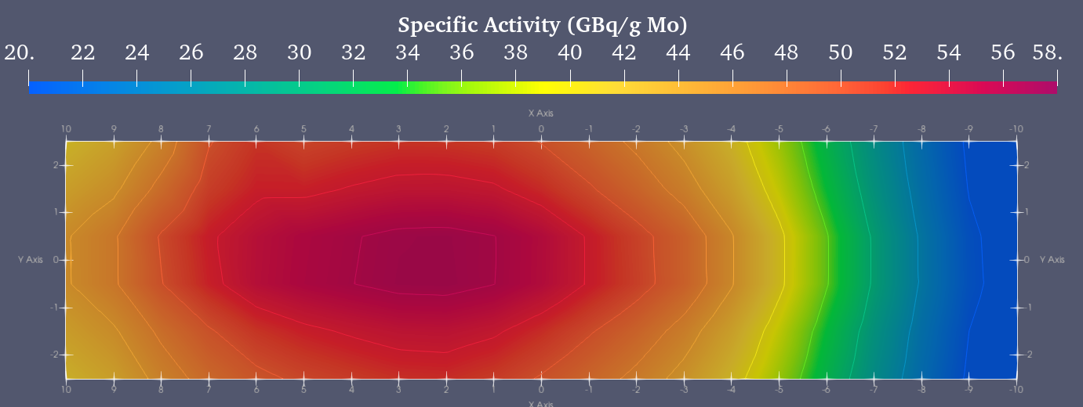
Assessment of the ⁹⁹Mo production in IFMIF-DONES
Sensitivity analysis of the ⁹⁹Mo production behind of HFTM
No >pero dejo por si necesito algo
Mesh used for Neutron spectra calculation
~8 cm
20 cm
Considering an average production of 44 GBq/g in the Mesh and taking into account a density of 3.17 g/cm³ of Mo in 4.69 g/cm³ of ¹⁰⁰MoO3 and mesh volume of 100 cm³, the total activity reached of ⁹⁹Mo would be about 14 TBq after 6 days of irradiation.
It would supply ⁹⁹Mo generators to cover the demand of Andalucía (100 GBq per ^{99m}Tc generator)

Slide 25
X-Decay EOB
6 días
Notes:
The quantity of 99Mo avaible for sale froman irradiated target is much less than the total quantuty of mo99 produced oin target because of radiactive decay and process losses. Standar industry practice is is to sell bulk mo99 on the basis of calibrated '6day curie', which is nominally the quantity of mo99 remaining 6 days after the 99Mo leaves the producer´s facility. mo99 has a 65,94 hour half-life.
To have one curie (37 GBq) remaining after six days of decay, a producer must ship 4,54 Ci (168 Bq). The production cicle of Mo99 ilustarting growth durong irradation follwed by losses due ti cehmical processing and radioactive decay is presented below.
Español> La cantidad de 99Mo disponible para la venta en un objetivo irradiado es mucho menor que la cantidad total de mo99 producido en el objetivo debido a la desintegración radiactiva y las pérdidas de proceso. La práctica industrial estándar es vender mo99 a granel sobre la base de un "curie de 6 días" calibrado, que nominalmente es la cantidad de mo99 restante 6 días después de que el 99Mo sale de las instalaciones del productor. El mo99 tiene una vida media de 65,94 horas.
Para que quede un curie (37 GBq) después de seis días de desintegración, un productor debe enviar 4,54 Ci (168 Bq). A continuación se presenta el ciclo de producción de Mo99, que ilustra el crecimiento inicial durante la irradiación seguido de pérdidas debido al procesamiento químico y la desintegración radiactiva.

Slide 26
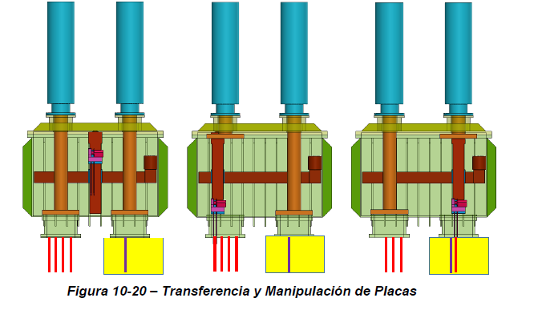
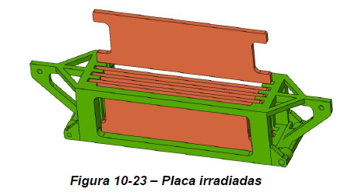

Slide 27
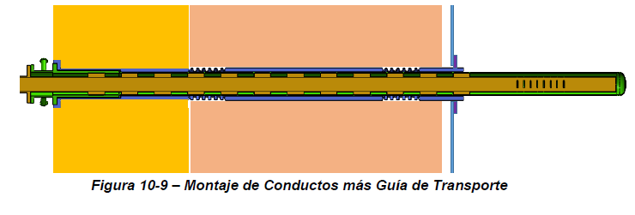
Preserve the atmosphere of Test Cell
What are the technological challenges in DONES?
First challenge
J. Gallo et all. ’Diseño Conceptual del Sistema de Producción de Radio-Isótopos con Fines Médicos’, 092-514-E-A40-00001, EAI,(2023)
Through hole in CT
Exterior continuity duct of the "Liner"
Radiological shielding blocks
Cooling He inlet gaps
Atmosphere outside TC
Atmosphere inside TC
27
Notes:
Agujero pasante en la TCThrough hole in CT
Guia de Transporte>Transportation Guide
Montaje de conductos más guia de Transporte>Conduit assembly plus transportation guide
bloques de blindaje radiologico >radiological shielding blocks
Conducto continuidad exterior del "Liner“>Exterior continuity duct of the "Liner“
Huecos de entrada de He de refrigeración > Cooling He inlet gaps

Slide 28
LOSS OF NEUTRONIC FLOW THROUGH THE DUCT
What technological challenges are there?
Second challenge
F.Mota at all., IN-DTF-DONES-EVO-T4, 2024

