Slide 1
Gamma spectroscopy of the nuclei produced
in fast-neutron-induced fission reaction
(at DONES)
Ł. W. Iskra
on behalf of the group from
Institute of Nuclear Physics PAN, Krakow, Poland
W. Królas, A. Maj, B. Fornal, K. Gajewska, et al., …
Third DONES User´s Workshop, Zagreb October 1-2, 2024.

Slide 2
Outline:
Nuclear structure and gamma spectroscopy
Gamma spectroscopy of fission products
- spontaneous fission
- thermal-neutron-induced fission
- fast-neutron-induced fission
Fission experiments at DONES – concept and uniqueness

Slide 3
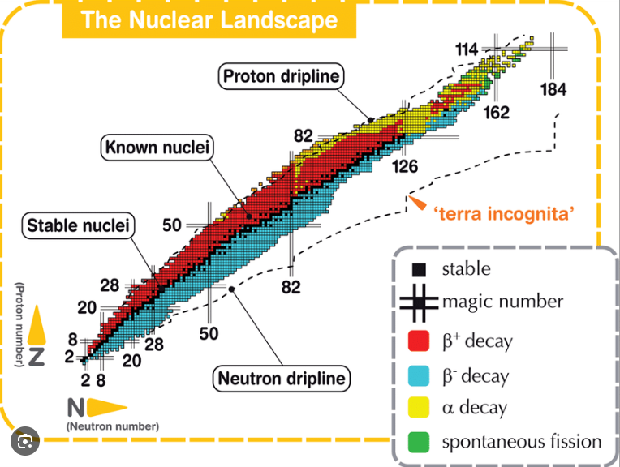
300 stable nuclei
3000 known nuclei
7000 predicted nuclei
Mass
Half-life
Decay mode
Courtesy of Alessio Galata
Shapes
How protons and neutrons are arranged and
how they interact with each other

Slide 4
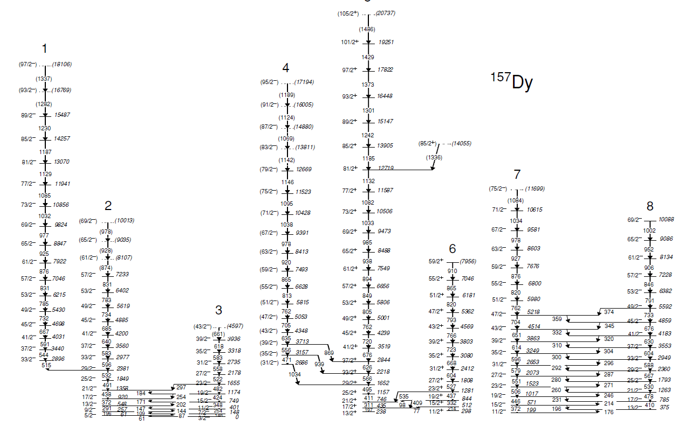
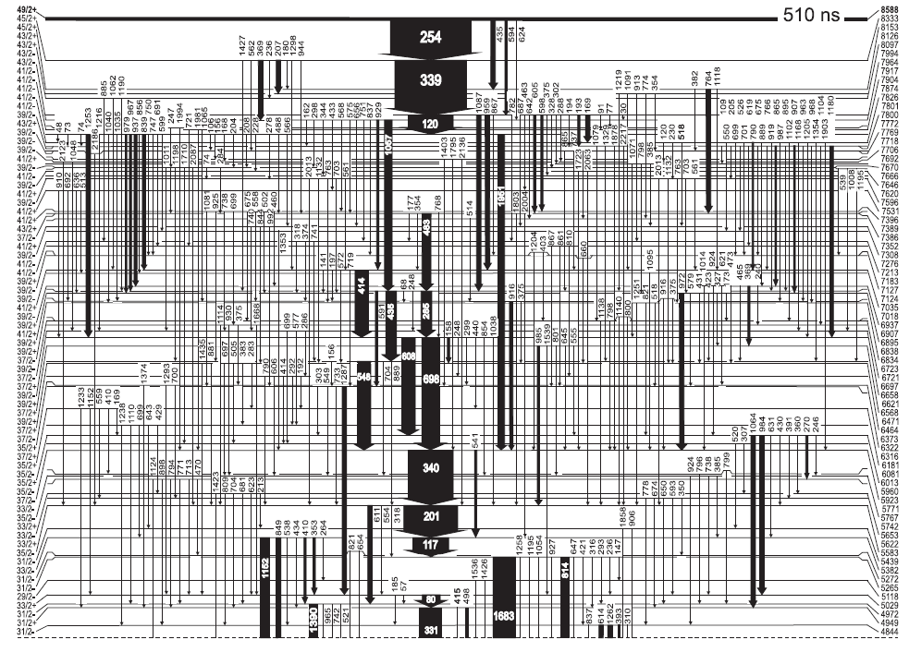
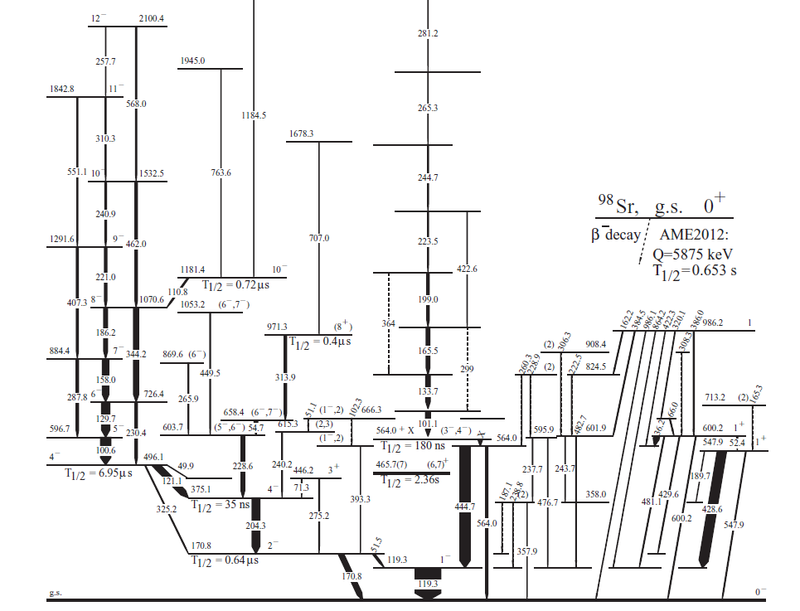
A. Pipidis et al., PRC 72, 064307 (2015)
R. Broda et al., PRC 101, 064320 (2020)
¹⁵⁷Dy
¹⁴⁷Gd
⁹⁸Y
180 ns
7 µs
W. Urban (Ł.W. Iskra) et al.., PRC 96, 044333 (2017)

Slide 5
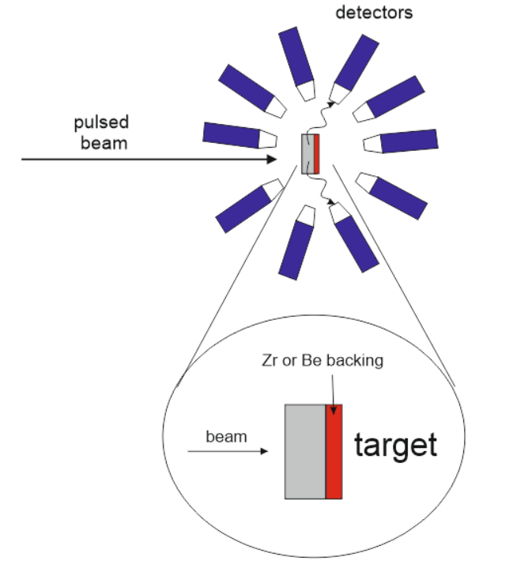
Typical experimental setup and requirements
Pulsed beam ( few ns width; hundreds ns repetition time)
- reaction tag
Thick target (or backing) – doppler free detection
Detectors :
- HPGe – discrete gamma-ray spectroscopy
- LaBr₃ – lifetimes measurement

Slide 6
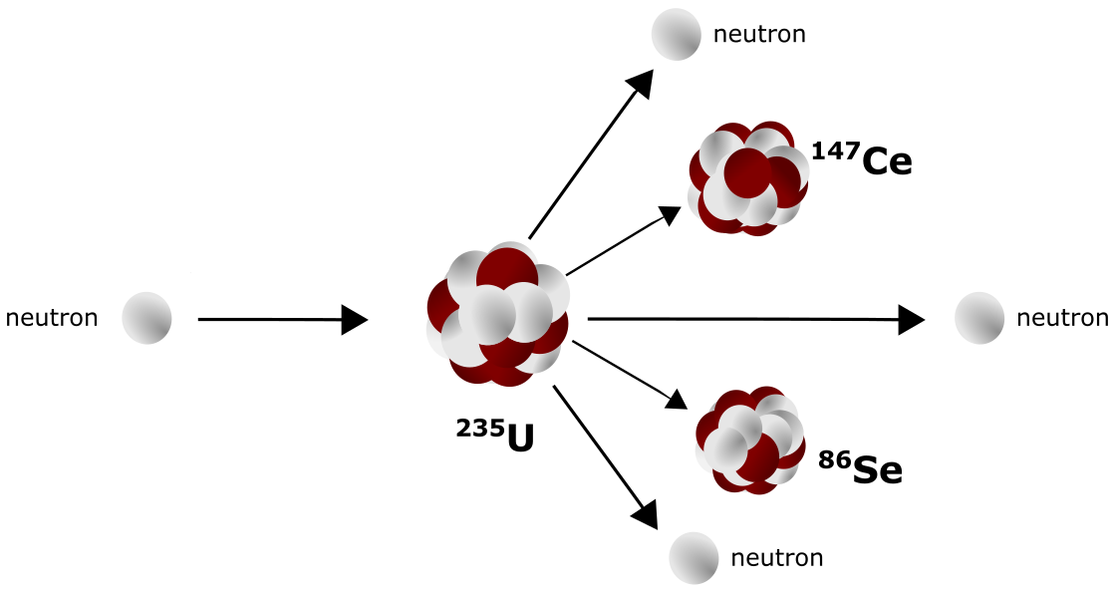
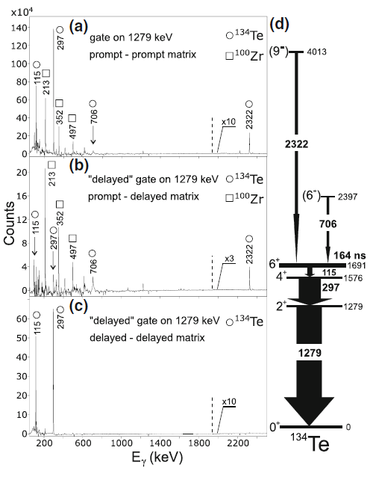
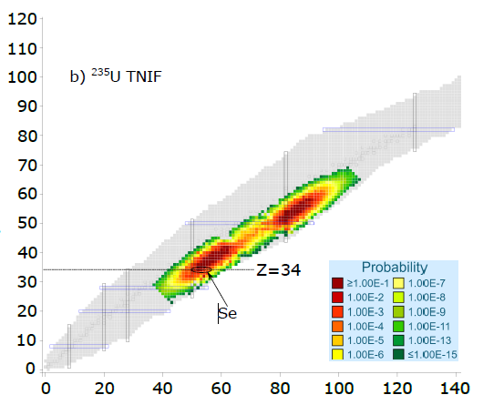
Hundreds of different nuclei
produced in one experiment
High statistic data
- long duration of the experiment
- pawerfull detection system
Pulsed beam – fission tag

Slide 7
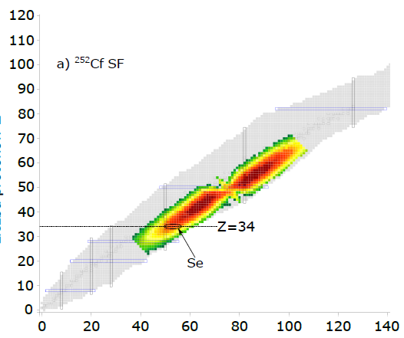
Spontaneous fission – ²⁵²Cf and ²⁴⁸Cm
Gammasphere array of Ge detectors at
Argonne National Laboratory (US)
(~ 100 HPGe detectors)
High statistic data
- long duration of the experiment
- powerful detection system
Pulsed beam – fission tag

Slide 8
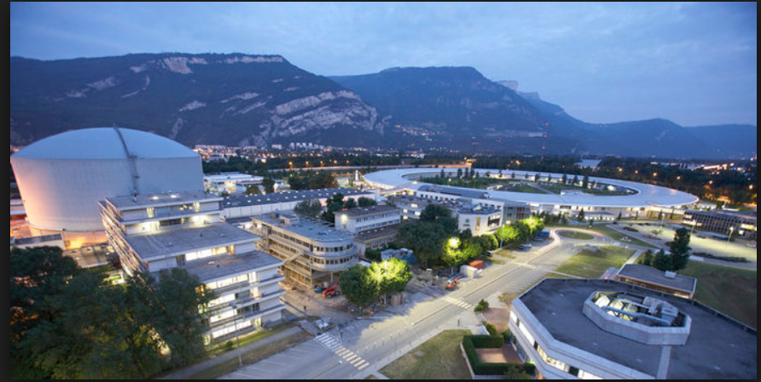
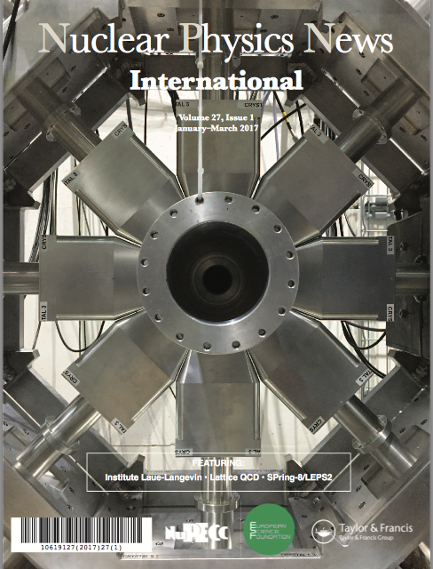
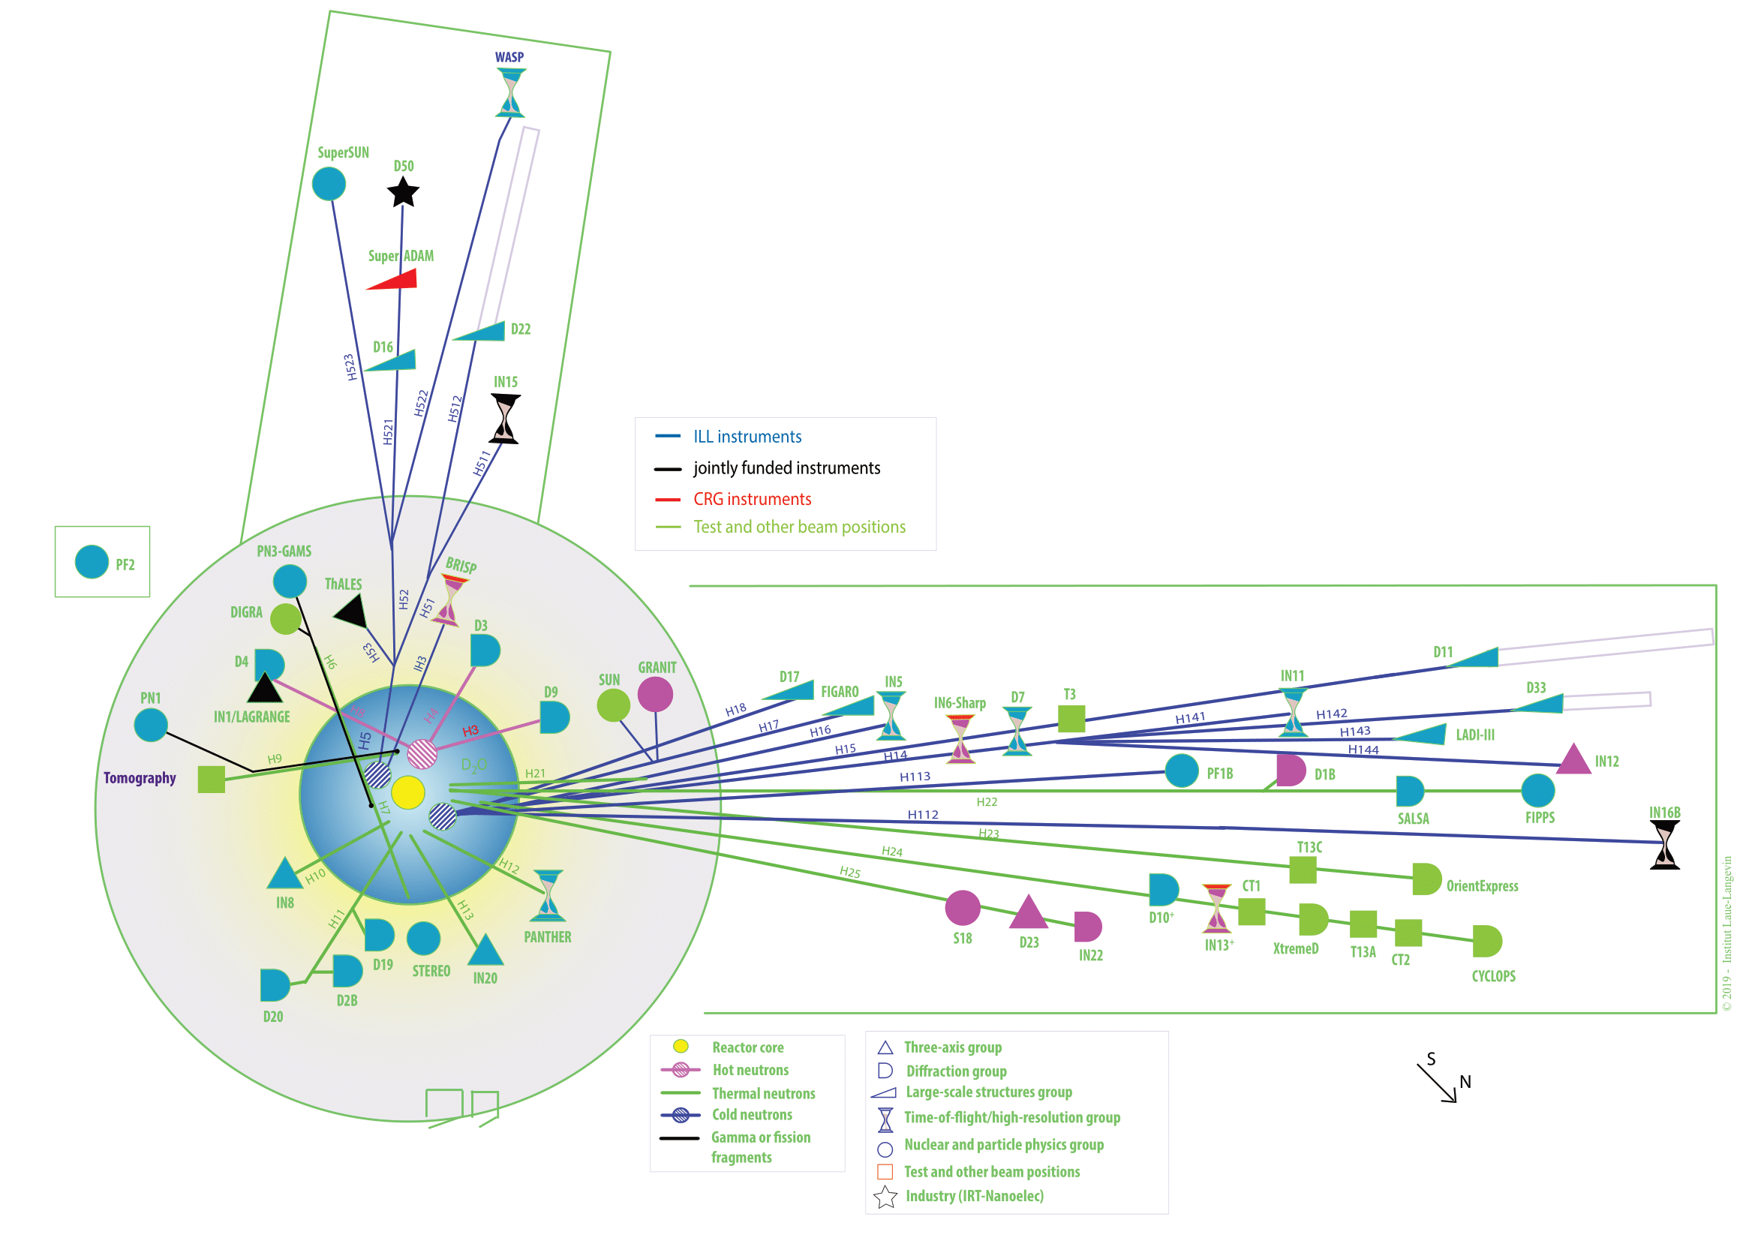
Institut Laue-Langevin - ILL
FIPPS FIssion Product Prompt γ-ray Spectrometer
FIPPS
16 clover detectors
Neutron induced fission of on ²³³U, ²³⁵U, and, ²⁴¹Pu
~50 days of measurements with each target

Slide 9
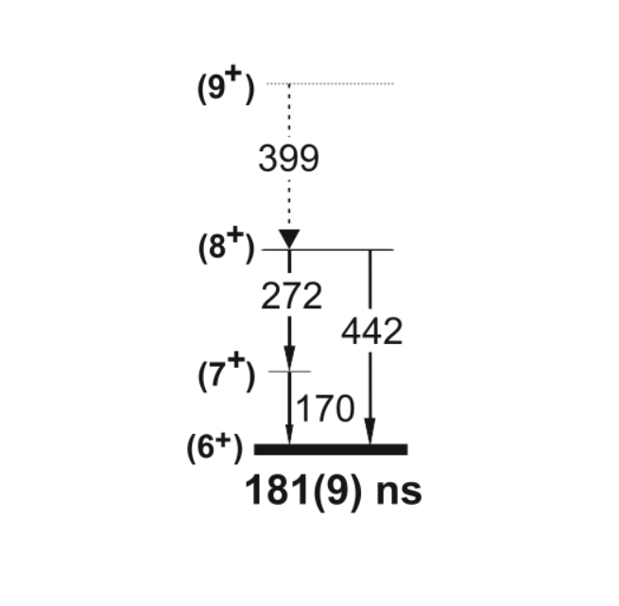
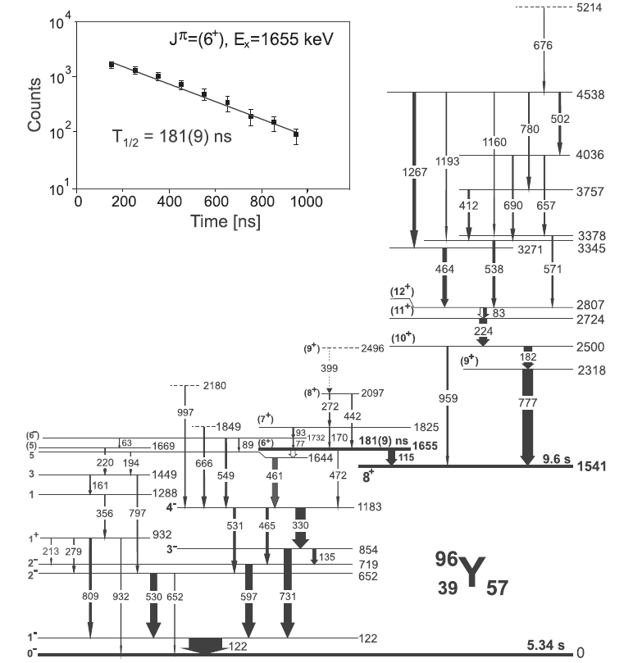
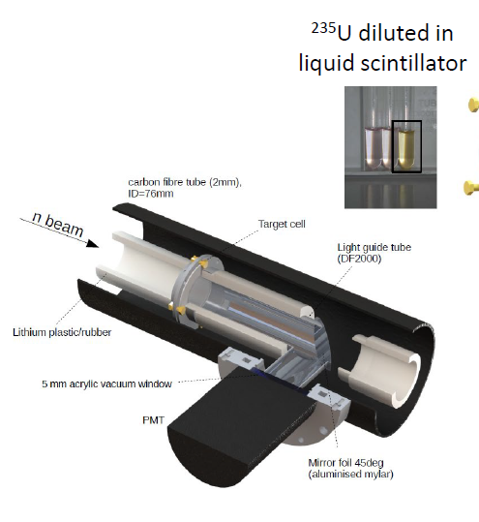
High statistic data
- long duration of the experiment
- powerful detection system
Pulsed beam – fission tag
F. Kandzia (Ł. W . Iskra) et al., Eur. Phys. J. A 56, 207 (2020).
Ł. W. Iskra, S. Leoni, B. Fornal et al., PRC 102, 054324 (2020)

Slide 10

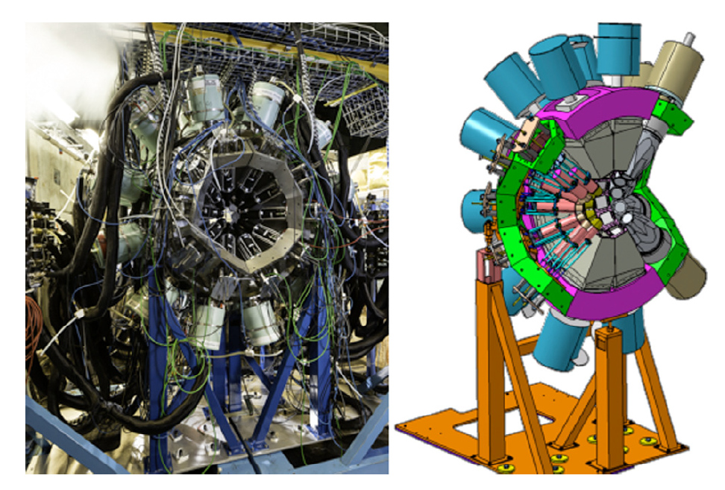
Laboratoire de Physique des 2 infinis Irène Joliot-Curie - IJCLab
v-ball campaign
Gamma spectroscopy HPGe
Lifetimes measurement
24 clover detectors
10 large coaxial detectors
20 LaBr₃
pulsed beam with 400 ns repetition time
Courtesy of J. Wilson

Slide 11
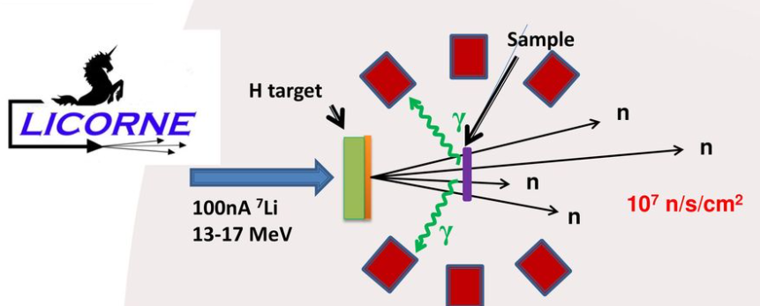
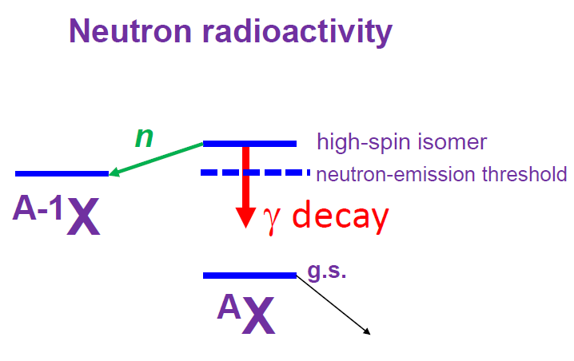
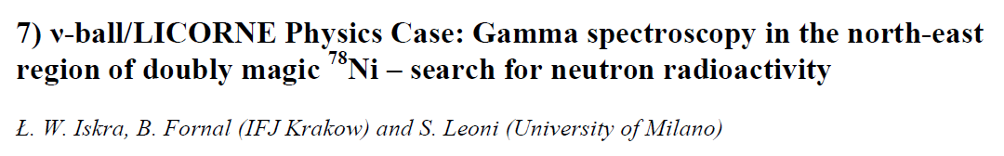
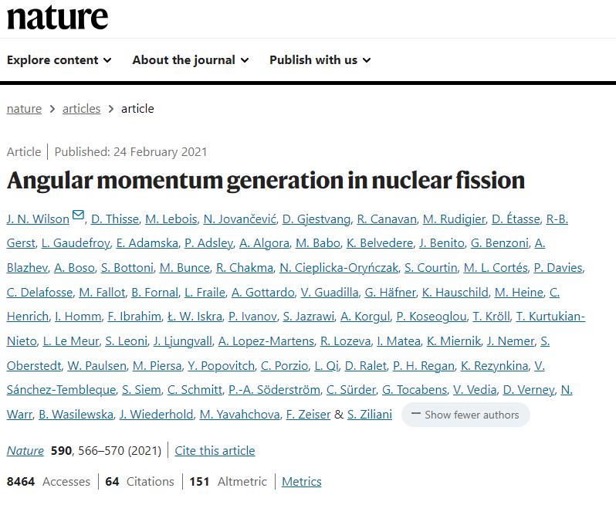
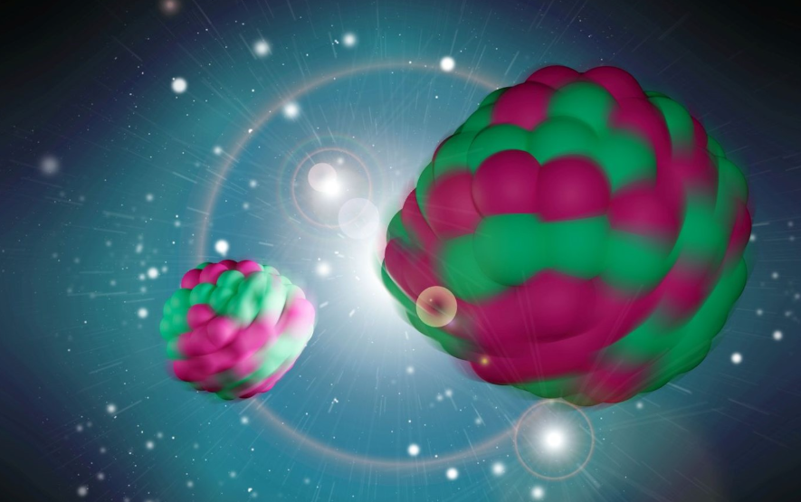
Neutron Energy 1.7 MeV
Courtesy of J. Wilson
L.K. Peker et al., Phys. Lett. B36 (1971) 547.
High statistic data
- long duration of the experiment
- powerful detection system
Pulsed beam – fission tag

Slide 12
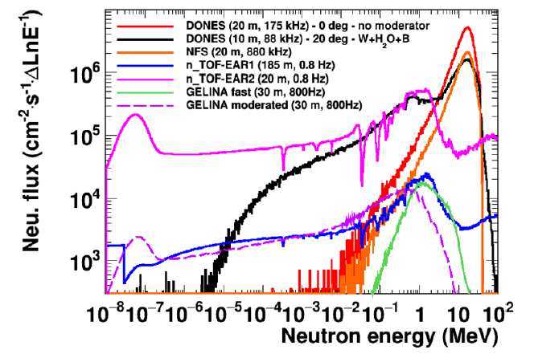
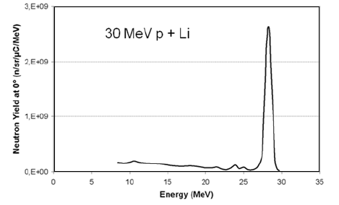
Neutrons For Science (NFS)
GANIL Caen (France)
²³²Th(n,f) reaction - 12 HPGe clovers; 1 week, ~8 g of ²³²Th (130 g)
1. 40 MeV d + Be
High statistic data
- long duration of the experiment
- powerful detection system
High flux
Fast neutrons
Pulsed beam – fission tag
x 10 more gamma events
Ł. W. Iskra et al., "Report … ," DONES-PreP WP8.2-1.
2. 30 MeV p + Li
X. Ledoux et al., EPJ Web of Conferences 146, 03003 (2017)

Slide 13
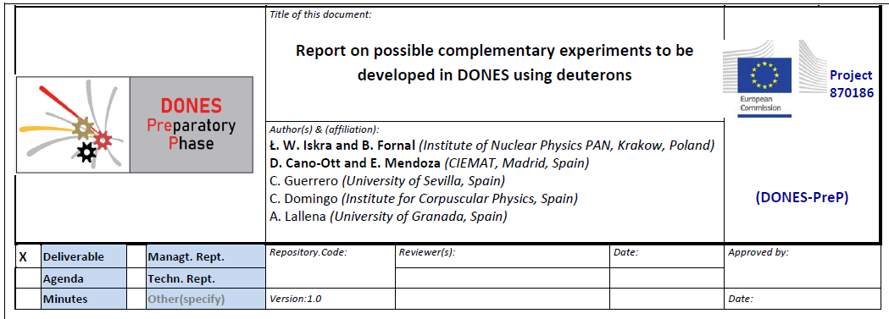
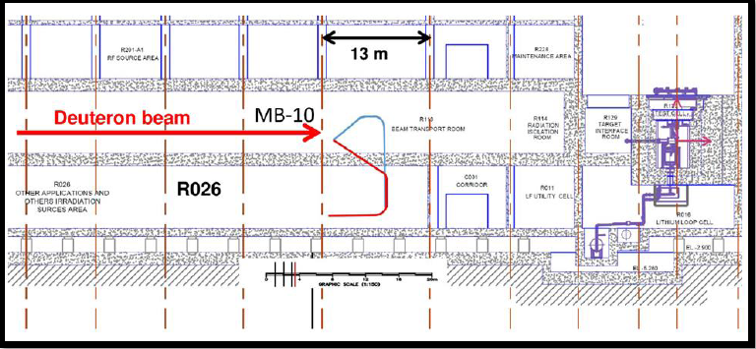
75 pages – 7 experimental programs
Neutrons For Science (NFS)
GANIL Caen (France)
DONES
High flux
High flux
Fast neutrons
Perform many measurements
with different radioactive targets
Fast neutrons
High statistic data
- long duration of the experiment
- powerful detection system
High statistic data
- long duration of the experiment
- powerful detection system
Pulsed beam – fission tag
Pulsed beam – fission tag

Slide 14
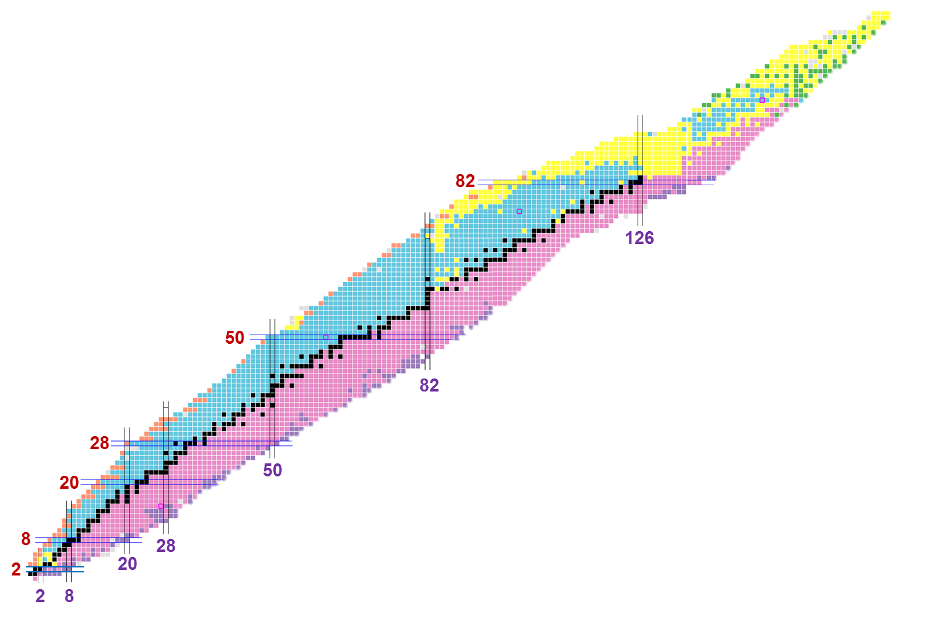
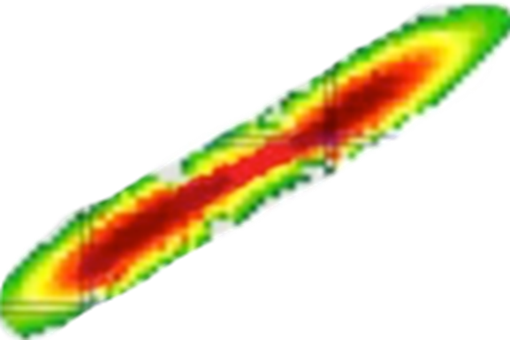
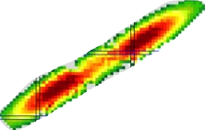
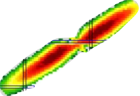
Fast-neutron-induced fission
of radioactive targets ²³⁰Th, ²²⁶Ra
²³⁵U
²³⁰Th
²³²Th
²²⁶Ra
Yields of products
from the 14 MeV-neutron
induced fission of ²³²Th
n(14 MeV) + ²³²Th
Thermal neutron induced fission
of ²³⁵U
Spontaneous fission of ²⁴⁸Cm
?
Courtesy of B. Fornal

Slide 15
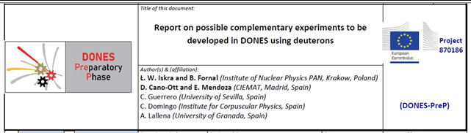
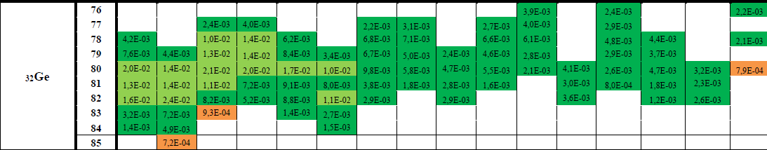
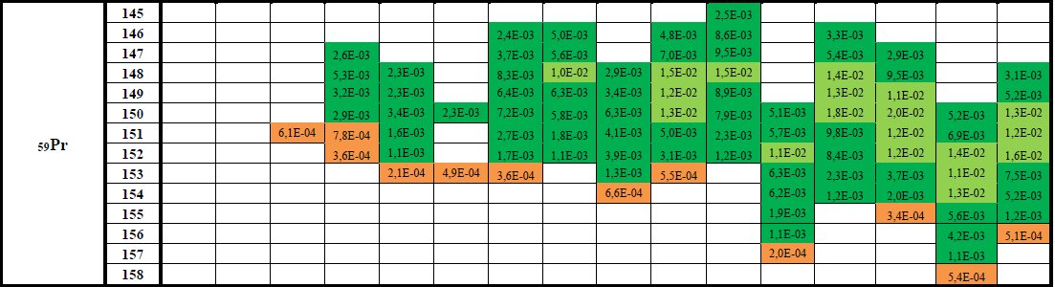

Slide 16
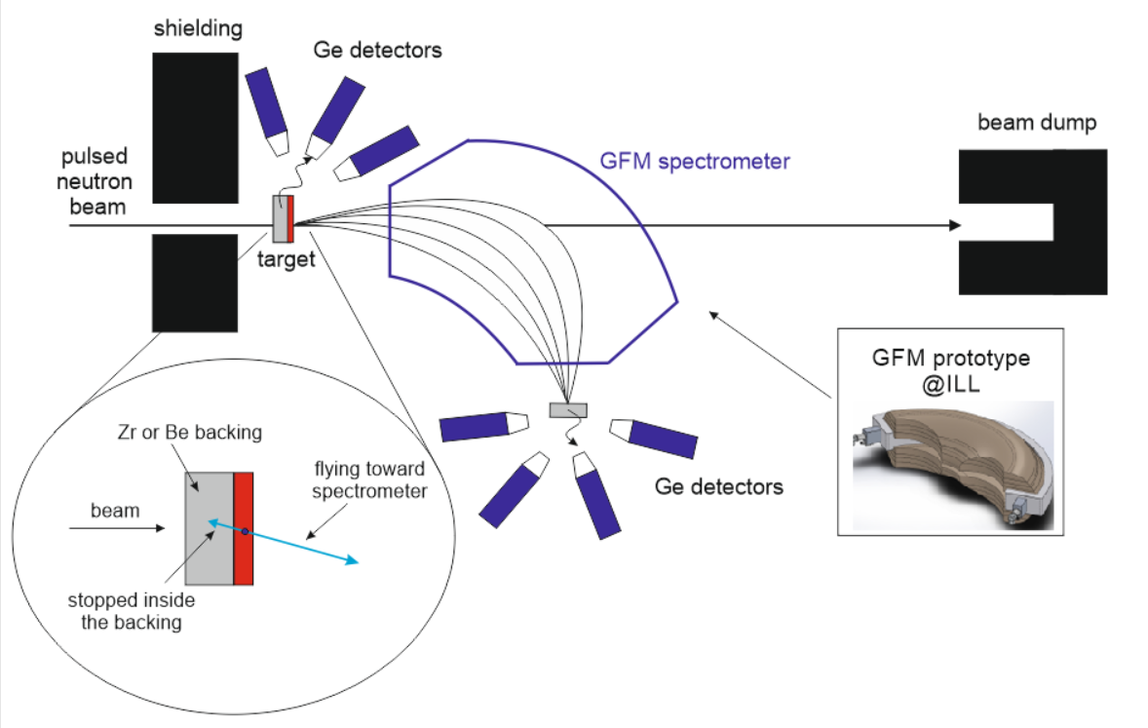
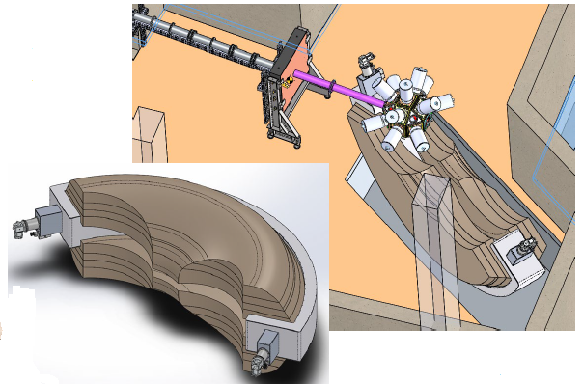
Gas-filled magnet concept
(P. Armbruster et al., Nucl. Instr. Meth 137, 103 (1976).)
Courtesy of Y-H Kim
„Left” fragment stopped in the backing
→ Doppler free prompt γ detection
coincidences
„Right” fragment will fly to the spectrometer
→ A, Z determination; delayed γ spectroscopy

Slide 17
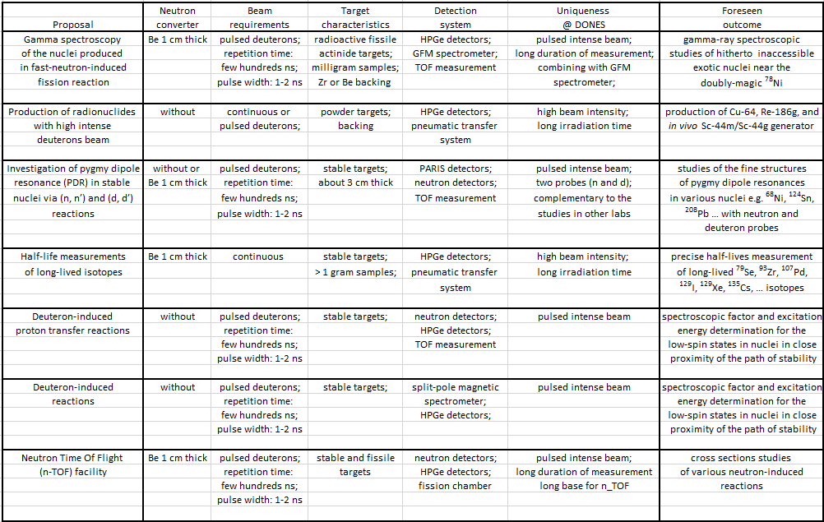
Summary table

Slide 18
Summary
Gamma spectroscopy of neutron-rich isotopes produced in fission process
is powerful tool in nuclear structure studies
A rich history and ongoing development of fission experiments
spontanous fission of ²⁵²Cf and ²⁴⁸Cm (Gammasphare, Euroball)
thermal-neutron-induced fission of ²³³U and ²³⁵U targets (ILL Grenoble with FIPPS array)
fast-nautron-induced fission of ²³²Th and ²³⁸U target ( IJCLab Orsay with v-ball array)
new measurements at NFS (GANIL)
Opportunity for DONES to become a world leader in nuclear structure
High intense pulsed fast neutron beam
Possibility of using many different radioactive targets
Long duration of measurements in respect to standard nuclear physics facilities
Innovative technical solutions eg. gas-filled magnet

Slide 19
Collaboration group
B. Fornal, W. Królas, A. Maj, K. Gajewska, et al.
The Institute of Nuclear Physics, Polish Academy of Sciences, Krakow, Poland
D. Cano-Ott and E. Mendoza (CIEMAT, Madrid, Spain)
C. Guerrero (University of Sevilla, Spain)
C. Domingo (Institute for Corpuscular Physics, Spain)
A. Lallena (University of Granada, Spain)
et al.
J. N. Wilson, M. Lebois, D. Thisse, N. Jovancevic, et al.
IJCLab, Orsay, France
C. Michelagnoli, U. Köster, F. Kandzia, Y. H. Kim, M. Jentschel et al.
ILL, Grenoble, France
Thank you
for your attention

Slide 20
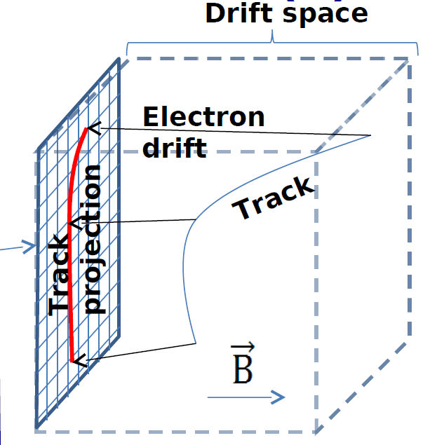
Gas-filled magnet concept
(P. Armbruster et al., Nucl. Instr. Meth 137, 103 (1976).)
„Left” fragment stopped in backing
→ Doppler free prompt γ detection
„Right” fragment will fly to the spectrometer
→ A, Z determination; daleyed γ spectroscopy
TOF → v (A, E)
}
$$Bρ \sim \frac{A}{Z^{α}}$$
Bρ (A, Z)
A, E, Z for each track
$$\frac{dE}{dx}(Z,E)$$
Courtesy of A. Blanc

Slide 21
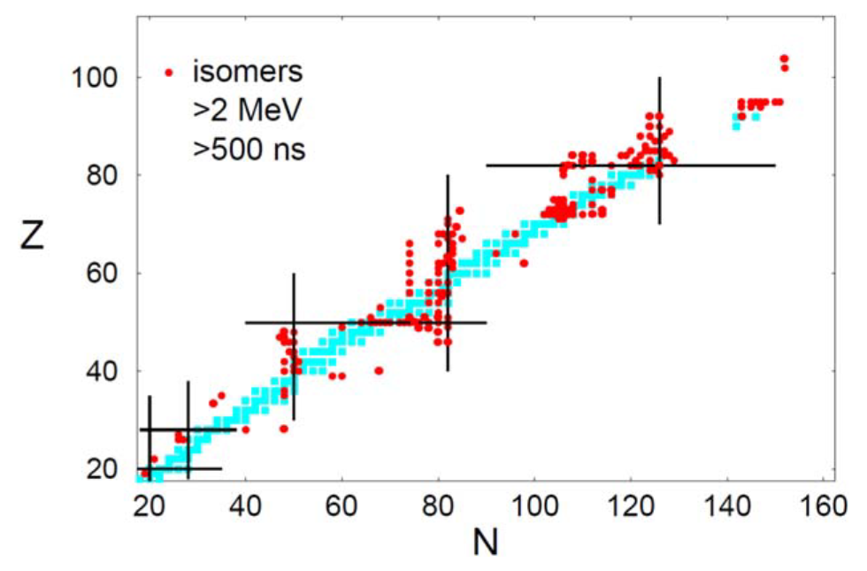
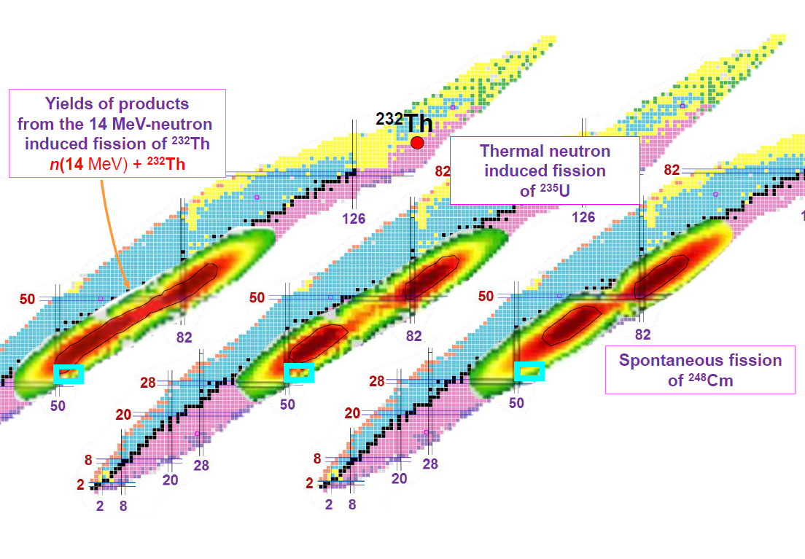
²⁰⁸Pb
¹³²Sn
⁷⁸Ni
Philip Walker and Zsolt Podolyák, Phys. Scr.95, 044004 (2020)
Courtesy of B. Fornal
L.K. Peker et al., Phys. Lett. B36 (1971) 547.

Slide 22
Active fission target
α, β
Fission
F. Kandzia (Ł. W . Iskra) et al., Eur. Phys. J. A 56, 207 (2020).

Slide 23
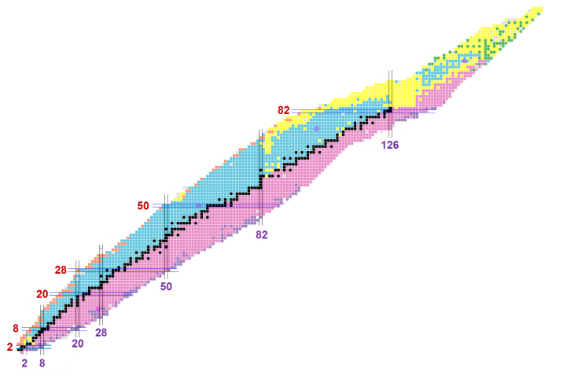
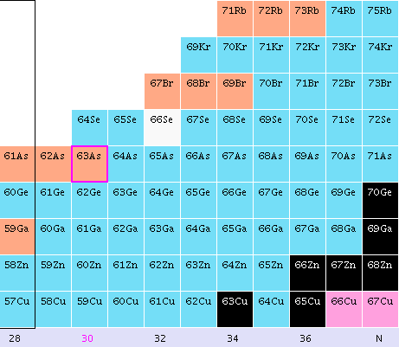
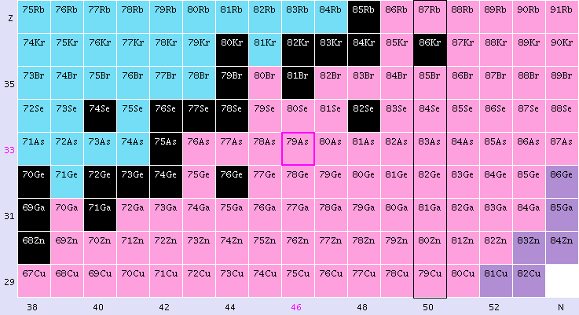
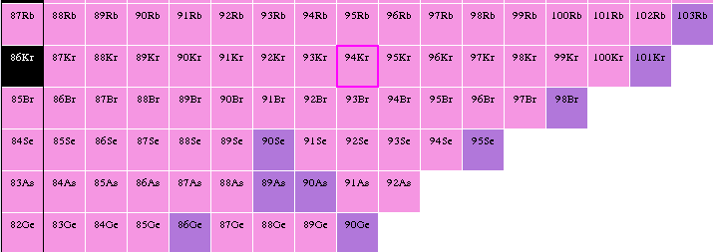
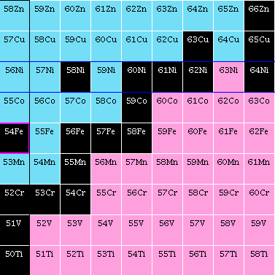
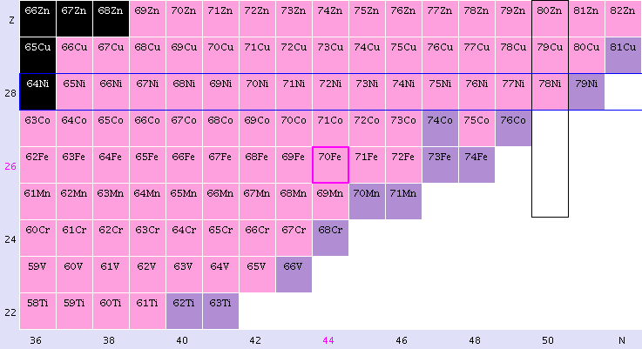
Yields of products from neutron
induced fission in the region
of interest
n(therm) + ²³⁵U
n(14 MeV) + ²³²Th
Rb
Kr
Br
Se
As
Ge
Ga
Zn
70Zn
Cu
Ni
⁷⁸Ni
Co
Fe
50
Mn
48
Cr
46
V
44
Ti
42
28
30
32
34
36
38
40

Slide 24
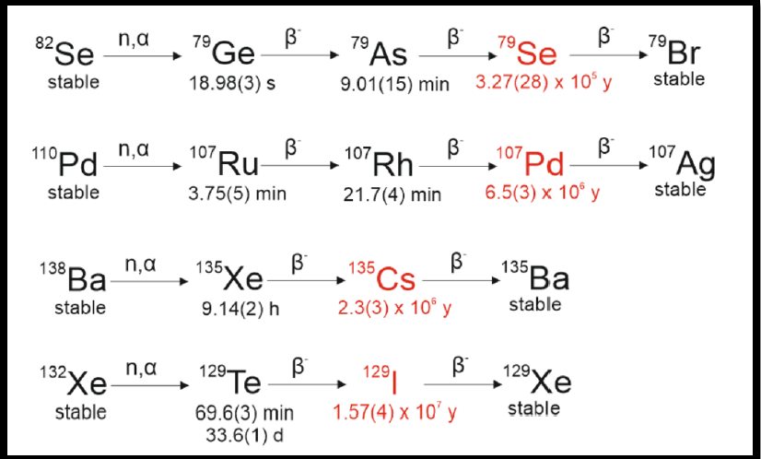
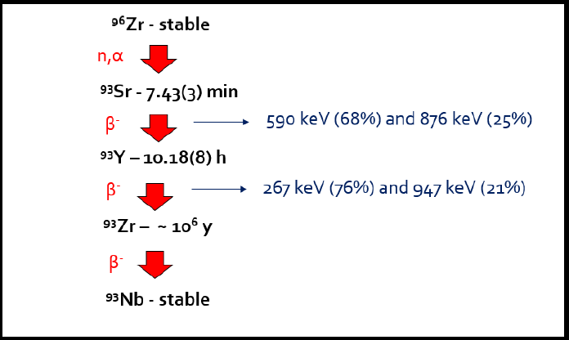
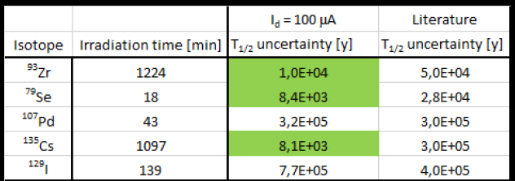
Design and development of nuclear physics experiments using a pulsed beam of fast neutrons at IFMIFDONES (Granada)
Future research plans
Measurements of the half-life of long-lived atomic nuclei at IFJ PAN
irradiation time + one day of activity measurement
1. Use of a stable ⁹⁶Zr target
2. Production of the ⁹³Sr isotope in the (n,α) reaction using
a 14 MeV neutron beam (neutron generator)
3. Measurement of 267 and 947 keV gamma rays using
low-background detection systems
4. Measurement of electrons associated with the β decay
of the ⁹³Zr isotope (nucleus of interest)

