Slide 1
Form for Expression of Interest for the Future Users of IFMIF-DONES Facility
Andreja Gajović¹*, Wojciech Krolas², Marek Lewitowicz³, Kristina Tomić, Luketić¹, Lovorka Čaja¹, Tonči Tadić¹
¹ Ruđer Bošković Institute, Zagreb, Croatia
² Institute of Nuclear Physics Polish Academy of Sciences, Krakow, Poland
³ Grand Accelerateur National d’Ions Lourds (GANIL), Caen Cedex, France

Slide 2
OUTLINE
Motivation and introduction
Software application specification
Example of on-line questionnaire
Instead of conclusion - inputs and suggestions

Slide 3
OUTLINE
Motivation and introduction
Software application specification
Example of on-line questionnaire
Instead of conclusion - inputs and suggestions

Slide 4
Motivation
IFMIF-DONES is an ESFRI facility so needs more visibility
Scientists from different fields of research from the whole EU and wider will be informed about DONES facility and its possible applications.
The questionnaire will broaden the DONES users community
It will give surveyed scientists the possibilities to join the DONES users community in this phase, express interest to use DONES facility in the future and even to suggest or create new experiments.
DONES users commitee will have insight in interest for use of facility including fusion-related experiments and complementary experiments, but also in Engineering and Technology interests

Slide 5
Introduction - DOCUMENTS
White Book on the Complementary Scientific Programme, ed. A. May, M. N. Harakeh, M. Lewitowicz, A. Ibara, W. Korilas, Krakow, November 2016.
The DONES Complementary Experiments and the Users Community, Marek Lewitowicz, 2nd DONES Xcitech School, April 2024, Grenada, Spain.
D3.4-1 Report on User Access Strategy for DONES (2021)
The scientific exploitation of DONES would be divided in three separate experimental programmes (EPs):
EP.1 An experimental program focused on high-priority fusion-related experiments i.e. irradiation campaigns of fusion materials’ samples;
EP.2 An experimental program focused on other fusion-related experiments;
EP.3 An experimental program focused on so called Complementary Research activity, i.e. experiments related to research fields out of fusion.

Slide 6
Introduction - DOCUMENTS
Periodic Technical Report, Part B (01/10/2019 to 01/04/2021)
WP 8 Other complementary experiments and Upgradeability
Task 8.1 Other complementary experiments using neutrons
-experiments that can take place in room R160 adjacent to the test cell
Without moderator: the neutrons with kinetic energy >1 MeV (10 MeV). At the entrance of room R160 the flux 1.67 10¹⁰ n/cm²/s.
With moderator placed at the entrance of room R1: kinetic energies <400 meV, fluxes of about 9. 10⁶ n/cm²/s.
Task 8.2 Other complementary experiments using deuterons
Measurements that could be conducted with a pulsed deuteron beam of 40 MeV or pulsed neutron beam produced in deuteron-induced reactions in room R026.
+ Our proposal (M. Hojić): Engineering and Technology (Technology Hub)

Slide 7
The DONES Complementary Experiments and the Users Community, M. Lewitowicz, 2nd DONES Xcitech School, April 2024, Grenada, Spain.

Slide 8
OUTLINE
Motivation and introduction
Software application specification
Example of on-line questionnaire
Instead of conclusion - inputs and suggestions

Slide 9
Software application specification
Draft forms are built using the Limesurvey software.
In the first period the answers of potential users will be saved in a data base and periodically exported to Google drive which will be visible to the members of DONES user committee.
In the future period, custom web application can be built using standard open source tools.

Slide 10
OUTLINE
Motivation and introduction
Software application specification
Example of on-line questionnaire
Instead of conclusion - inputs and suggestions

Slide 11
Questionnaire consist of 4 main parts:
Introduction: purpose of the questionary, few words about IFMIF-DONES facility (with link), GDPR disclamer (only our text)
General information: name, institution, address, e-mail address (place for text)
Defining specific interest in using DONES facility (depending on potential user’s field of research): research area, area of interest, facility, experiment (thicks), „other” (place for text)
Final information: background and expertise, motivation and scientific objectives, experimental plan, references (place for text)

Slide 12
LINK to questionnaire:
https://survey.czi.irb.hr/q/index.php?r=survey/index&sid=237425&lang=en

Slide 13
Questionnaire consists of 4 main parts:
Introduction: purpose of the questionnaire, few words about IFMIF-DONES facility (with link), GDPR disclamer (only our text)
General information: name, institution, address, e-mail address (place for text)
Defining specific interest in using DONES facility (depending on potential user’s field of research): research area, area of interest, facility, experiment (thicks), „other” (place for text)
Final information: background and expertise, motivation and scientific objectives, experimental plan, references (place for text)

Slide 14
Introduction pages:

Slide 15
Introduction pages:

Slide 16
Questionnaire consist of 4 main parts:
Introduction: purpose of the questionary, few words about IFMIF-DONES facility (with link), GDPR disclamer (only our text)
General information: name, institution, address, e-mail address (place for text)
Defining specific interest in using DONES facility (depending on potential user’s field of research): research area, area of interest, facility, experiment (thicks), „other” (place for text)
Final information: background and expertise, motivation and scientific objectives, experimental plan, references (place for text)

Slide 17
General page:

Slide 18
General page:

Slide 19
Questionnaire consist of 4 main parts:
Introduction: purpose of the questionary, few words about IFMIF-DONES facility (with link), GDPR disclamer (only our text)
General information: name, institution, address, e-mail address (place for text)
Defining specific interest in using DONES facility (depending on potential user’s field of research): research area, area of interest, facility, experiment (thicks), „other” (place for text)
Final information: background and expertise, motivation and scientific objectives, experimental plan, references (place for text)

Slide 20
Main part:

Slide 21
Main part_nuclear fusion:

Slide 22
Main part_nuclear fusion:

Slide 23
Main part_non-fusion:

Slide 24
Main part_non-fusion:
Santiago mentioned doping of Si as industrial application

Slide 25
Main part_non-fusion:
Santiago and Alain mentioned neutron therapy of cancers

Slide 26
Main part_non-fusion:
Santiago mentioned doping of Si as industrial application

Slide 27
Main part_non-fusion:

Slide 28
Main part
non-fusion_NUCLEAR:

Slide 29
Main part
non-fusion_NUCLEAR:

Slide 30
Main part
non-fusion_NUCLEAR:

Slide 31
Main part:
Our Matija Hojić suggested

Slide 32
Main part:
- neutron radiography - irradiation of electronics

Slide 33
Questionnaire consist of 4 main parts:
Introduction: purpose of the questionary, few words about IFMIF-DONES facility (with link), GDPR disclamer (only our text)
General information: name, institution, address, e-mail address (place for text)
Defining specific interest in using DONES facility (depending on potential user’s field of research): research area, area of interest, facility, experiment (thicks), „other” (place for text)
Final information: background and expertise, motivation and scientific objectives, experimental plan, references (place for text)

Slide 34
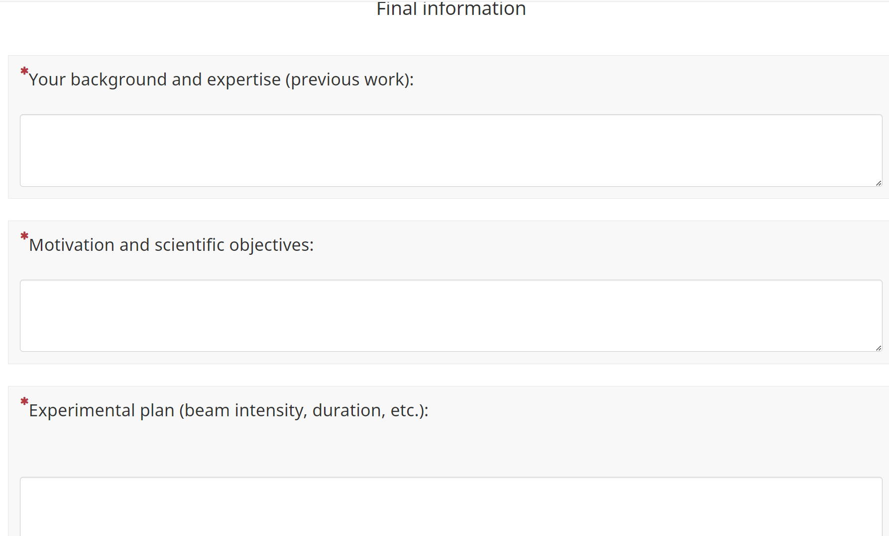
Final part:

Slide 35
Final part:

Slide 36
OUTLINE
Motivation and introduction
Software application specification
Example of on-line questionnaire
Instead of conclusion - inputs and suggestions

Slide 37
OUTLINE
Motivation and introduction
Software application specification
Example of on-line questionnaire
Instead of conclusion - inputs and suggestions
Please discuss with us about:
Predicted experiments and suggestions: Andreja.Gajovic@irb.hr
Software solutions: Lovorka.Caja@irb.hr

Slide 38
Thank you for your attention!

Slide 39
Thank you for your attention!
...and input in the future weeks

