Slide 1
Views on Status and Needs of Nuclear Data for Fusion Technology
3rd DONES User Workshop
D. Leichtle
With M. Avrigeanu, U. Fischer, M. Gilbert, A. Konobeev, G. Schnabel, Y. Qiu

Slide 2
Fusion neutronics integration
Fusion Neutronics
Models
Analysis Integration
Tools Workflows
Radiological Protection
Nuclear Data
System Engineering
Objectives in nuclear data development and validation
Provision of reference nuclear data (including covariance data) for fusion technology applications with verification and validation.
Experimental support for nuclear data evaluation, benchmarking and validation of fusion nuclear data and neutronics tools.
Requirements
Accurate and reliable radiation transport and activation analysis capabilities.
Quantification and propagation of uncertainties in nuclear data to engineering responses.

Slide 3
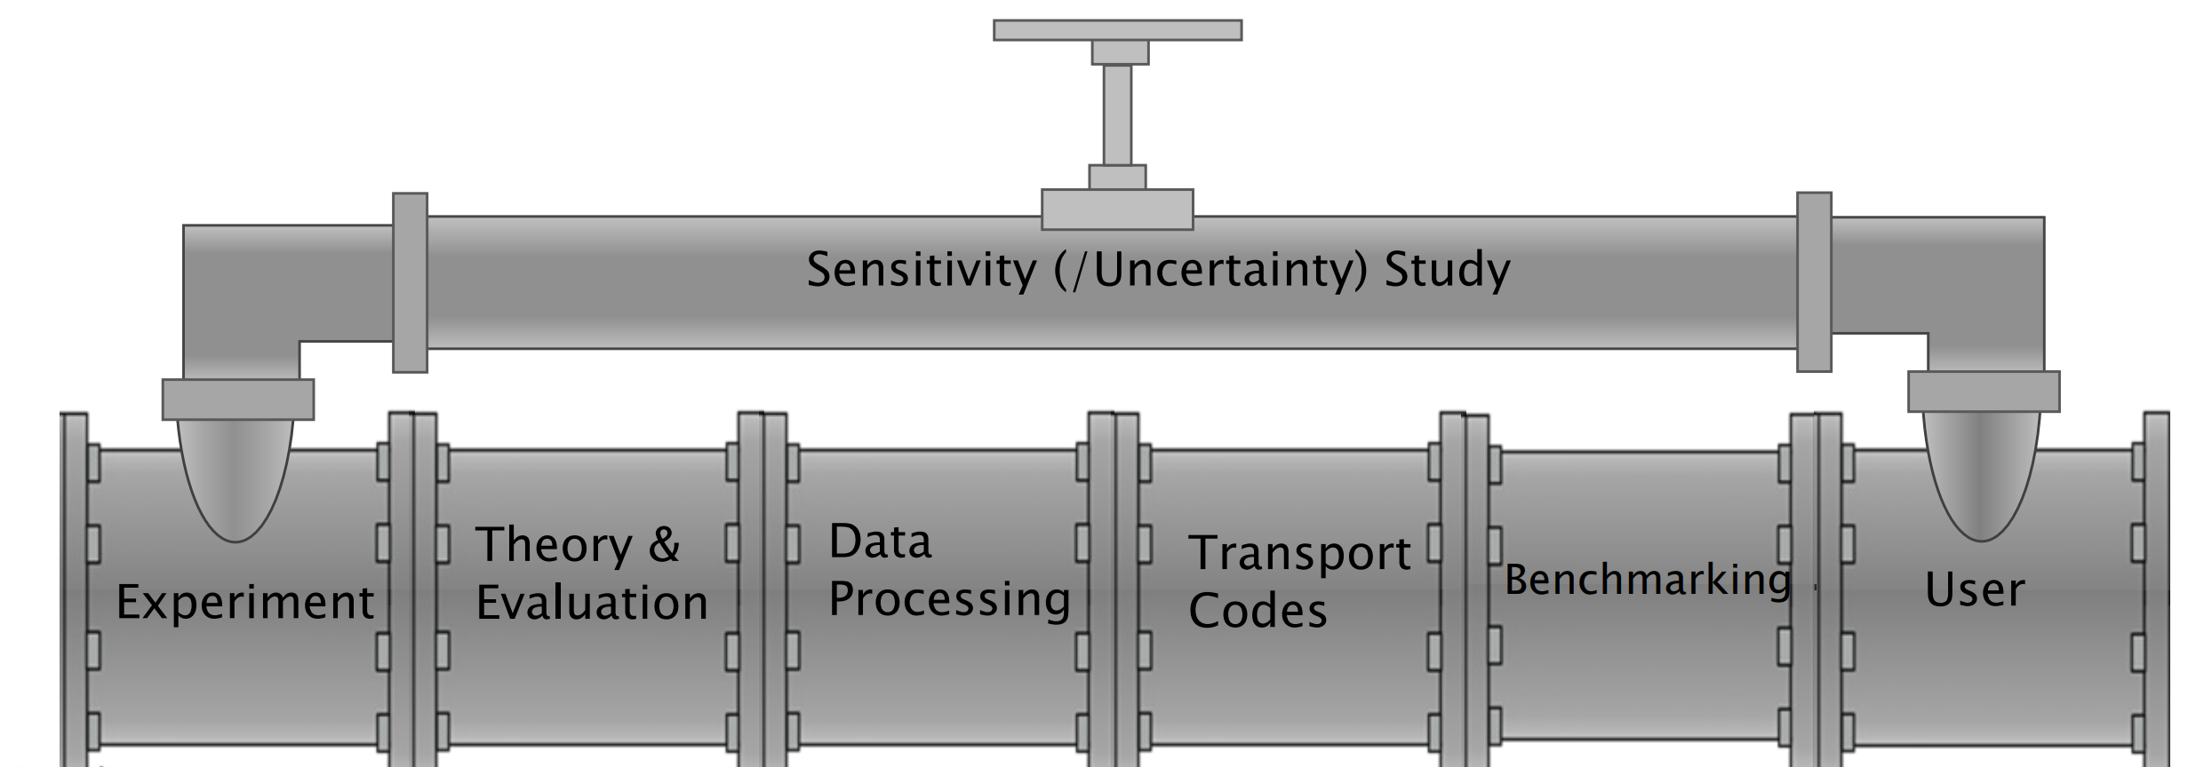
Scope of fusion nuclear data research
Nuclear data (evaluation) pipeline with system components
Theory, Experiments, Evaluation, Data Processing, Benchmarking, Sensitivity&Uncertainty analysis, Applications
Neutronics/activation tools
Applicatons
Based on: D. Brown (BNL)
Nuclear reaction theory, nuclear models
High-accuracy nuclear cross section measurements
Nuclear data evaluation including covariances
Data processing
MC transport libraries
Response libraries (reaction rates)
Verification and validation
Benchmarking
Experimental validation
Sensitivity and uncertainty assessment

Slide 4
WPBB Nuclear data development and experimental activities
Nuclear Data Evaluations
Nuclear data evaluations of general purpose neutron cross section data, activation, decay, dosimetry, displacement damage and gas production data, and proton/deuteron cross section data.
Processing, maintenance and update of cross section and covariance data application libraries; benchmarking analyses to test and validate nuclear data libraries including suitable sensitivity and uncertainty assessments to provide feedback to evaluation efforts.
Development of advanced evaluations capabilities for fast neutrons, light nuclei and direct interactions; improvement of nuclear models and nuclear model calculation tools; improvement of specific processing, sensitivity/uncertainty and particle transport tools.
Nuclear Experiments
Mock-up and pure material benchmark experiments for validation of transport/shielding performances.
Measurements of material activation cross sections for DEMO: There is the continuous need to validate nuclear data and codes for the inventory/activation analysis of real DEMO materials.
Measurements of gas production and damage cross sections: Further extension of the experimental database for structural and functional materials used in DEMO, including all important constituents of Eurofer and breeder/multiplier materials. Special work is considered to measure tritium production cross sections in this context.
Development of nuclear methods and instrumentation: Supporting activity to improve measurement capabilities for various applications under harsh environmental conditions, including radiation hardness. Procurement and testing of prototype instrumentation with a focus on BB and DEMO design integration with required modelling and simulation support.
Contributions to international databases for nuclear data (e.g. RIPL, JEFF, TENDL, EXFOR) and experimental benchmarks (e.g. SINBAD).

Slide 5
Selected current nuclear data activities at WPBB
General purpose evaluations (and methodological developements) on 56Fe, 9Be, 12C.
Processing and improvements of application-ready covariance data.
Development and applications of V&V tools on fusion relevant data evaluations (JADE)
Decay heat validation studies, including improvements on metastable isomer production yields (W isotopes)
Validation of fast neutron alpha-particle emission (structural materials)
Analysis of isomeric cross sections in deuteron-induced reactions (e.g. Mo)
Pre-analysis and preparation of a concrete shielding benchmark experiment (@FNG)
Preparation of cryogenic experiments for damage cross section measurements (W,Fe,Mo)
Data processing and evaluation for candidate SINBAD additions.

Slide 6
Selected (and incomplete) high priority objectives
Neutron data
General purpose nuclear cross section libraries (JEFF4.0, FENDL3.2c, TENDL2023 …)
Derived consistent application libraries (activation, damage, …)
Improved, complimentary differential cross section measurements at 14 MeV and up to 50 MeV.
Measurements of activation cross sections and gas production yields (incl. Tritium) above 14 MeV.
Charged particle data
Deuteron general purpose data and activation data (up to 40 MeV)
Quality assurance in nuclear data
V&V framework
Data management
Uncertainties and margins
Computational and experimental capabilities
Training, outreach, …
Facilities for differential and integral cross section measurements.

